Slide 1
Year 6 Newspaper Reports – Famous Person Focus
Unit aim:
Write a newspaper-style report about ONE key achievement or significant moment from a famous person you are interested in.
Your final report will include:
• Headline + subheading
• Lead paragraph answering the 5Ws
• Formal, objective paragraphs (importance order)
• Quotations from sources
• Cohesive devices, passive voice and relative clauses
• Edited and published final version
Use the separate WAGOLL booklet when tasks tell you to.
You are writing a NEWSPAPER REPORT, not a biography. Focus on ONE important achievement and explain why it matters.

Slide 2
How to use this slide deck
Each lesson has 4 slides:
1) LO + Success Criteria
2) Teach & Notice
3) Task 1 (with vocabulary bank)
4) Task 2 (with vocabulary bank)
Keep all drafts so you can show improvements. Use vocabulary banks to upgrade your writing.
Read the whole slide before writing. Complete Task 1 before Task 2. Use at least 5 words from the vocabulary bank each lesson.

Slide 3
Lesson 1: What is a newspaper report? – LO & Success Criteria
Learning Objective:
To identify the purpose and key features of a newspaper report.
Success Criteria:
• I can explain that a report gives facts, not opinions.
• I can identify the headline and lead.
• I can identify at least one quotation.
• I can explain how paragraphs are organised.
You are learning what a newspaper report is. A newspaper report informs the reader using facts and evidence. You will learn the features reporters use to help readers understand quickly.

Slide 4
Lesson 1: Teach & Notice
• Reports inform the reader about an event or person using facts.
• They are written in the past tense and third person.
• They include a headline and a lead paragraph with the most important information.
• They often include quotations from witnesses or experts.
Look for features that make a report clear: headline, lead, facts, quotations, paragraphs.

Slide 5
Lesson 1: Task 1
• Open the WAGOLL booklet.
• Annotate a model report:
circle headline
underline lead
highlight facts
box quotations
draw boxes around paragraphs.
Vocab
headline
lead
quotation
fact
neutral
Annotate carefully so you can SEE the structure. Ask: what happened? who was involved?

Slide 6
Lesson 1: Task 2
• Create a 'Features checklist' in your book.
• Find one example of each feature in the WAGOLL and copy it.
Vocab
paragraph
evidence
reported
stated
confirmed
Year 6 Extension: Identify how the writer maintains objectivity, then explain how formal vocabulary, precise evidence, and sentence control make the report sound authoritative.

Slide 7
Lesson 2: Researching a famous person – LO & Success Criteria
Learning Objective:
To gather relevant facts about a famous person using reliable sources and short notes.
Success Criteria:
• I can choose a famous person I am interested in.
• I can use at least 2 sources.
• My notes are short phrases (not full sentences).
• I can check facts match across sources.
You are learning how reporters research a person. You will choose a famous person you are interested in. You will collect accurate facts from more than one source and take notes in short phrases.

Slide 8
Lesson 2: Teach & Notice
Today we will:
Use more than one source to check accuracy.
• Take notes as phrases: dates, achievements, places, key events.
• Record where information came from (source title/website/book).
• Choose facts that are useful for a report (impact/achievement), not every life detail.
Use at least two sources so you can confirm facts. Write notes as phrases, not full sentences.

Slide 9

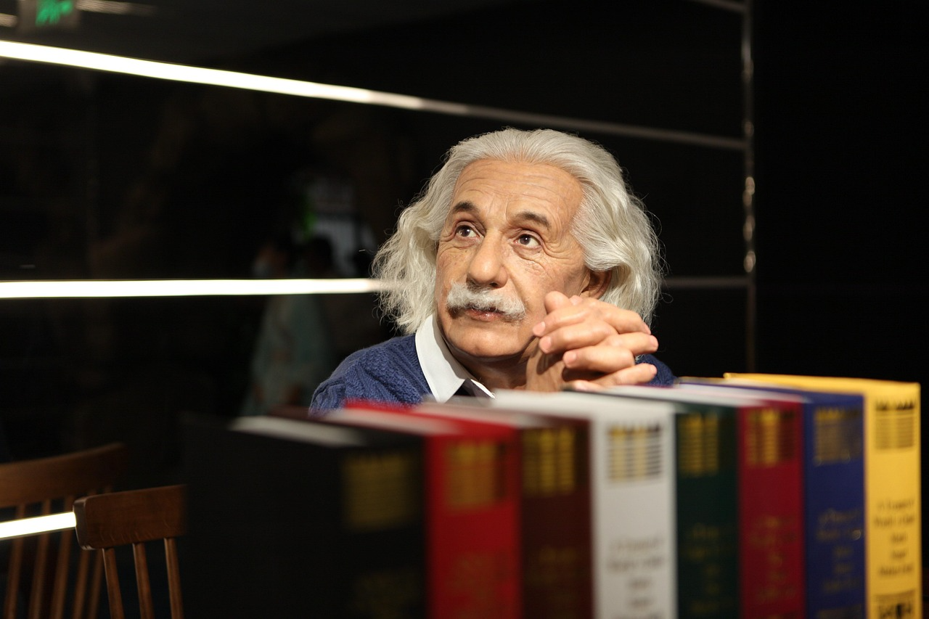

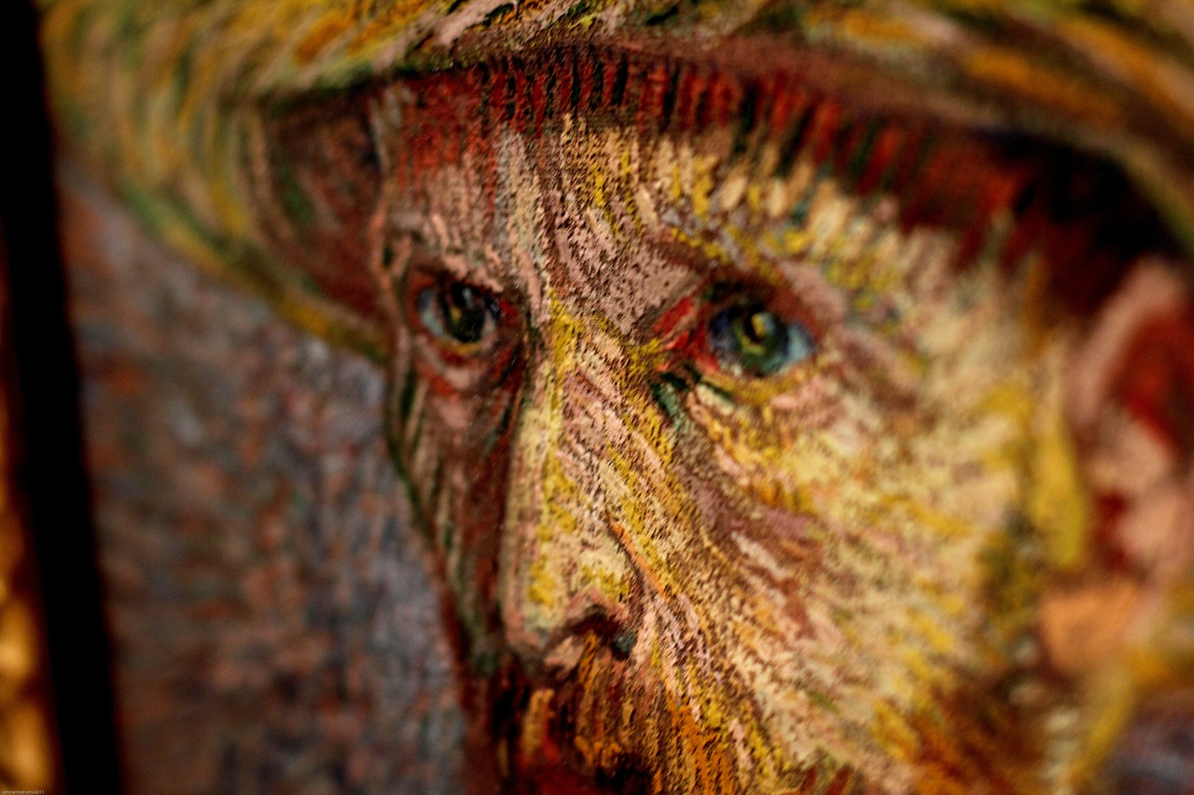
Lesson 2: Task 1
• Choose your famous person (sport/science/arts/history).
• Use 2+ sources to find: early life (brief), key achievement, why they are famous, impact/legacy.
Vocab
source
reliable
evidence
notes
fact-check
Collect facts about ONE key achievement or moment. Focus on what makes it news-worthy.

Slide 10

Lesson 2: Task 2
• Write 10–12 notes as short phrases.
• Star the 5 facts you think are most news-worthy.
Vocab
achievement
impact
legacy
contribution
influence
Year 6 Extension: Explain why your chosen facts are the most news-worthy, ranking them by significance and justifying your choices using impact, reliability, and relevance.

Slide 11
Lesson 3: The 5Ws lead paragraph – LO & Success Criteria
Learning Objective:
To write an effective lead paragraph answering the 5Ws about a famous person's achievement.
Success Criteria:
• My lead answers at least 4 of the 5Ws.
• My lead is 1–2 sentences.
• I use past tense and third person.
• I avoid opinions.
You are learning how to write a lead paragraph. The lead gives the most important information straight away. You will answer the 5Ws using your research: who, what, where, when, why/how.

Slide 12
Lesson 3: Teach & Notice
• Lead = first paragraph; most important facts first.
• Include the famous person's name and the key achievement.
• Keep it short: 1–2 sentences.
• Avoid starting with 'This report is about…' – start with the event/achievement.
A strong lead is short and factual. It gives the reader the main news immediately.

Slide 13
Lesson 3: Task 1
• Open the WAGOLL booklet.
• Underline the lead and label the 5Ws in it.
Vocab
who
what
where
when
why/how
Label the 5Ws in a model so you know what information belongs in the lead.

Slide 14
Lesson 3: Task 2
• Write TWO different leads about your person using the same facts.
• Choose the stronger one and underline the best verb.
Vocab
was recognised
made history
achieved
discovered
was awarded
Year 6 Extension: Craft a more sophisticated lead by combining precise detail with an economical sentence structure, ensuring the information remains concise, formal, and clearly prioritised.

