Slide 1
Evolution and Inheritance
Year 6 Science
Lesson 1
Evolution: Change Over Time

Slide 2
Learning Objective
Understand what evolution is and explain how living things change over very long periods of time.

Slide 3
Success Criteria
I can define evolution using scientific vocabulary.
I can explain that evolution happens over millions of years.
I can describe an example of a living thing that has changed over time.

Slide 4
Key Vocabulary
Evolution means change in living things over time.
Species is a group of similar living things.
Characteristics are the features of living things.
Evidence is information that supports an idea.

Slide 5
What Is Evolution?
Evolution is the process by which living things change over extremely long periods of time.
These changes do not happen suddenly or within one lifetime. Instead, they happen gradually across many generations.
Over time, small changes build up and can lead to clear differences between living things from the past and those alive today.

Slide 6
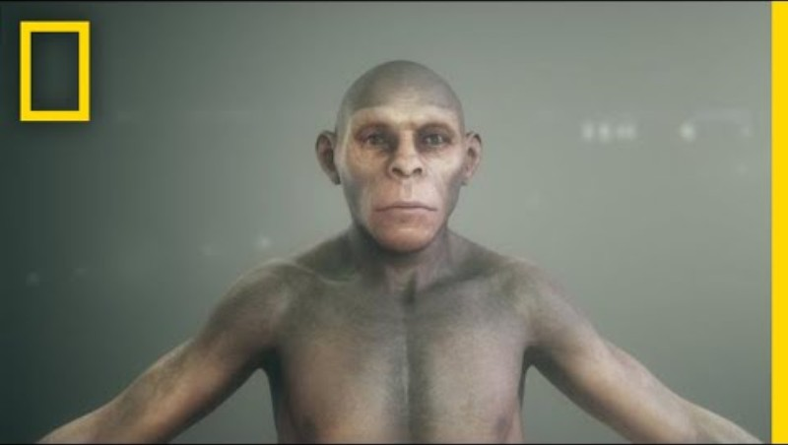

Slide 7
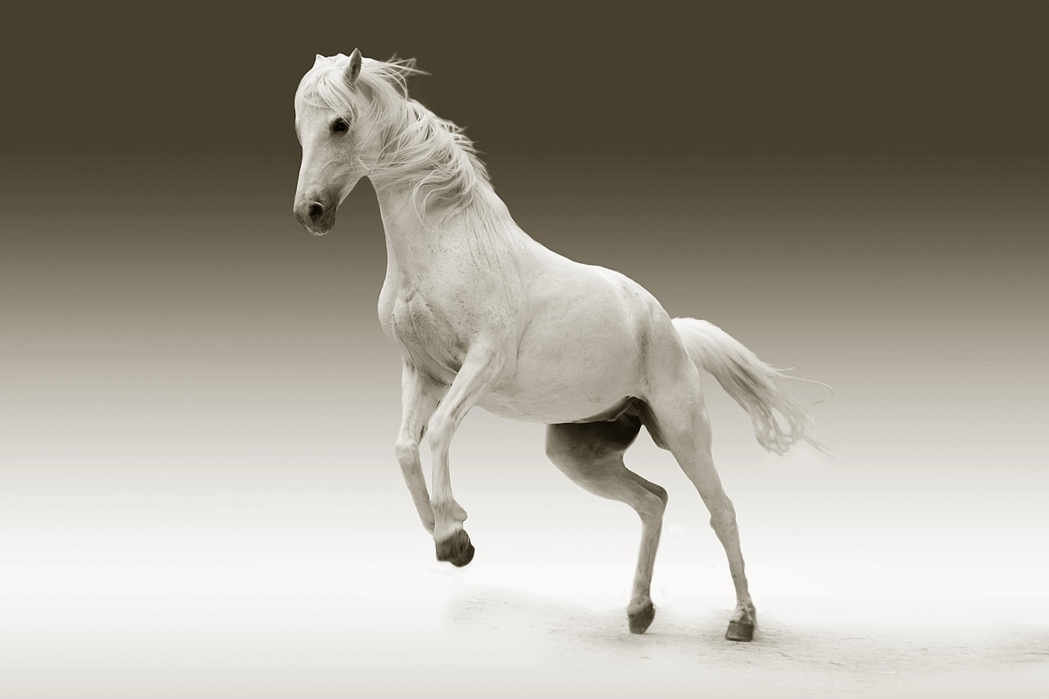
Worked Example
Early horses were much smaller and had shorter legs than modern horses.
Over millions of years, horses with slightly longer legs were better at escaping predators and travelling long distances to find food.
Because these horses survived and reproduced more successfully, longer legs became more common over time.

Slide 8
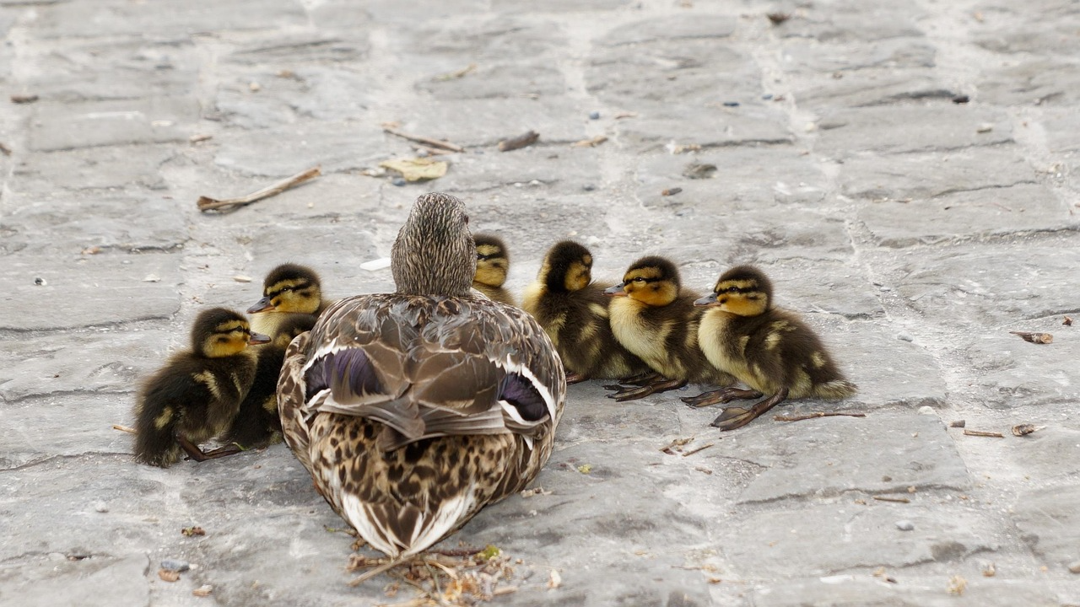
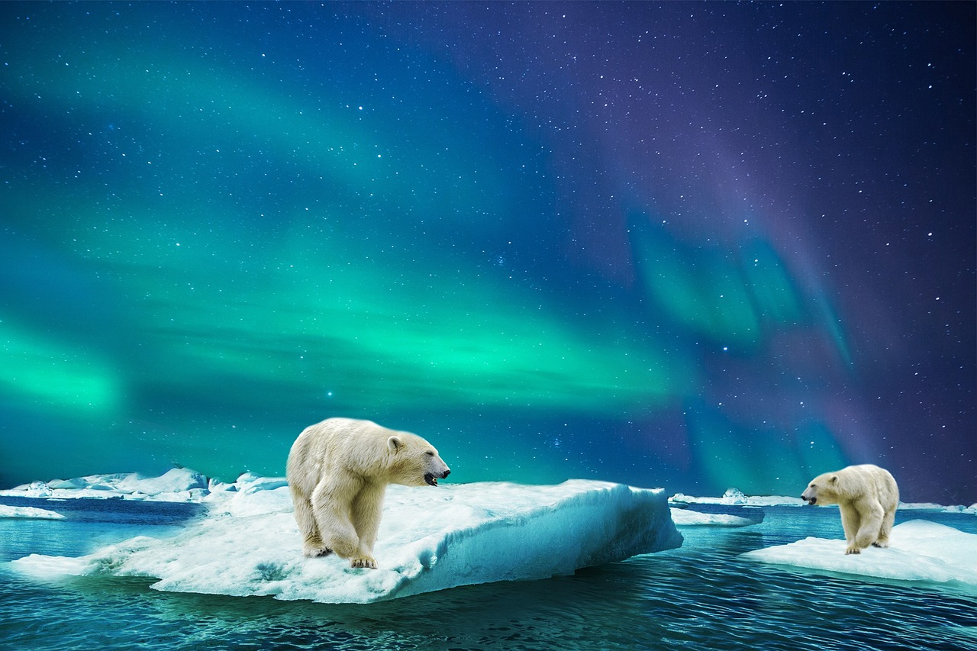
Important Clarification
Living things do not decide to change. Evolution happens because some characteristics help living things survive and reproduce more successfully than others.
Helpful characteristics are more likely to be passed on to offspring over many generations.

Slide 9
Check for Understanding
Consider whether evolution happens quickly or slowly and whether it can happen within one lifetime. Be ready to explain your thinking.
Evolution is the process by which living things change over time.

Slide 10
Reasoning Challenge
Explain why animals that do not change may struggle to survive when their environment changes.
Over many generations, animals with __________ were more likely to survive because __________.

Slide 11
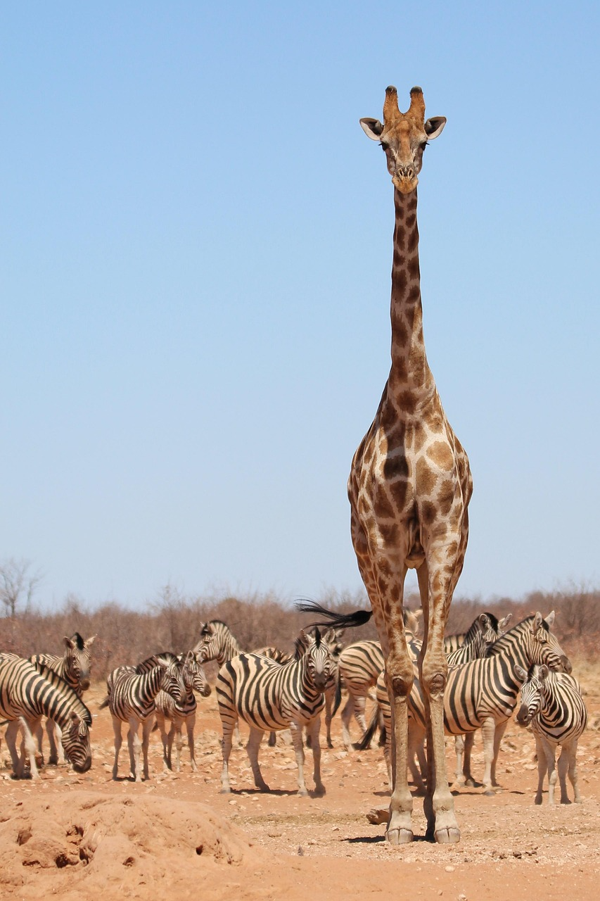
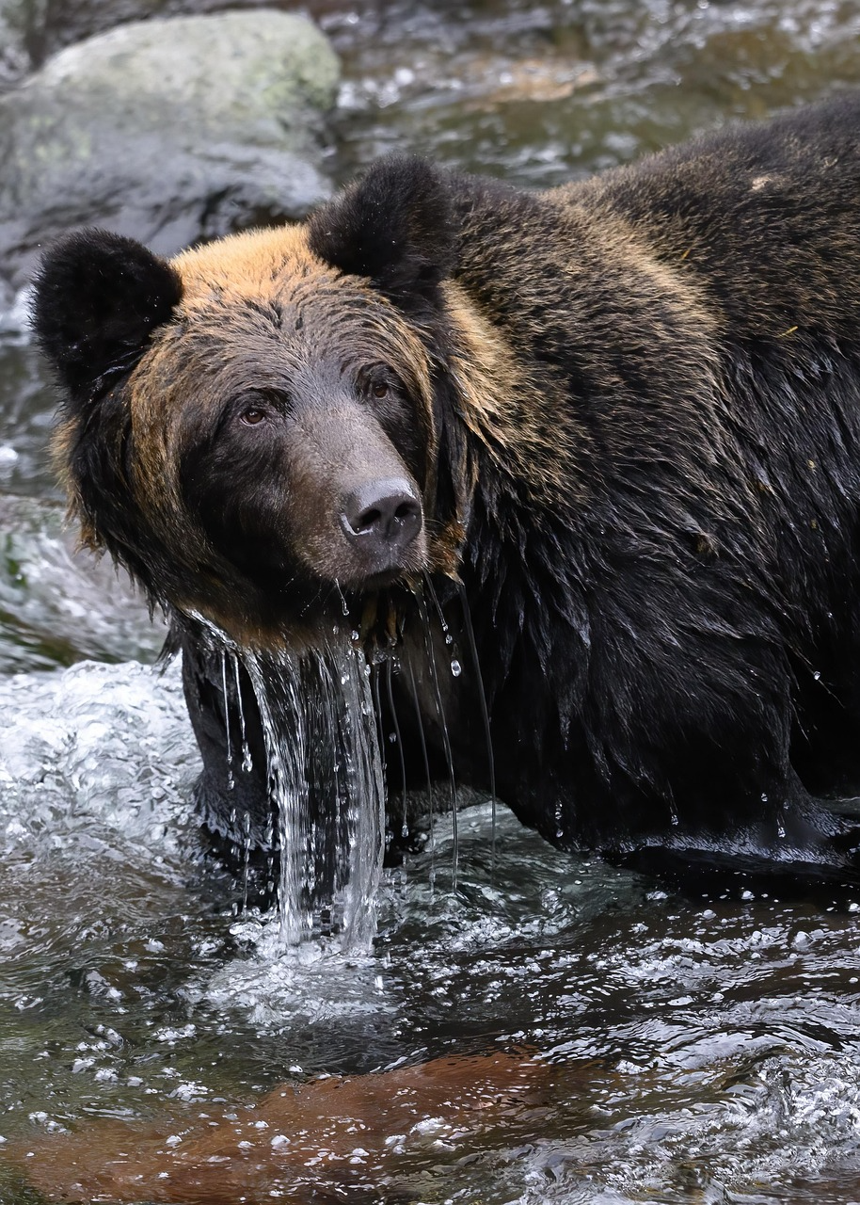
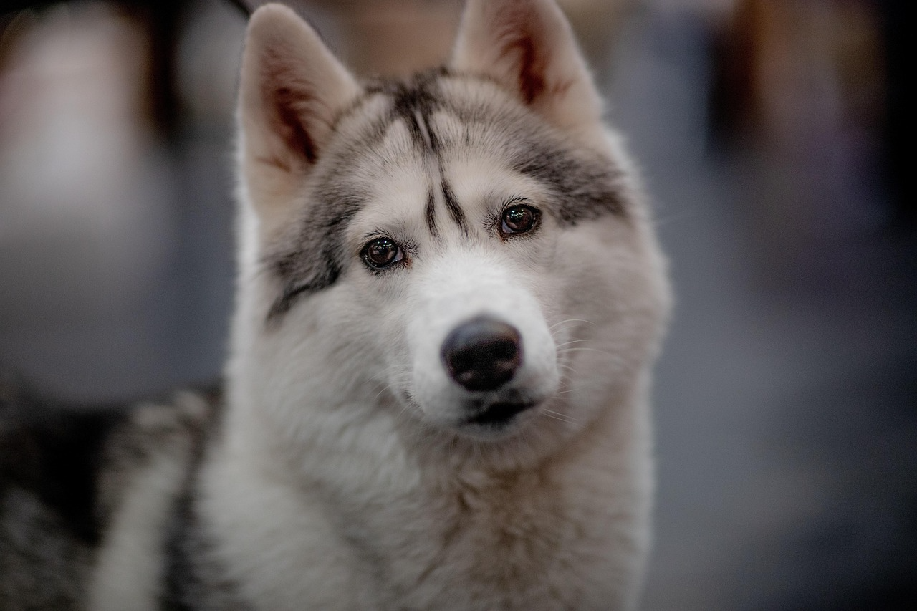
Visual Analysis
Look at the images.
Describe the differences you notice and explain which characteristics might help survival and why.

Slide 12
Your task
Choose an animal
Research facts about the evolution of your chosen animal
The evolution of which characteristic helped them survive the most
Complete a fact file
Present to a partner and explain your reasoning using evidence.

Slide 13
Stretch Thinking
If the Earth became much colder, explain which characteristics would help animals survive and why.

Slide 14
Exit Quiz
What does evolution mean?
Decide whether this statement is true or false: evolution happens in one lifetime.
Name one characteristic that could help an animal survive.

