Slide 1
Year 5 Poetry Unit – Self‑Study
Each poem type is taught as its own lesson sequence.
You will use the model texts (WAGOLLs), follow the steps, and complete independent tasks.
The blue box gives you instructions to follow on your own.
Work through slides in order. Read the model texts aloud. Complete the tasks in your book.

Slide 2
Diamante Poems – Sequence Overview
• Lesson 1: Structure and contrast
• Lesson 2: Draft and refine vocabulary
• Lesson 3: Publish and reflect
Complete all three lessons in order. Keep your first draft so you can show improvements in Lesson 2 and Lesson 3.

Slide 3
Diamante Poems – Lesson 1: Learning Objective
To understand the structure of a diamante poem and how contrast creates meaning.
You will learn how a diamante poem is built. You will spot the turning point and explain how the meaning shifts from one idea to its contrast.

Slide 4
Diamante Poems – Lesson 1
Diamante structure (7 lines):
1) Noun
2) Two adjectives
3) Three -ing verbs
4) Two nouns (link/contrast)
5) Three -ing verbs
6) Two adjectives
7) Contrasting noun
Key idea: line 4 is the turning point.
Work through each rule carefully. Pause after each point and check you understand it before moving on.

Slide 5

Diamante Poems – Lesson 1: WAGOLL (Model Text)
Fire
Hot, bright
Crackling, roaring, burning
Flames, destruction
Cooling, shrinking, fading
Quiet, dark
Ash
Read the model once. Read it again and spot where it follows the rules. Underline one word choice you think is powerful.

Slide 6
Diamante Poems – Lesson 1: Guided Practice
Follow these steps:
1) Choose a pair (Day → Night).
2) List 6 adjectives and 6 -ing verbs.
3) Pick the strongest 2 adjectives and 3 verbs for each side.
4) Decide the two turning-point nouns for line 4.
Follow the steps. If you get stuck, return to the WAGOLL and copy the structure before adding your own ideas.

Slide 7
Diamante Poems – Lesson 1: Independent Task
Write your own diamante using one pair:
• Hope → Fear
• Calm → Chaos
• Freedom → Control
Write 7 lines and keep the exact structure.
Complete the task independently. When finished, tick off each rule to check your poem follows the form.

Slide 8
Diamante Poems – Lesson 2: Learning Objective
To refine a diamante by upgrading vocabulary for precision and impact.
You will improve vocabulary so every word is precise. You will replace weak adjectives and verbs and make the contrast clearer.

Slide 9
Diamante Poems – Lesson 2
Upgrade prompts:
• Replace vague adjectives (nice, good, big)
• Choose vivid -ing verbs (crackling, drifting, collapsing)
• Keep word choices matched to each side of the diamond
Work through each rule carefully. Pause after each point and check you understand it before moving on.

Slide 10
Diamante Poems – Lesson 2: Guided Practice
Practise upgrading:
quiet → deathly quiet
burning → blistering
shrinking → crumbling
Write 3 upgrades of your own.
Follow the steps. If you get stuck, return to the WAGOLL and copy the structure before adding your own ideas.

Slide 11
Diamante Poems – Lesson 2: Independent Task
Edit your diamante draft:
• Replace 3 weak words
• Improve 1 -ing verb
• Check line 4 clearly links/contrasts
Complete the task independently. When finished, tick off each rule to check your poem follows the form.

Slide 12
Diamante Poems – Lesson 2: Edit / Publish
Publish checklist:
• Correct 7-line structure
• Strong, precise vocabulary
• Diamond layout is clear
• Read aloud: does the shift feel smooth?
Edit first, then publish neatly. Aim to improve at least 3 words and make your layout clear for a reader.

Slide 13
Diamante Poems – Lesson 3: Learning Objective
To publish a final diamante and explain how contrast changes meaning.
You will publish your poem neatly and explain how your turning point (line 4) changes the meaning.

Slide 14
Diamante Poems – Lesson 3: Independent Task
Write a short reflection:
• Which 2 words are your strongest choices?
• How does line 4 create the turning point?
Complete the task independently. When finished, tick off each rule to check your poem follows the form.

Slide 15
Diamante Poems – Lesson 3: Edit / Publish
Final presentation:
• Neat diamond layout
• Optional illustration matching both nouns
• Share or record yourself reading it aloud
Edit first, then publish neatly. Aim to improve at least 3 words and make your layout clear for a reader.

Slide 16
Haiku Poems – Sequence Overview
• Lesson 1: 5–7–5 structure + imagery
• Lesson 2: Improve imagery + syllables
• Lesson 3: Publish + explain effect
Work slowly and recount syllables after every edit. In haiku, accuracy and precision matter.

Slide 17
Haiku Poems – Lesson 1: Learning Objective
To understand haiku structure (5–7–5) and create vivid imagery.
You will learn the 5–7–5 syllable pattern and choose concrete images and strong verbs to capture a moment.

Slide 18
Haiku Poems – Lesson 1
Haiku rules:
• 3 lines
• 5 syllables
• 7 syllables
• 5 syllables
Focus: nature or a moment in time. Use concrete images and strong verbs.
Work through each rule carefully. Pause after each point and check you understand it before moving on.

Slide 19

Haiku Poems – Lesson 1: WAGOLL (Model Text)
Winter morning sky
Breath floats in the frozen air
Silence before bells
Read the model once. Read it again and spot where it follows the rules. Underline one word choice you think is powerful.

Slide 20
Haiku Poems – Lesson 1: Guided Practice
Follow these steps:
1) Choose a moment (e.g., morning playground)
2) List 10 images (nouns/verbs)
3) Draft line 1 (5 syllables)
4) Draft line 2 (7 syllables)
5) Draft line 3 (5 syllables)
Follow the steps. If you get stuck, return to the WAGOLL and copy the structure before adding your own ideas.

Slide 21

Haiku Poems – Lesson 1: Independent Task
Write your own haiku about:
• a season
• weather
• a quiet moment
Count syllables and underline your strongest image.
Complete the task independently. When finished, tick off each rule to check your poem follows the form.

Slide 22
Haiku Poems – Lesson 2: Learning Objective
To improve a haiku by replacing vague words with precise imagery while keeping syllables accurate.
You will upgrade vocabulary but keep the syllable count correct. You will replace general nouns and weak verbs with precise choices.

Slide 23
Haiku Poems – Lesson 2: Teach Explicitly
Upgrade prompts:
• bird → sparrow
• went → drifted
• cold → frozen
After each change: recount syllables.
Work through each rule carefully. Pause after each point and check you understand it before moving on.

Slide 24
Haiku Poems – Lesson 2: Guided Practice
Improve 2 lines:
‘Cold air’ → ‘Frozen air’
‘Birds fly’ → ‘Sparrows scatter’
Write 2 improvements of your own.
Follow the steps. If you get stuck, return to the WAGOLL and copy the structure before adding your own ideas.

Slide 25
Haiku Poems – Lesson 2: Independent Task
Edit your haiku:
• Improve 2 words
• Recount syllables
• Read aloud to check rhythm
Complete the task independently. When finished, tick off each rule to check your poem follows the form.

Slide 26
Haiku Poems – Lesson 2: Edit / Publish
Publish checklist:
• 5–7–5 correct
• Concrete images and strong verbs
• Neat layout and title (optional)
Edit first, then publish neatly. Aim to improve at least 3 words and make your layout clear for a reader.

Slide 27
Haiku Poems – Lesson 3: Learning Objective
To publish a haiku and explain how imagery creates meaning.
You will publish your haiku and explain how one image helps the reader picture the moment.

Slide 28
Haiku Poems – Lesson 3: Independent Task
Write a short note:
• Which image is strongest?
• What does it help the reader imagine?
Complete the task independently. When finished, tick off each rule to check your poem follows the form.

Slide 29
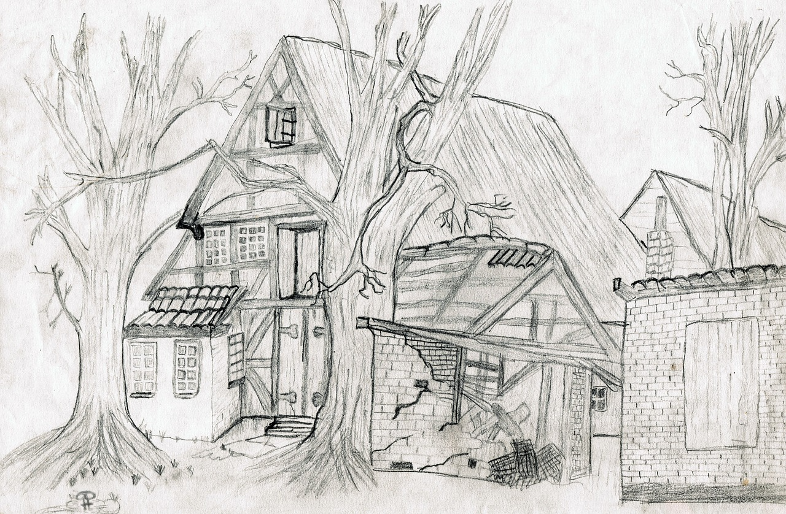
Haiku Poems – Lesson 3: Edit / Publish
Share and improve:
• Swap with a partner
• Receive one praise for imagery
• Make one final improvement
Edit first, then publish neatly. Aim to improve at least 3 words and make your layout clear for a reader.

