Slide 1
Year 5 – Animals Including Humans
Lesson 1: Human Life Stages
We will use scientific vocabulary, evidence and respectful discussion.
Notes:
Script:
• Read the LO and Big Question aloud.
• Turn-and-talk: What do you already know?
• Remind pupils: we use respectful language; no personal sharing required.
• Explain: we will use evidence (because/therefore).

Slide 2
Learning Objective and Success Criteria
Learning Objective:
Identify and describe stages of human development from birth to old age and place them in order.
NC focus:
Describe the changes as humans develop to old age.
Success Criteria (WILF):
I can name the main life stages in the correct order.
I can describe changes across stages using growth and development correctly.
I can compare two stages using because/therefore.
Notes:
Script:
• Share NC focus and how today’s learning builds towards it.
• Read WILF and highlight what ‘good’ looks like.

Slide 3
Big Question
How do humans change as they grow?

Slide 4
Retrieval Starter
1) What do living things need to stay alive?
2) Name one way bodies change as we grow.
3) True/False: Humans stop changing once they are adults.
Answer on mini-whiteboards and justify using because.
Notes:
Script:
• Quick retrieval.
• Cold call: ‘What evidence do you have?’
• Correct misconceptions before new learning.

Slide 5
Key Vocabulary (say it • define it • use it)
development – changes in the body and abilities over time
growth – increase in size (height and mass)
infant – a very young baby
teenager – a young person in the teen years
adult – a fully grown person
older adult – a person in later life
Notes:
Script:
• Choral repeat.
• Pupils use each word in a sentence.
• Quick check: ‘Which word means…?’

Slide 6
Misconceptions to Watch For
Humans stop changing after childhood (they continue to change !)
Everyone develops at the same speed (there is natural variation)
Notes:
Script:
• Read each misconception.
• Ask pupils to correct it using a full sentence.

Slide 7
Safety / Ground Rules
• Respectful language; no personal sharing required.
• Use fictional/example data; do not ask pupils to share personal ages or family details.
Notes:
Script:
• Set ground rules clearly.
• Explain opt-out choices where needed.
• Keep learning scientific and general.

Slide 8
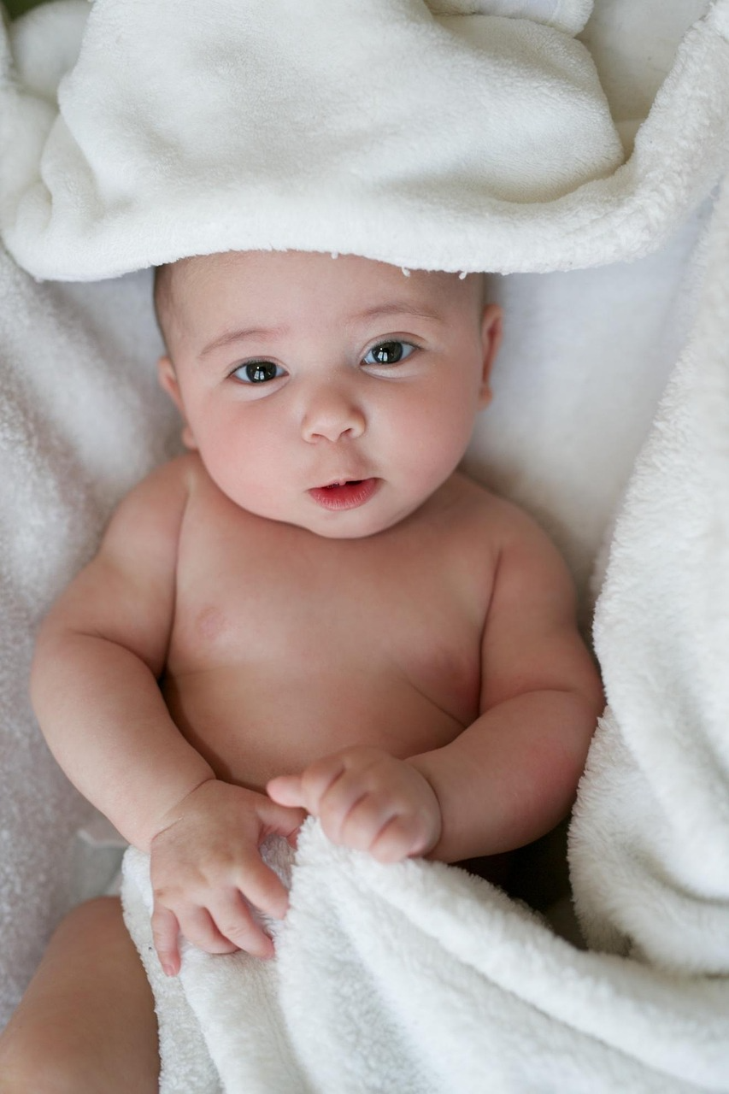

Key Knowledge: Life Stages Overview
What are life stages?
All humans pass through a series of life stages as they grow and change. These stages follow a general pattern, but the exact timing varies from person to person.
The five main stages:
Infant (0-2 years) - rapid growth, learning to walk, talk and feed.
Child (2-11 years) - steady growth, developing social and academic skills.
Notes:
Script:
• Emphasise: growth = size; development = abilities.
• Use examples that are general and age-appropriate.

Slide 9


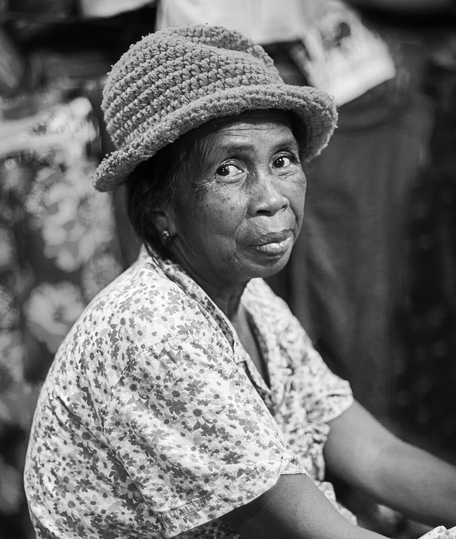
Key Knowledge: Life Stages Overview
What are life stages?
All humans pass through a series of life stages as they grow and change. These stages follow a general pattern, but the exact timing varies from person to person.
The five main stages:
Teenager (11-18 years) - puberty begins, growth spurts, increasing independence.
Adult (18-65 years) - fully grown, taking on responsibilities such as work and family.
Older adult (65+ years) - gradual changes in strength, mobility and health.
Notes:
Script:
• Emphasise: growth = size; development = abilities.
• Use examples that are general and age-appropriate.

Slide 10

Key Knowledge: Types of Changes
Physical changes:
Height, weight and body shape change at every stage.
Growth is fastest during infancy and the teenage years.
Skill development:
As we grow, we learn new skills such as reading, problem-solving, driving and looking after others.
These develop most during childhood and adolescence.

Slide 11
Key Knowledge: Types of Changes
Independence:
Babies depend on adults for everything.
As children grow, they become more independent.
Adults make their own choices and often care for others.
Key point:
Growth means getting bigger in size.
Development means gaining new abilities and skills.
Both happen throughout life but at different rates.

Slide 12
Working Scientifically: classify and explain
What does classify mean?
To classify means to sort things into groups based on their features. Scientists classify to organise information and spot patterns.
How do we classify changes?
We can sort changes into categories: physical changes, skill development, and independence. Each life stage has changes in all three categories.
Using evidence language:
Scientists explain their thinking using connecting words. Use because to give a reason and therefore to show a result.
Example: Teenagers grow taller because their bodies go through puberty. Therefore, they need more energy from food.
Notes:
Script:
• Model one explanation: ‘In adulthood, responsibilities increase because…’

Slide 13
Working Scientifically: Communicate Clearly
Using vocabulary accurately:
When we describe changes, we must use scientific vocabulary. Say growth when we mean getting bigger, and development when we mean gaining new abilities.
Sentence stems to help you:
During [stage], humans often...
One change that happens is... because...
This is different from [other stage] therefore...
Top tip:
Use words like often, usually and can, to show that not everyone develops at the same rate. Avoid saying all or always.

Slide 14
Model: Comparing Life Stages
Why do we compare stages?
Comparing two life stages helps us see how humans change over time. It shows what is similar and what is different.
Example comparison - Childhood vs Adulthood:
Childhood: rapid growth in height and weight; learning basic skills like reading and writing; adults provide care and make decisions.
Adulthood: growth has stopped; skills are fully developed; adults care for themselves and often for children or older relatives.
Evidence sentence:
Adults are fully grown, therefore their growth rate is much slower than during childhood. Children grow quickly because their bodies are still developing.
Notes:
Script:
• Model a comparison using because/therefore.
• Remind: not everyone is the same—use ‘often’ and ‘can’.

Slide 15
Model: Another Comparison
Example comparison - Infancy vs Older Adulthood:
Infancy: very rapid growth; learning to walk, talk and feed; completely dependent on adults for survival.
Older adulthood: body gradually becomes less strong; some skills may decline; may need more support but has a lifetime of experience and knowledge.
Similarities:
Both infants and older adults may need help from others. Both experience significant physical changes. Both stages involve adapting to new circumstances.
Evidence sentence:
Infants depend on adults because they cannot care for themselves. Some older adults also need support, therefore both stages can involve relying on others.
Your turn: Choose two stages and write your own comparison using because and therefore.

Slide 16
Activity (We do → You do)
Groups build a class timeline using stage cards.
Add 2+ changes for each stage on sticky notes.
Write 3 comparison sentences (two stages) using because/therefore.
Notes:
Script:
• We do: order the first two stages together.
• You do: groups complete timeline and add changes.
• Circulate: check vocabulary accuracy.

Slide 17
How to Record Evidence
Record changes under each stage heading.
Use categories: physical / skills / independence.
Use evidence stems: ‘This changes because…’
Notes:
Script:
• Show an example sticky note for each category.

Slide 18
Challenge / Greater Depth
Create a Venn diagram: childhood vs older adulthood.
Write a ‘myth buster’ statement correcting one misconception.
Notes:
Script:
• Push for careful, respectful language (avoid stereotypes).

Slide 19
Plenary / Exit Ticket
Exit 1: Put stages in order.
Exit 2: One change that can happen in later life is…
Notes:
Script:
• Use exits to identify pupils needing support with stage order/vocab.

