Slide 1
Lesson 1: What is a Living Thing?
Learning Objective:
Identify the characteristics of living things.
Notes:
Script:
1) Welcome pupils and read the learning objective aloud.
2) Share the big question. Ask pupils to turn-and-talk for 30 seconds.
3) Tell pupils: we will learn new scientific words and use evidence to explain our ideas.

Slide 2
Big Question:
How can we tell if something is alive?
Notes:
Script:
1) Welcome pupils and read the learning objective aloud.
2) Share the big question. Ask pupils to turn-and-talk for 30 seconds.
3) Tell pupils: we will learn new scientific words and use evidence to explain our ideas.

Slide 3
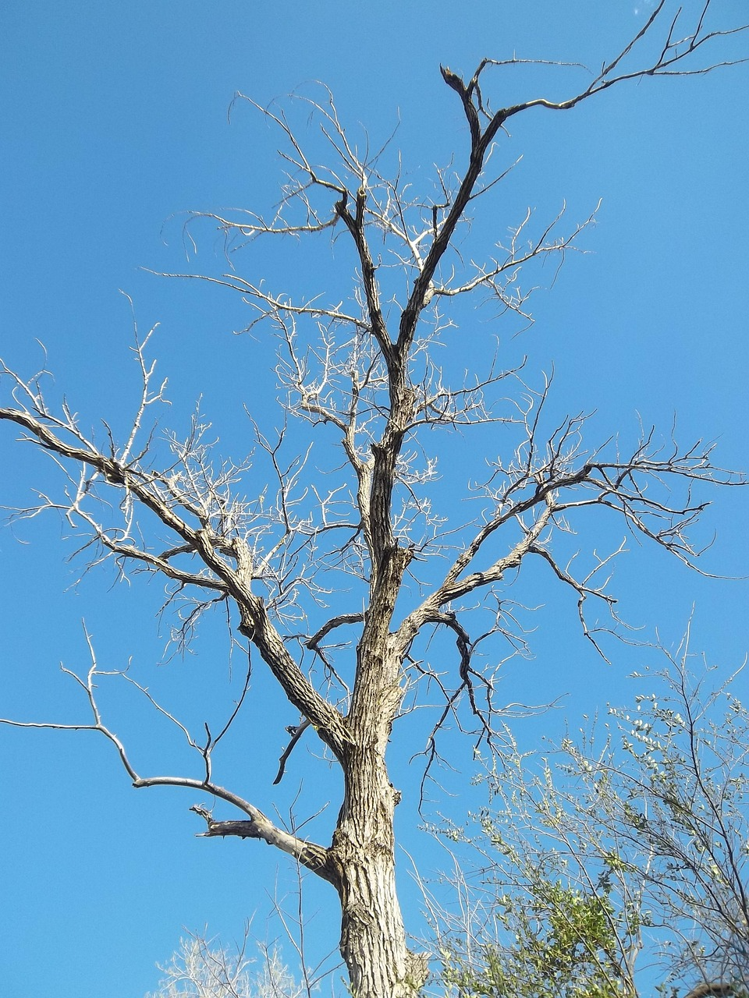
Big Question: How can we tell if something is alive?
Living things are organisms that share key characteristics: they grow, reproduce, take in nutrients, and respond to their environment.
Notes:
Script:
1) Welcome pupils and read the learning objective aloud.
2) Share the big question. Ask pupils to turn-and-talk for 30 seconds.
3) Tell pupils: we will learn new scientific words and use evidence to explain our ideas.

Slide 4
Retrieval Starter
(Prior Knowledge)
1) Name two things plants need to grow.
2) Is a seed alive? Explain your thinking.
3) What is a habitat? (If you know)
Notes:
Script:
Use mini whiteboards. Read each question.
After each response, ask: *What evidence do you have?*
Address misconceptions quickly, then link to today’s learning.

Slide 5
Key Vocabulary
(say it • define it • use it)
Organism – Any living thing.
Living – Something that carries out life processes (e.g., needs nutrients and can reproduce).
Non-living – Something that has never been alive (e.g., rock, water).
Dead – Something that was once alive but is no longer.
Life processes – The things living things do to stay alive.
Nutrition – Getting food to provide energy.
Notes:
Script:
Choral repeat each word.
Give the child-friendly definition.
Ask for an example sentence using the word.
Quick check: *Which word means…?*

Slide 6
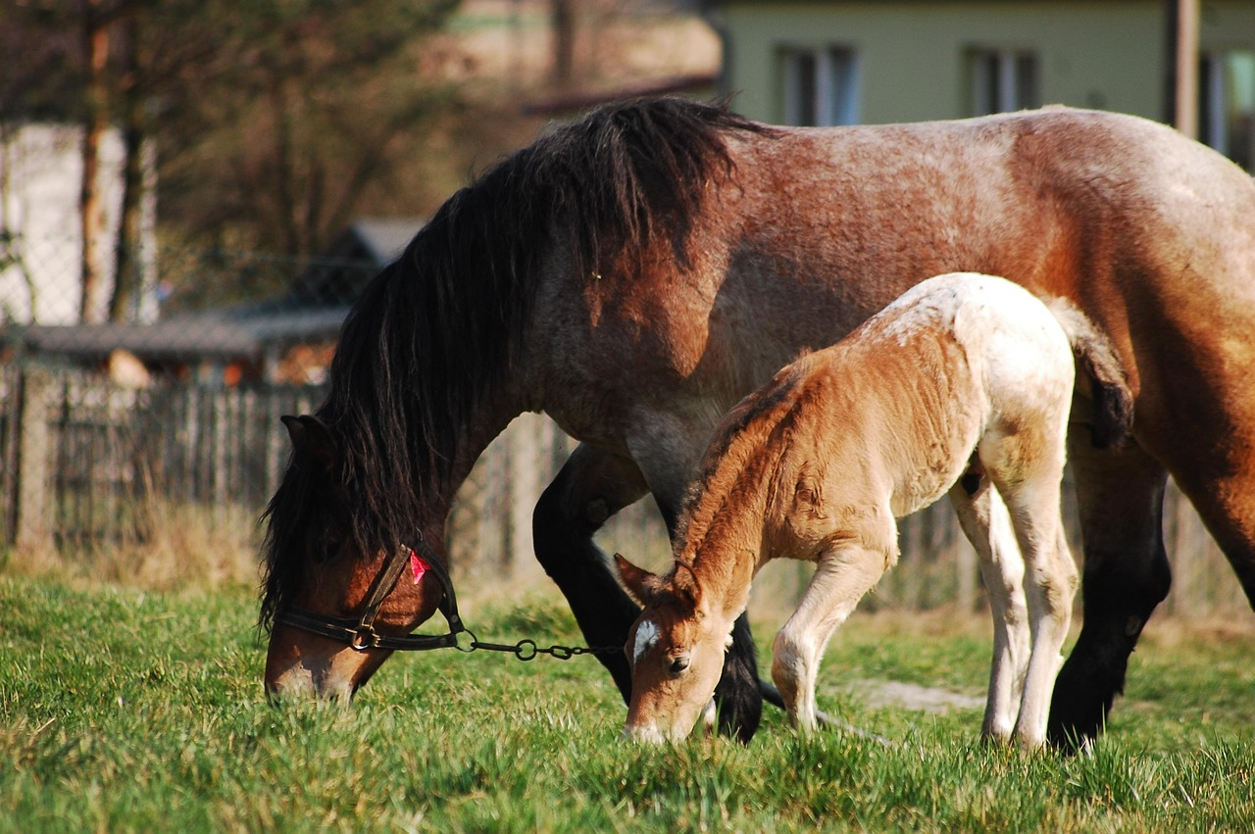
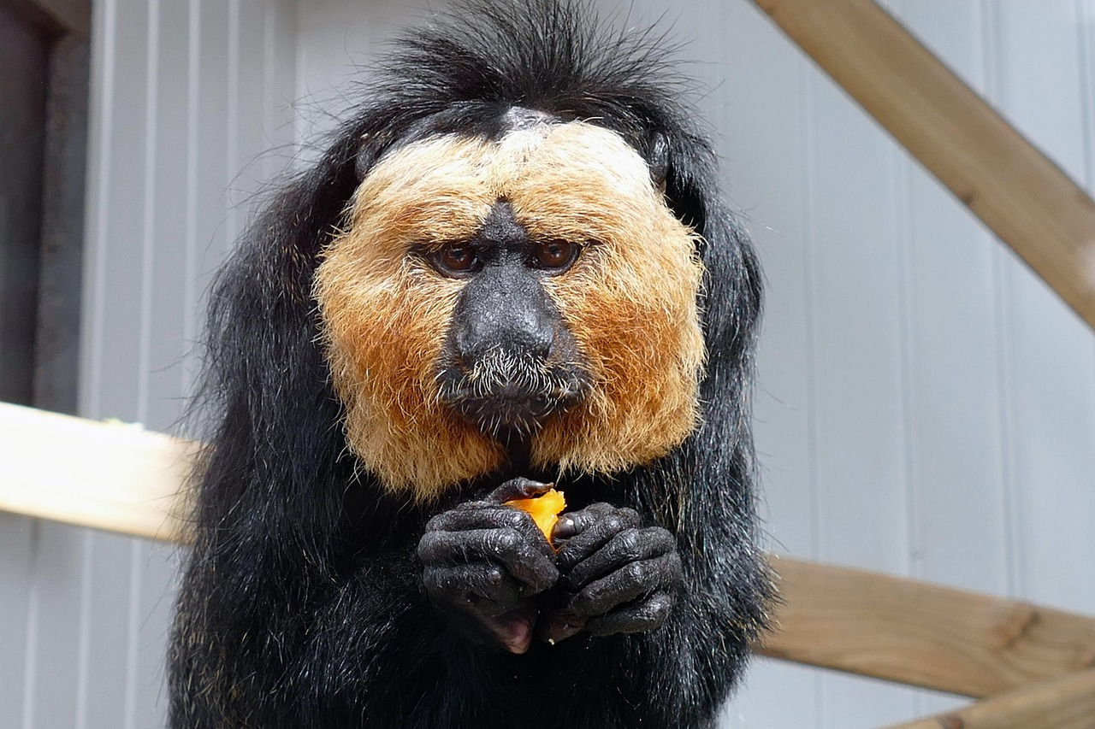
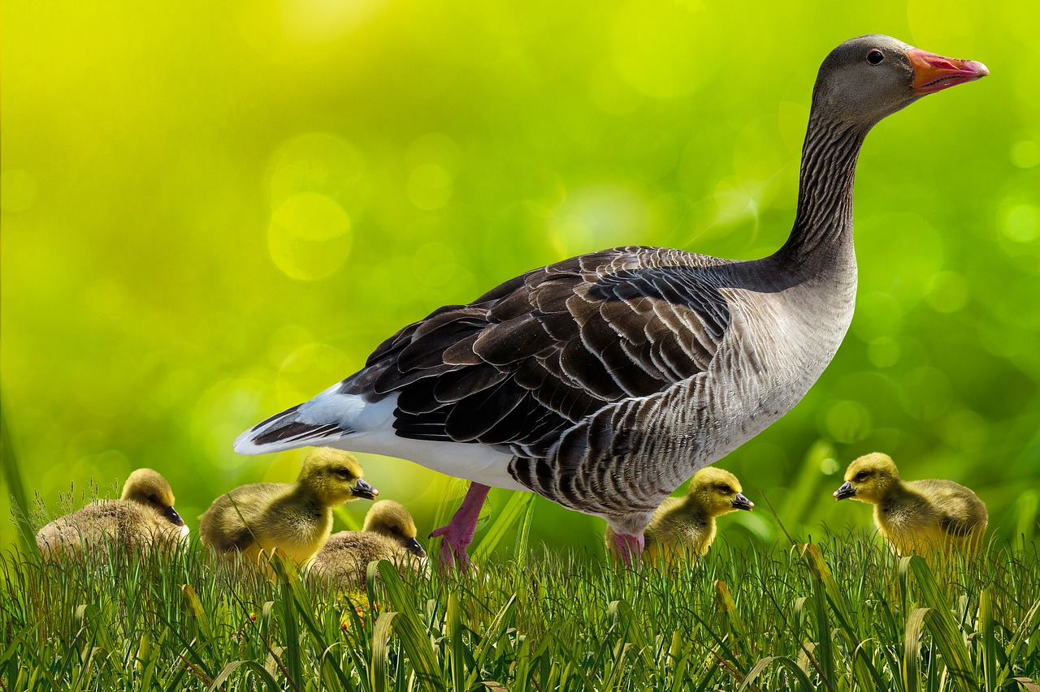
Key Idea: Living things do life processes
Living things: need energy (food), water and air
They grow and change over time
They can produce young (reproduce)
They respond to what is happening around them
Characteristics of living things - Living things: Video playlist - BBC Bitesize
Notes:
Script:
Explain that scientists look for *life processes* to decide if something is living.
Give examples: kittens grow; plants respond to light; animals reproduce.

Slide 7
Scientific talk frames
I think ____ is living because ____
My evidence is ____
I disagree because ____
A better group would be ____
Notes:
Script:
Model one sentence using vocabulary.
Encourage pupils to use *because* and give evidence.

Slide 8
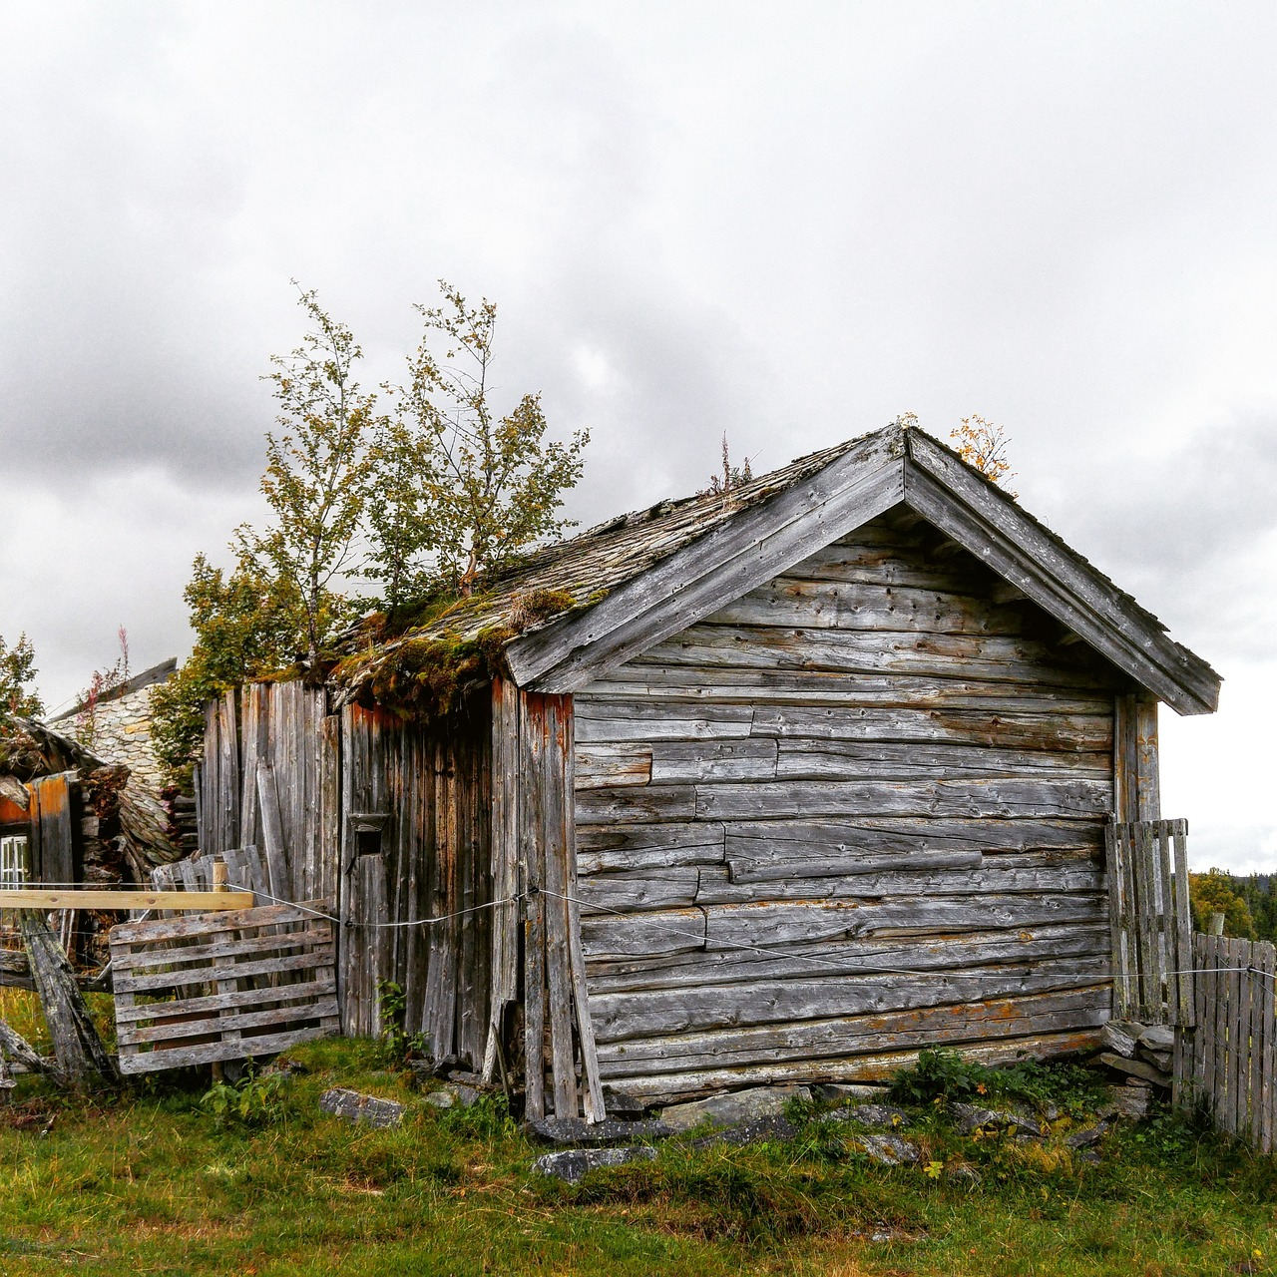


Model: Sorting objects with reasons
Example: Leaf → Dead (it was part of a plant)
Example: Stone → Non-living (never alive)
Example: Snail → Living (moves, needs food, grows)
Notes:
Script:
Model thinking aloud: state your decision, then your evidence.
Show how to write a full sentence explanation.

Slide 9
Sorting tricky examples
A wooden chair
A flame
A robot
A wooden chair: made from a tree → once alive → now dead
A flame: not alive (does not reproduce in the biological sense)
A robot: can move but is not living (no life processes)
Notes:
Script:
Use these as misconception busters.
Ask pupils to justify using the words living, dead and non-living.

Slide 10
Activity (We do → You do)
Task 1: Sort picture cards into Living / Dead / Never Alive.
Task 2: Choose 3 items and write a justification sentence for each.
Notes:
Script:
Model the first example together (We do).
Then release pupils to complete the main task (You do).
Circulate: question pupils using vocabulary and prompt for reasoning.
Stop mid-way for a quick share of good examples.

Slide 11
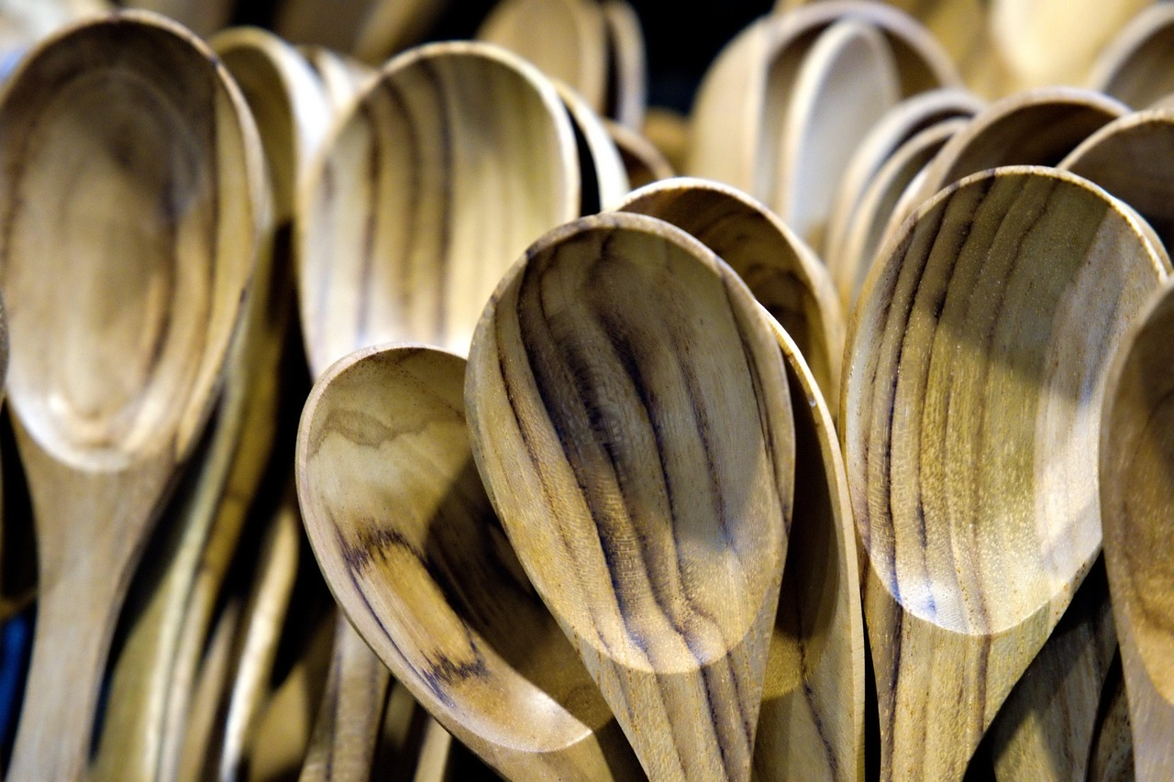
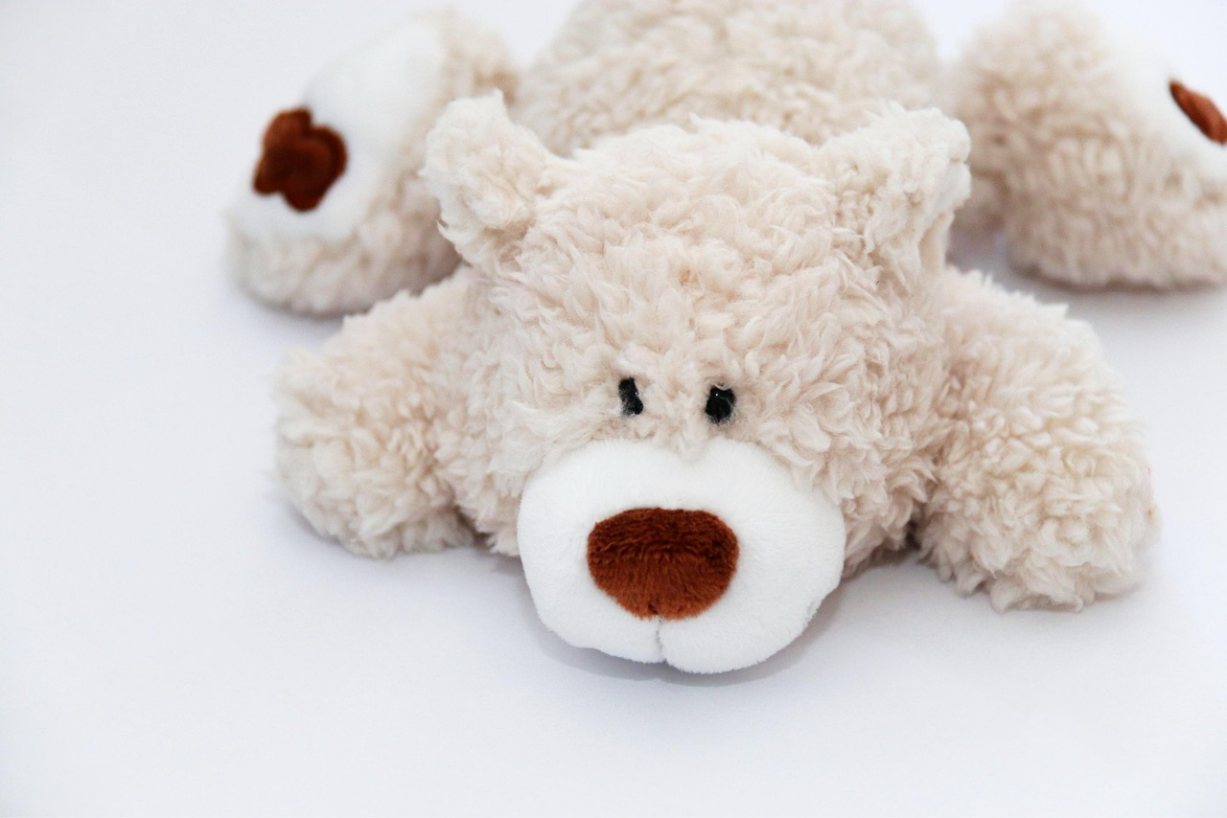
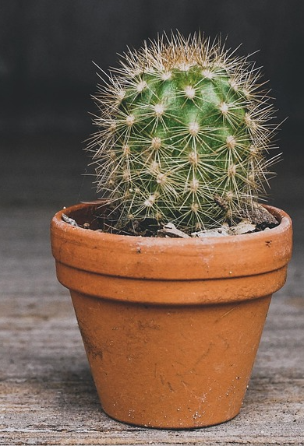
Activity (We do → You do)
Item | Living / dead /never been alive | How do you know?
Notes:
Script:
Model the first example together (We do).
Then release pupils to complete the main task (You do).
Circulate: question pupils using vocabulary and prompt for reasoning.
Stop mid-way for a quick share of good examples.

Slide 12
Challenge / Greater Depth
Explain why a wooden chair is dead and not non-living. Include the word “once alive”.
Explain using because…
Use at least 2 vocabulary words.
I think ____ is living because ____
My evidence is ____
I disagree because ____
A better group would be ____
Notes:
Script:
Direct pupils who finish early to the challenge.
Expect a written explanation with scientific vocabulary and clear reasoning.

Slide 13
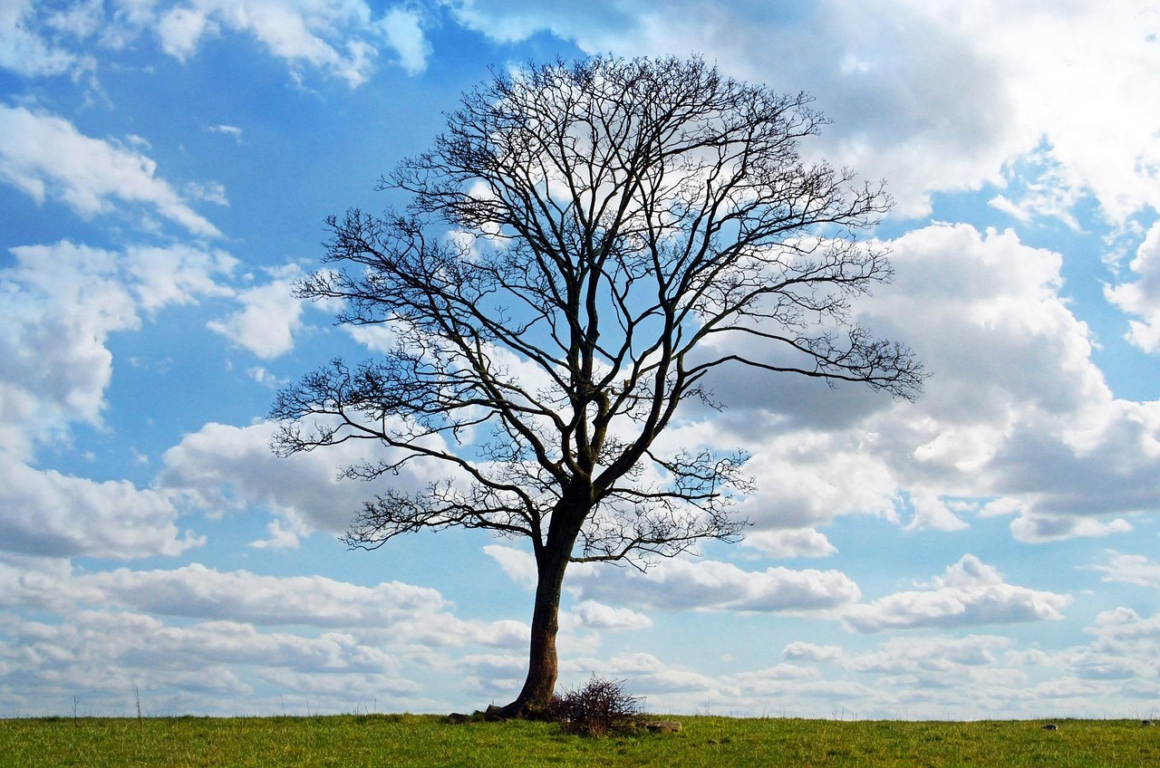
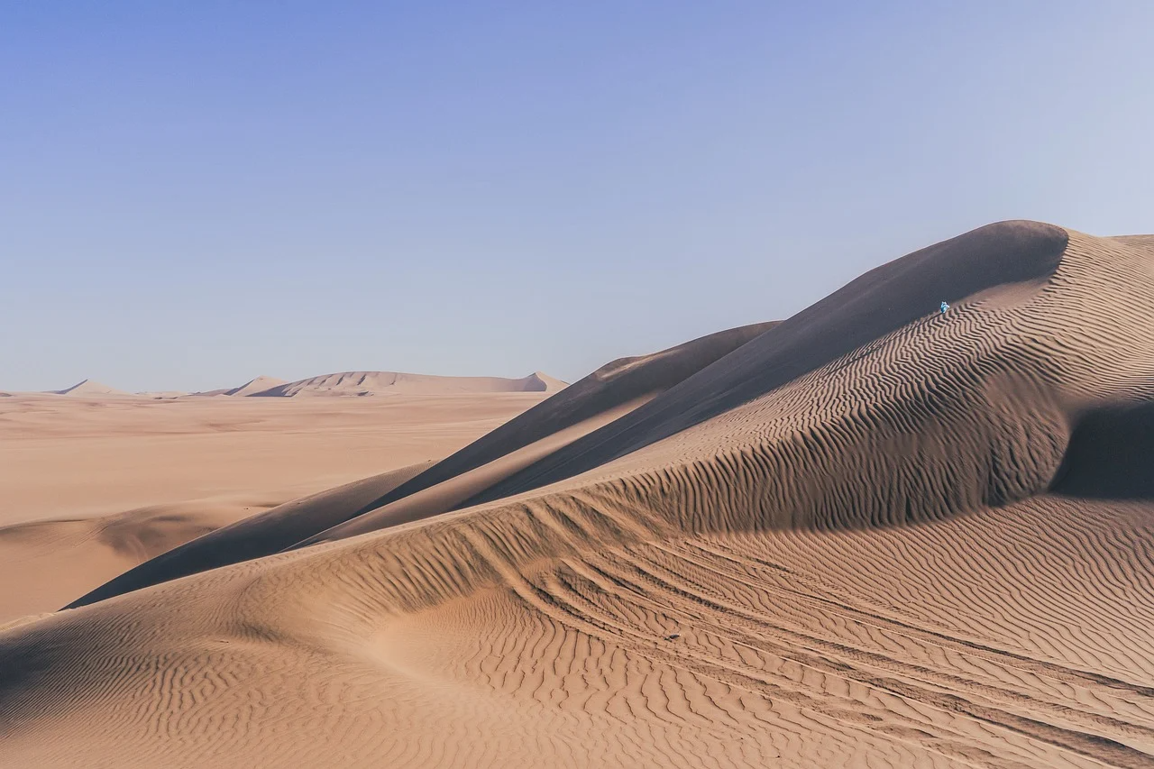
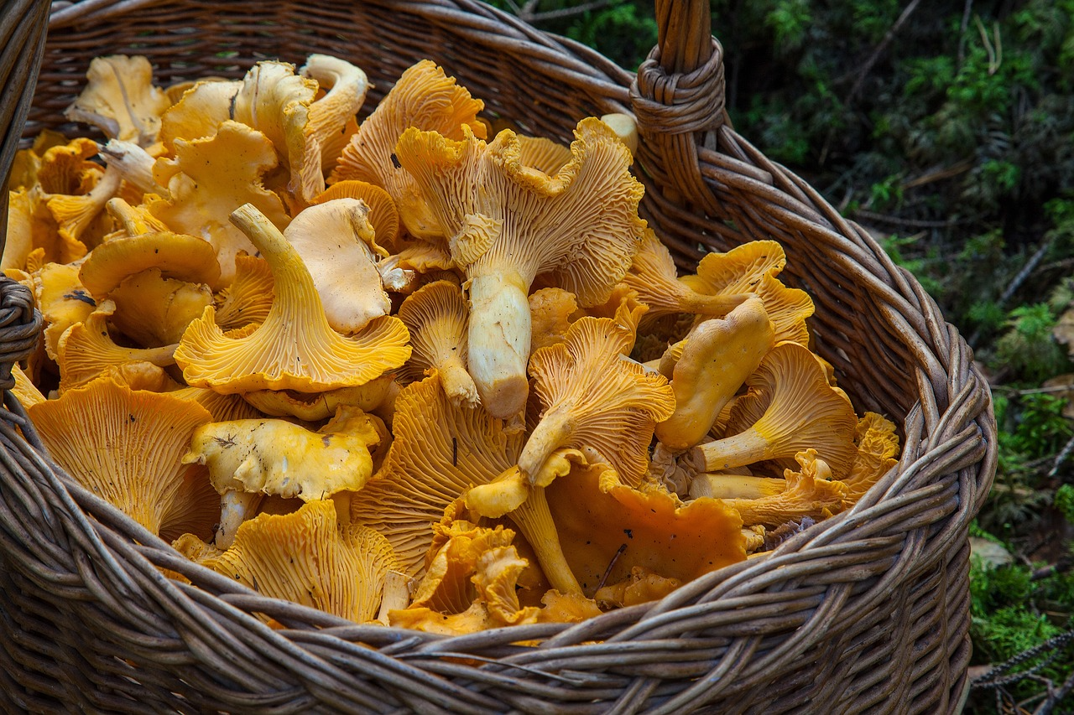
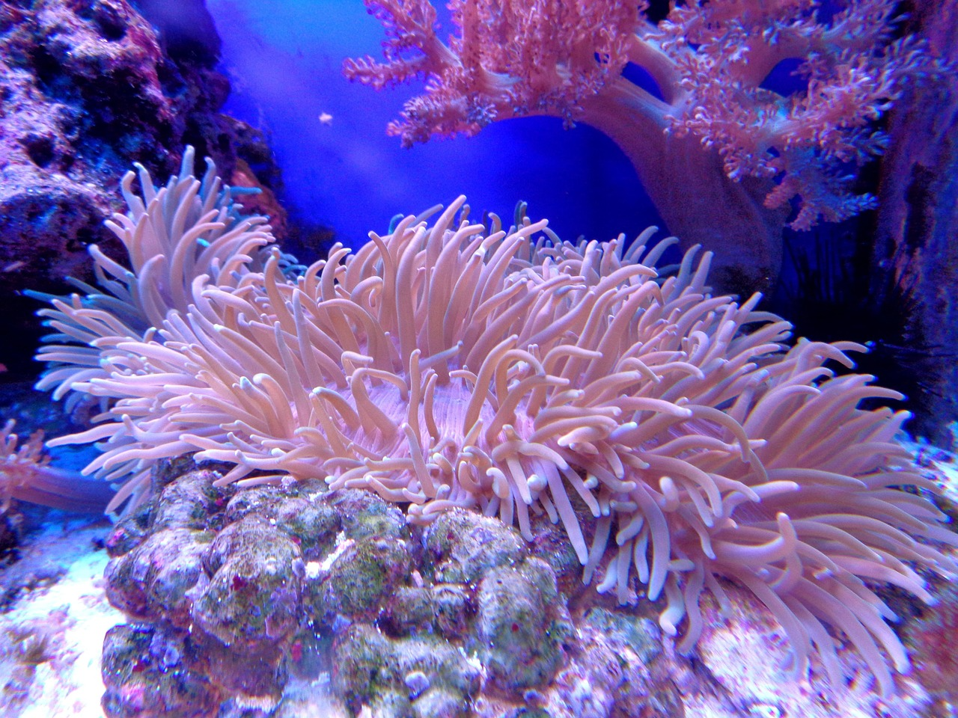
Plenary (Exit Ticket)
Exit Ticket Q1: Circle the living things:
sand / mushroom / coral / tree.
Exit Ticket Q2: Write one sentence: “A ____ is living because ____.”
Notes:
Script:
Pupils answer independently.
Collect for assessment or use a quick cold-call share.
End by returning to the big question and summarising the key idea.

