Slide 1
Year 3 Science: Animals Including Humans
Unit focus:
Nutrition: right types and amounts; animals cannot make their own food
Skeletons and muscles: support, protection and movement
How we work like scientists:
Classifying
Using evidence from research
Explaining with ‘because/so/therefore’
Notes:
Unit overview slide. Remind pupils: we will use scientific vocabulary and evidence in our explanations.

Slide 2
Lesson 1: What is nutrition? Food groups and nutrients
Today we are learning (LO):
To explain that animals (including humans) get nutrition from food and identify main food groups and key nutrients.
Success criteria (WILF):
I can explain what nutrition means.
I can explain that animals cannot make their own food.
I can name some nutrients (carbohydrate, protein, fat, vitamins, minerals).
I can sort foods into groups and justify my choices using evidence.
Notes:
Use a quick hook: body as a machine needing fuel. State LO and model one example sentence using ‘nutrition’ and ‘nutrient’.

Slide 3
Sticky Knowledge
(what we must remember)
Nutrition means getting the substances our bodies need from food.
Animals (including humans) cannot make their own food; we get nutrition from what we eat.
Different foods give different nutrients (e.g., carbohydrates for energy, protein for growth/repair).
Food can be grouped in different ways (food groups) to help us plan variety.
Talk prompt: "Which idea is NEW for you today?"
Notes:
Keep it simple and concrete. Rehearse ‘animals cannot make their own food’ and connect to plants from last unit (plants can).

Slide 4
Vocabulary
Vocabulary (word • meaning • science meaning • example)
Word | Child-friendly meaning | Science meaning | Example sentence
nutrition | the goodness we get from food | the process of taking in nutrients from food to stay alive and healthy | Nutrition helps my body stay healthy.
nutrient | a helpful substance in food | a substance in food that the body needs (e.g., protein, vitamins) | A nutrient in milk is protein.
carbohydrate | a food that gives energy | a nutrient used by the body for energy (e.g., bread, rice) | Bread gives me carbohydrates for energy.
protein | helps our body grow and repair | a nutrient used to build and repair body tissues (e.g., beans, eggs) | Protein helps my muscles repair.
fat | a nutrient that stores energy | a nutrient that stores energy and supports the body; needed in small amounts | Some fats help my body, but I don’t need lots.
vitamin | tiny helpers for health | small substances needed for body functions (e.g., vitamin C) | Fruit has vitamins.
Notes:
Teach words with say/clap/segment. Ask pupils for their own example sentence. Reinforce that fat is a nutrient (small amounts).

Slide 5
Vocabulary
Vocabulary (word • meaning • science meaning • example)
Word | Child-friendly meaning | Science meaning | Example sentence
mineral | tiny helpers like calcium | substances like calcium/iron needed for bones, blood and more | Calcium is a mineral for strong bones.
food group | a category of similar foods | a way to organise foods by the nutrients they often provide | Fruit is a food group.
Notes:
Teach words with say/clap/segment. Ask pupils for their own example sentence. Reinforce that fat is a nutrient (small amounts).

Slide 6

Did you know..?
• NUTRITION is the goodness we get from food.
• A NUTRIENT is a helpful substance in food.
• Animals (including humans) cannot make their own food.
• We get nutrition from what we eat.
Key nutrients:
• Carbohydrates give energy.
• Protein helps growth and repair.
• Fat stores energy (we need some).
• Vitamins and minerals help us stay healthy.
Key fact:
We get nutrition from food because it contains nutrients.
Notes:
Read lines with choral repetition. Point to a food card for each nutrient type. Emphasise full-sentence speaking.

Slide 7
Guided Practice:
Questions + Talk Partner
Talk Partner Stems:
I classified ___ as ___ because ___.
This food might give ___ because ___.
The label/picture is evidence that ___.
Check Questions:
What does nutrition mean?
Can humans make their own food? Explain.
Which nutrient gives energy?
Name one food and one nutrient it might give.
Notes:
Use quick talk-partner bursts (30 seconds). Cold-call for full sentence answers. Check misconceptions gently.

Slide 8
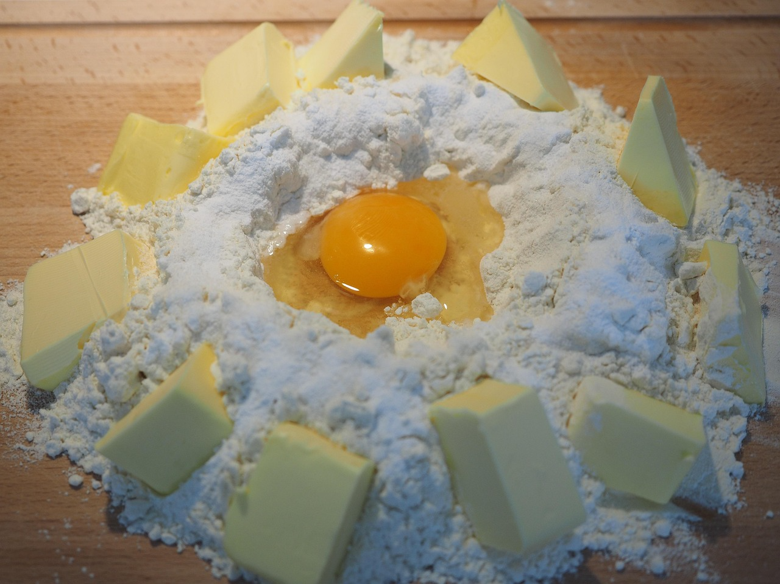
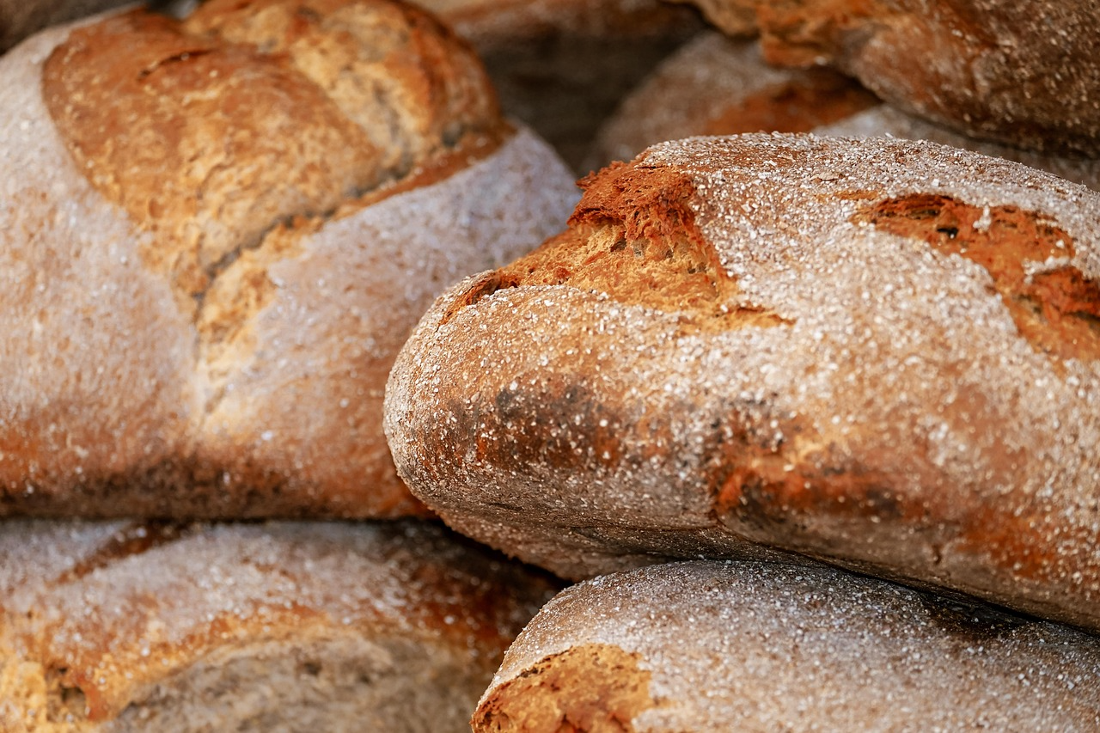
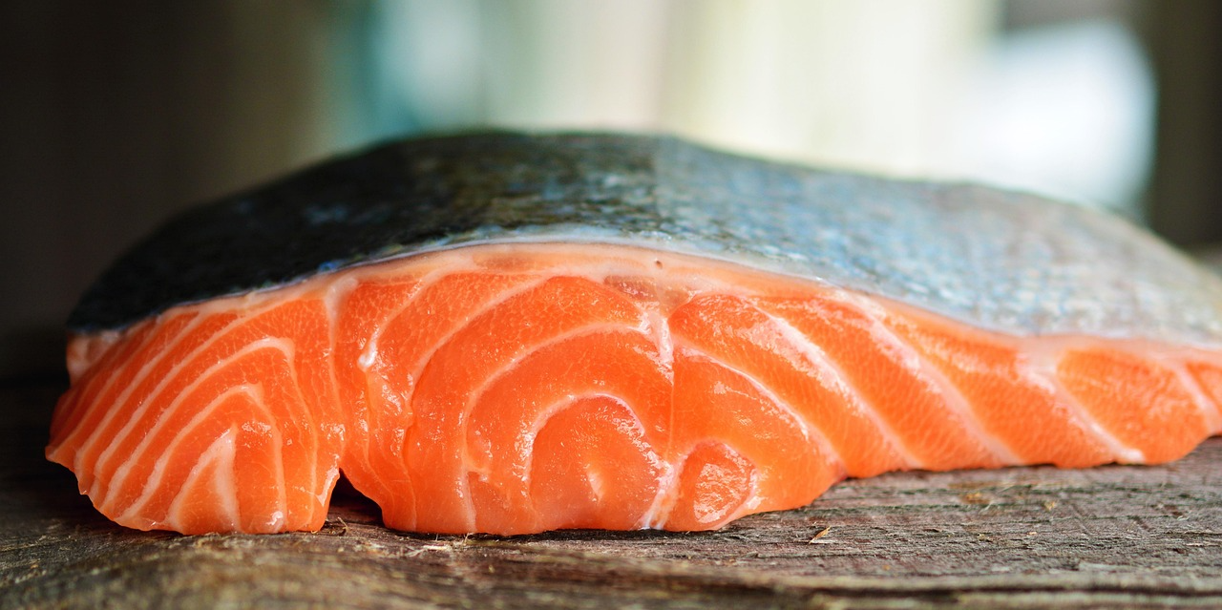
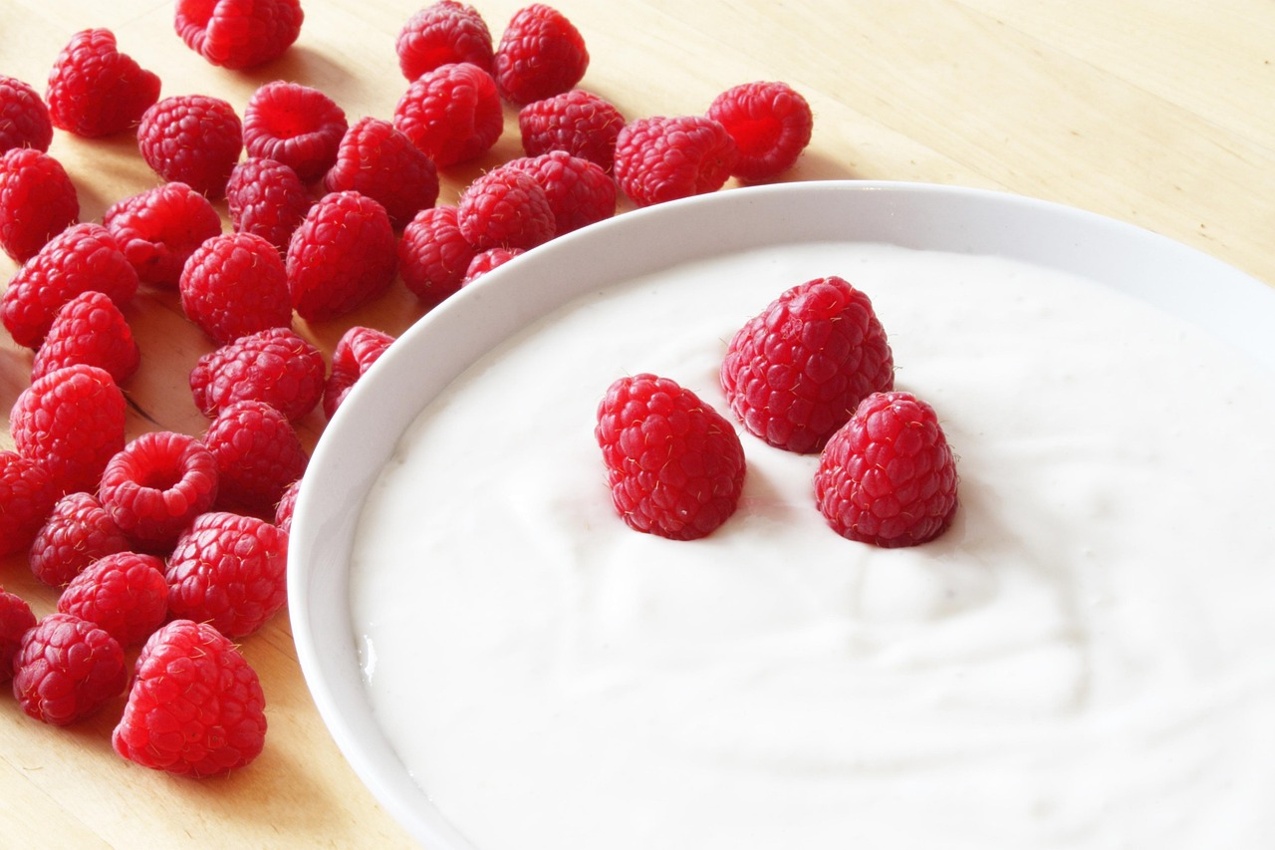
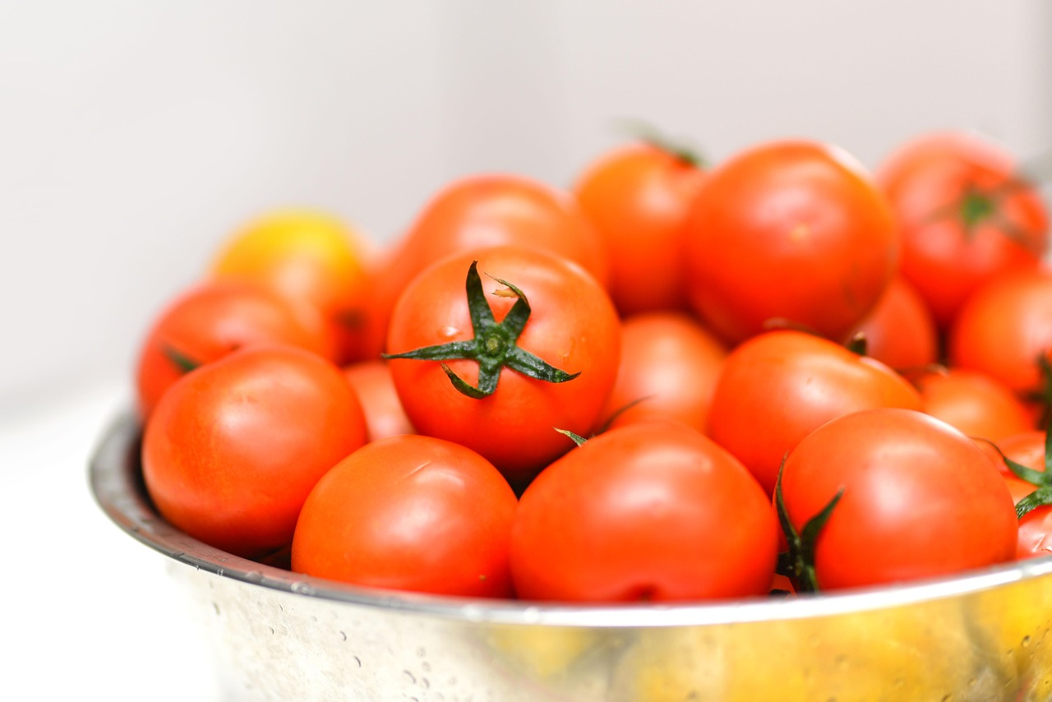
Main Activity
Group task:
1) Sort food cards into food groups (carbohydrates, fats, proteins, fruits and vegetables, dairy).
2) Complete a table: Food → Group → One nutrient it gives → Evidence (picture/label clue)
Notes:
Model one completed row of the table first. Circulate for evidence-based justifications.

Slide 9
Main Activity
3) Write 3 sentences:
“I classified ___ as ___ because ___.”
Finish: Underline your scientific words (nutrition, nutrient, carbohydrate, protein, evidence).
Notes:
Model one completed row of the table first. Circulate for evidence-based justifications.

Slide 10
Main Activity
Type of nutrient | Foods rich on that nutrient | Picture
Task: Use scientific words - nutrition, nutrient, carbohydrate, protein, evidence
Notes:
Model one completed row of the table first. Circulate for evidence-based justifications.

Slide 11
Support / Scaffolds (help me succeed)
Use fewer cards and only 3 groups at first (fruit/veg, protein, carbohydrates).
Picture word bank + pre-filled table headings.
Adult prompts: “What do you notice?” “Which group does it fit?” “Use the word nutrient.”
Notes:
Pre-select a simplified set of cards and provide icons. Provide adult support for reading labels.

Slide 12
Challenge / Greater Depth
Choose one challenge:
Add “why” reasoning: link a nutrient to its role (energy/growth/health).
Spot foods that fit more than one group and explain why.
Create a mini-glossary with precise definitions for 5 words.
Notes:
Push reasoning with ‘because’ and ‘evidence’. Invite pupils to notice multi-group foods.

Slide 13
Plenary (show what you learned)
Turn-and-talk: “One thing I learned about nutrition is…”
Then complete the exit sentence: “Nutrition is… A nutrient is… One example is…”
Exit ticket: Write ONE sentence using a key word from today.
Notes:
Collect exit tickets to see who can define nutrition/nutrient accurately.

