Slide 1
Year 2
Narrative Unit of writing
Adaptable unit of lessons to suit any of the recommended reading texts

Slide 2
Year 2 — Lesson 3: Showing Feelings
Focus: Show how a character feels using actions.

Slide 3
Success Criteria
• I can show a feeling using actions.
• I can use simple sentences.
• I can talk about how a character feels.

Slide 4
Our focus
Characters do not always say how they feel.
Writers show feelings using faces, actions, and body movement.
Today we will practise showing feelings in simple sentences.

Slide 5
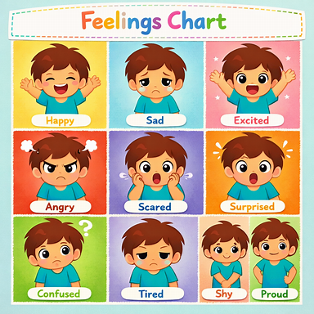
Task 1 — Act the Feeling
Listen to the feeling.
Act it without speaking:
• happy
• sad
• scared
• excited
Vocabulary: happy, sad, scared, excited, smiling, hiding, shaking

Slide 6
Task 2 — Match the Feeling
Match the sentence:
‘He was scared.’
with an action:
‘He hid behind the chair.’
Vocabulary: happy, sad, scared, excited, smiling, hiding, shaking

Slide 7
Task 3 — Feeling Chart
Complete together:
• happy → smiling
• scared → hiding
• excited → jumping
Vocabulary: happy, sad, scared, excited, smiling, hiding, shaking

Slide 8
Task 4 — Simple Writing
Write 1–2 sentences.
Show how the character in your story feels
Describing their actions or how they look.
Do not name the feeling ( show not tell).
Vocabulary: happy, sad, scared, excited, smiling, hiding, shaking

Slide 9
Plenary
What do you think about the personality of you character ( what they are like on the inside) ?
What makes you think that? Is there anything in the text to suggest that?
Vocabulary: quiet, loud, slow, fast, waiting, listening, worried

