Slide 1
Year 2
Narrative Unit of writing
Adaptable unit of lessons to suit any of the recommended reading texts

Slide 2
Year 2 — Lesson 2: Setting Analysis
Focus: Looking closely at settings in stories.

Slide 3
Success Criteria
• I can talk about a setting.
• I can use sense words.
• I can write a simple sentence about a place.

Slide 4

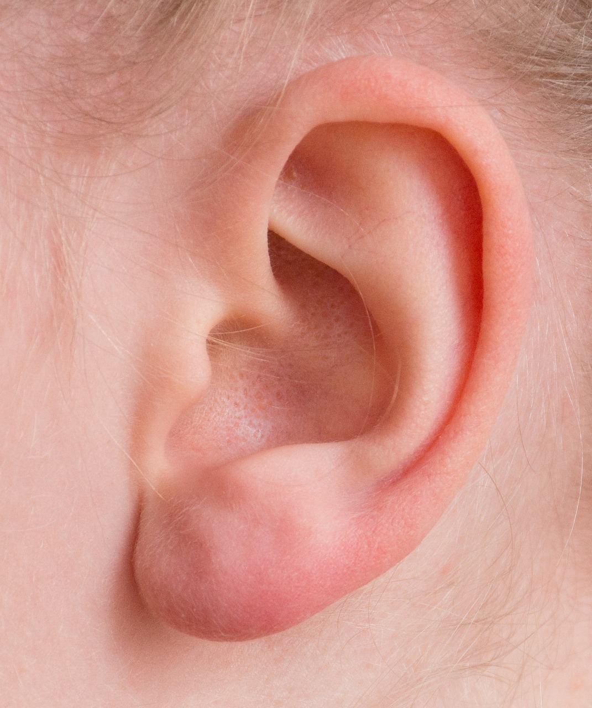
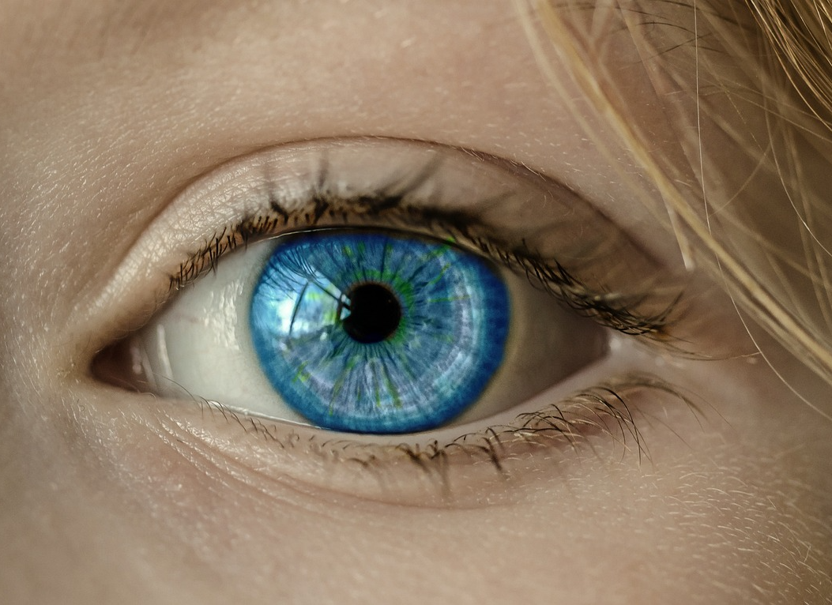
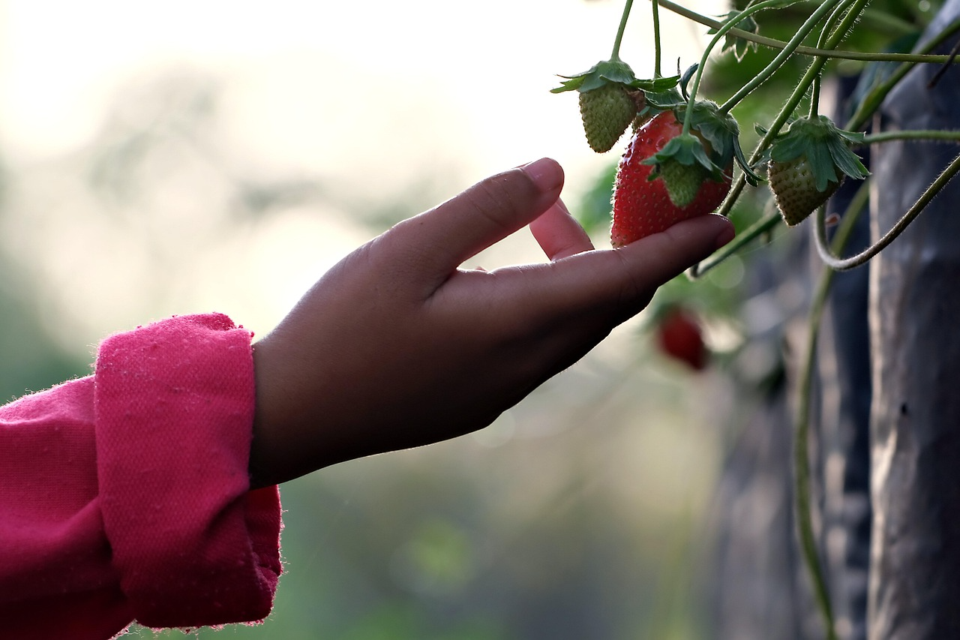
Our focus
Writers look carefully at places in stories.
They notice what they can see, hear, and feel.
Today we will look closely at a setting together.

Slide 5
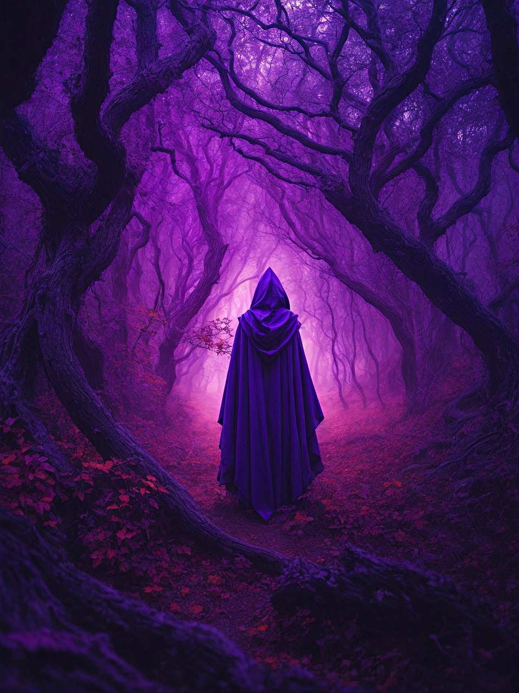
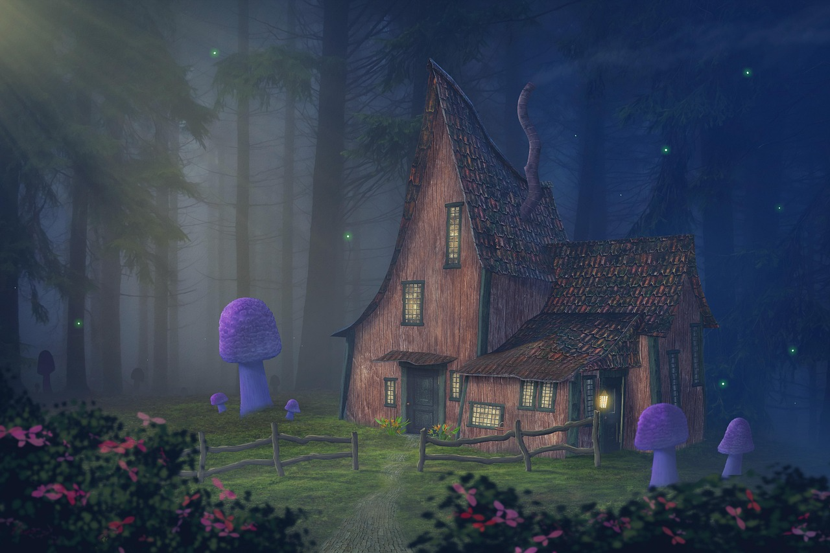

Task 1 — Explore a Setting
Listen to or read a short story opening
( your chosen title).
Look at a picture of the setting.
Talk about what you notice.
Vocabulary: see, hear, feel, quiet, loud, dark, bright

Slide 6
Task 2 — What Can You Notice?
Say a sentence for each:
• I can see…
• I can hear…
• I can feel…
Vocabulary: see, hear, feel, quiet, loud, dark, bright

Slide 7
Task 3 — Match the Words
Draw a picture of the setting in your story. Match words to the picture:
• quiet / loud
• dark / bright
• soft / hard
Vocabulary: see, hear, feel, quiet, loud, dark, bright

Slide 8
Task 4 — Simple Writing
Write 1–2 sentences about the place.
Use at least one sense word.
Vocabulary: see, hear, feel, quiet, loud, dark, bright

Slide 9
Plenary
Did the senses help you when you created the description of the setting? How did they help you ?
If I read your description , will I be able to imagine the place in my head ?
Vocabulary: quiet, loud, slow, fast, waiting, listening, worried

