Slide 1
Year 2
Narrative Unit of writing
Adaptable unit of lessons to suit any of the recommended reading texts

Slide 2
Year 2 — Lesson 1: Hook & Immersion
Focus: Entering the story world and exploring atmosphere.

Slide 3
Success Criteria
• I can describe what I notice.
• I can use my senses.
• I can choose words that match the mood.

Slide 4
Our focus
Before writers begin a story, they explore the world it takes place in.
Today we are stepping into a new setting.
We are not writing yet — we are noticing, imagining, and feeling.

Slide 5
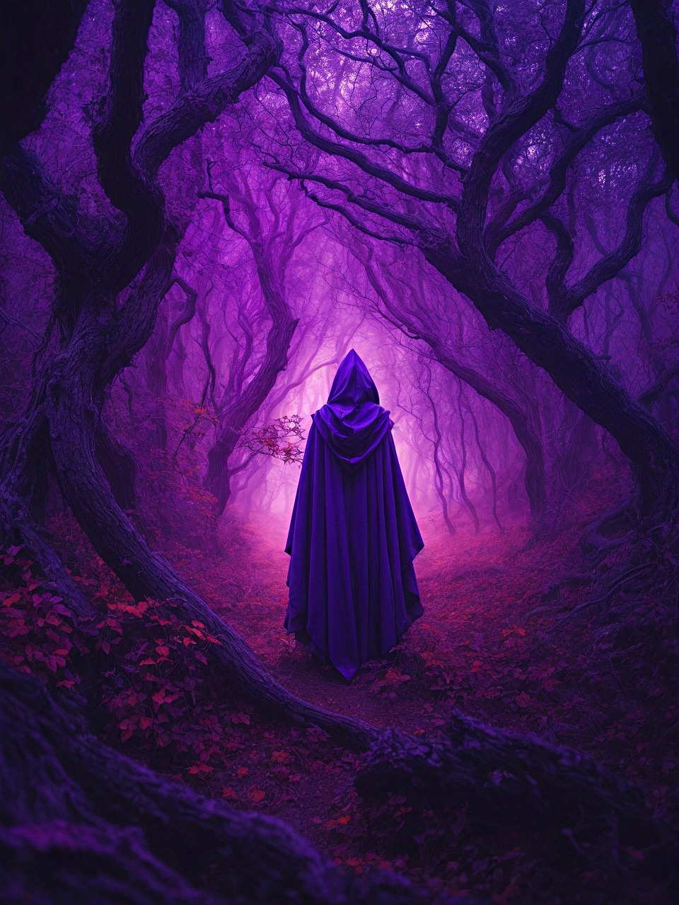
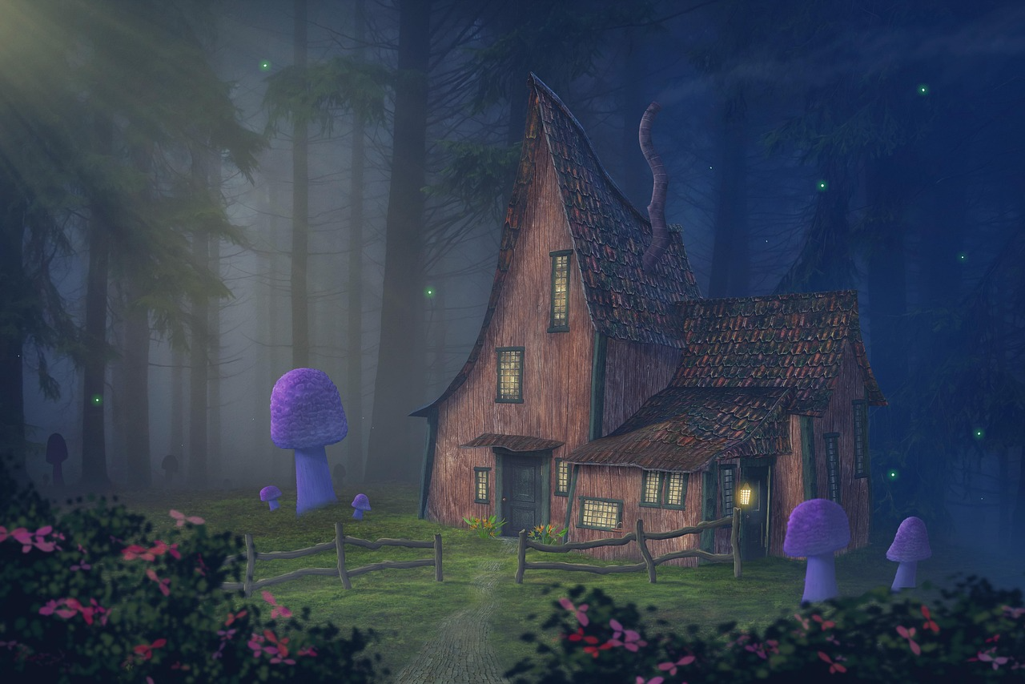
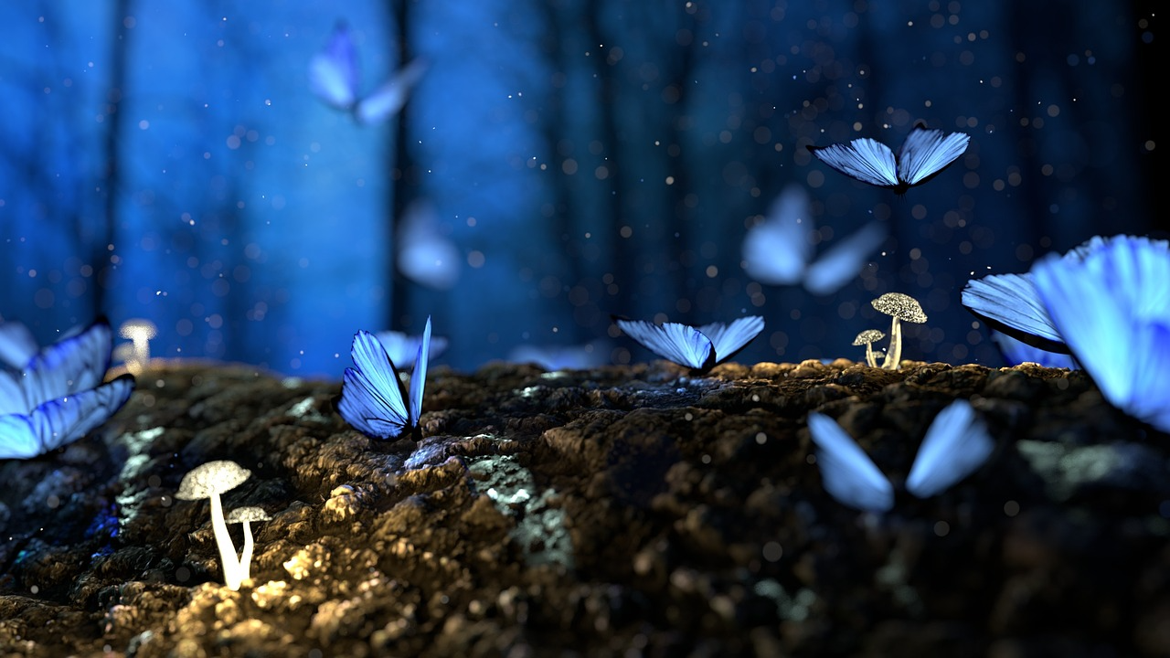
Task 1 — Story World Experience
Choose one:
• Read the opening of your chosen story
• Look at an image of a forest, night sky, or mysterious place.
Talk about:
‘What does this place feel like? Safe? Strange? Exciting?’
Vocabulary: dark, quiet, soft, glowing, rustling, tiny, huge

Slide 6
Task 2 — Noticing Grid
Complete the grid:
• I can see…
• I can hear…
• I can smell…
• This place feels…
Vocabulary: dark, quiet, soft, glowing, rustling, tiny, huge

Slide 7
Task 2 — Noticing Grid
Sense involved | Describe | Why do you feel… Any other detail
I can see
I can hear
I can smell
It feels like …
Vocabulary: dark, quiet, soft, glowing, rustling, tiny, huge

Slide 8
Task 3 — Vocabulary Collection
Collect interesting words that match the mood.
Use pictures, talk, and teacher help.
Vocabulary: dark, quiet, soft, glowing, rustling, tiny, huge

Slide 9
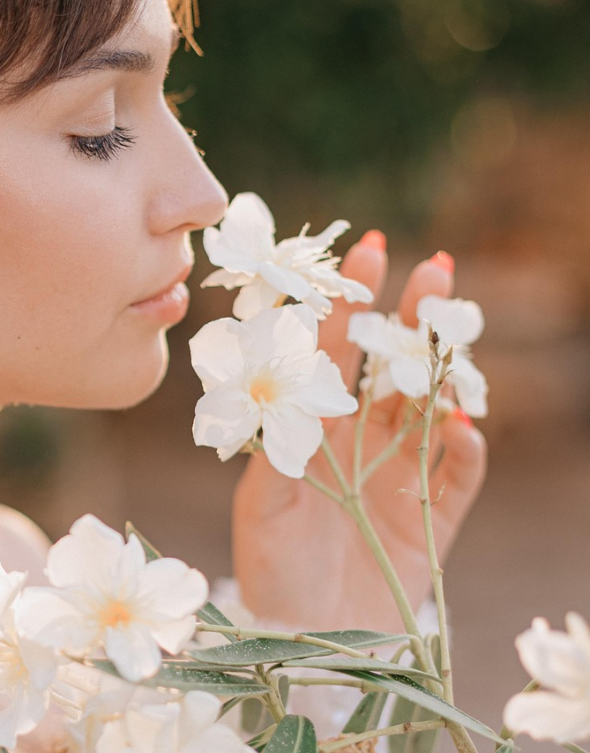
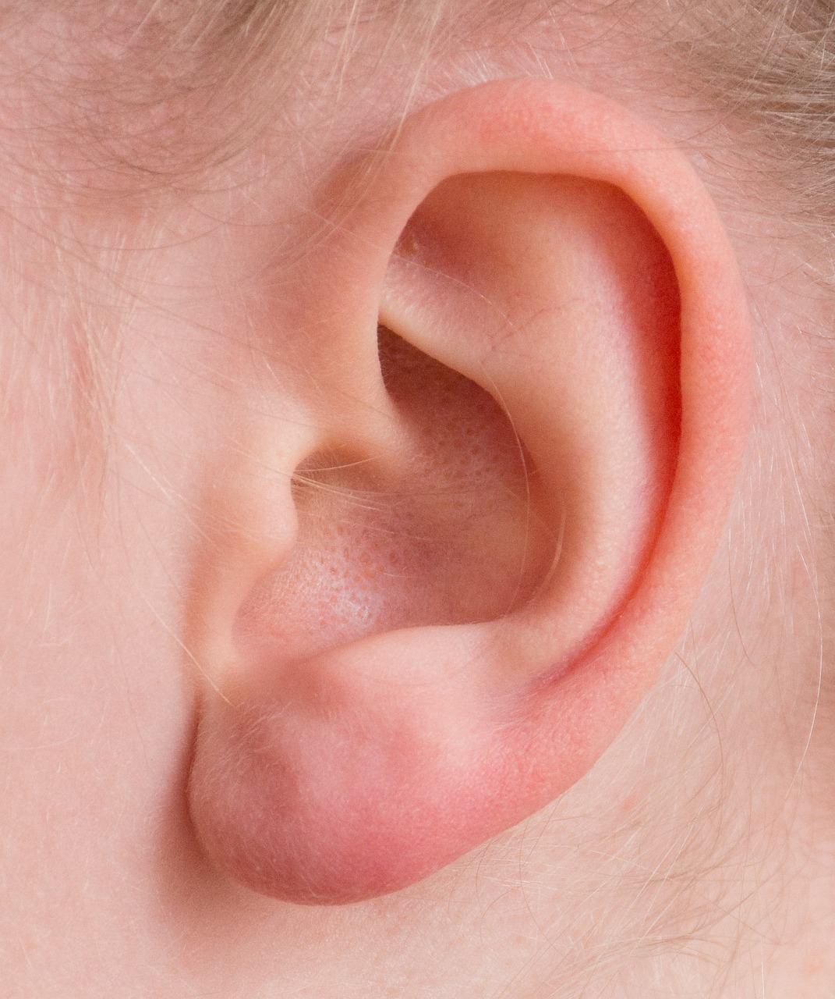
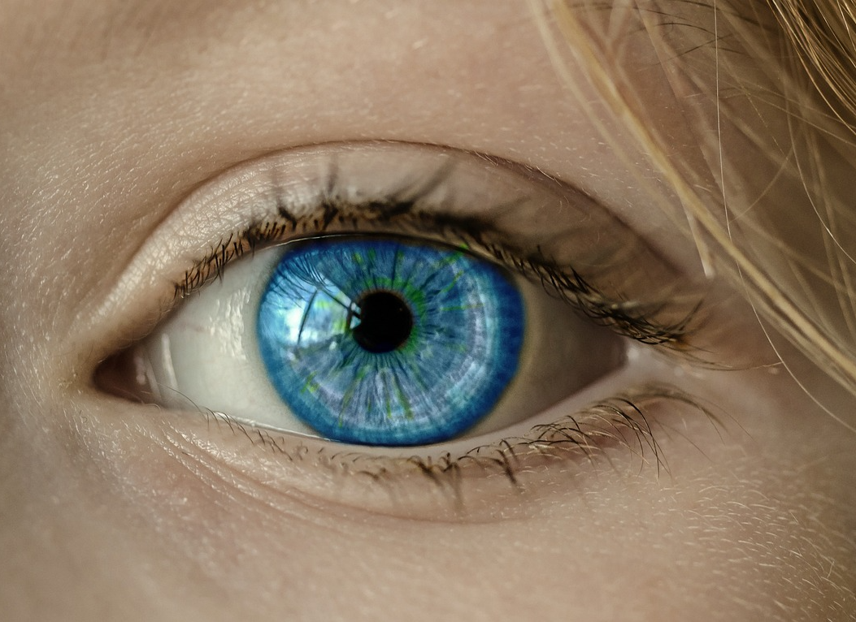
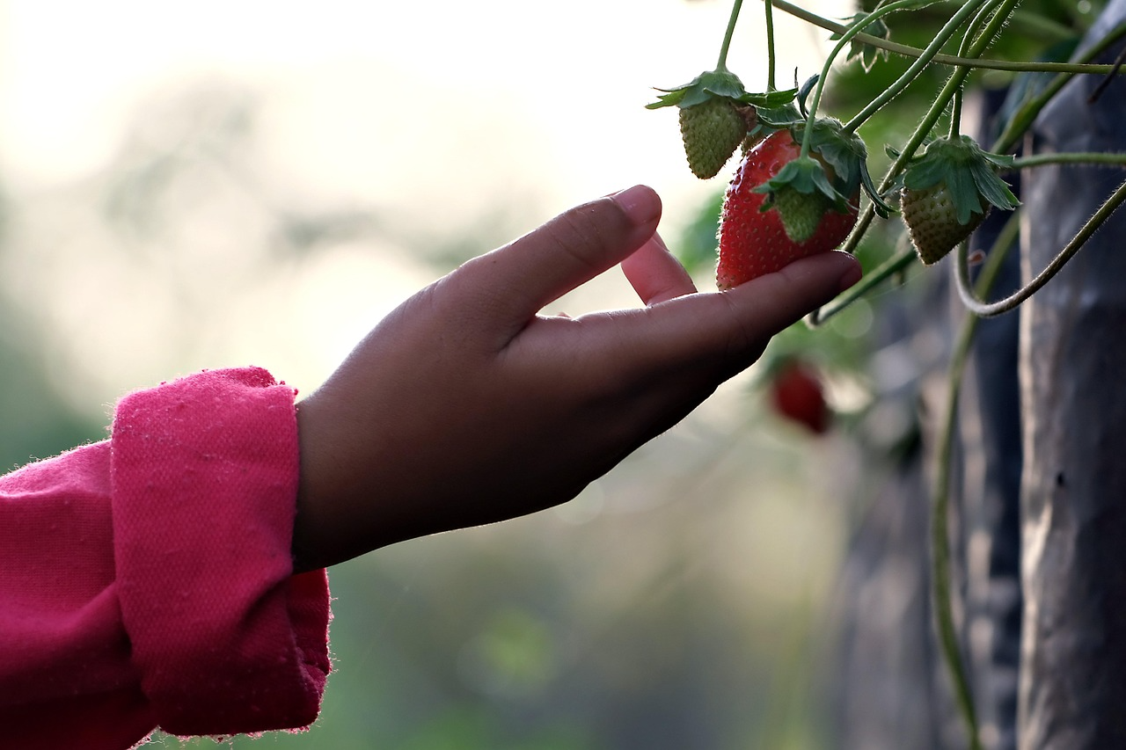
Task 4 — Quick Write (2–3 sentences)
Write 2–3 sentences to describe the setting.
Use your senses to help you.
Vocabulary: dark, quiet, soft, glowing, rustling, tiny, huge

Slide 10
Plenary
Why is the story set there ?
Why do you think the author choose exactly that place?
Vocabulary: quiet, loud, slow, fast, waiting, listening, worried

