Slide 1
Year 5 SPaG
Autumn Term – Lesson 3
Modal Adverbs

Slide 2
Learning Objective
Use modal adverbs to show how certain something is.

Slide 3
Success Criteria
I can identify modal adverbs.
I can choose the correct modal adverb.
I can explain how modal adverbs change meaning.

Slide 4
Key Vocabulary (with definitions)
Modal adverb – an adverb that shows how likely something is.
Possibly – it might happen, but it is not certain.
Probably – it is more likely to happen.
Certainly – it will happen; no doubt.
Certainty – how sure the writer or speaker is.

Slide 5
Do Now – Retrieval
Circle the modal adverb:
She will probably arrive late.
Which shows the most certainty?
possibly / probably / certainly

Slide 6
Teacher Explanation
Modal adverbs add extra meaning to a sentence.
They show how sure the writer is.
They often come before the verb or at the start of a sentence.

Slide 7
Teacher Modelling
The team will win the match.
The team will possibly win the match.
The team will certainly win the match.
Discuss how the meaning changes.

Slide 8
Guided Practice
1. It will certainly rain tomorrow. (to reflect a small chance)
2. She will possibly pass the test. (to reflect very sure)
3. He will probably be on time. (to reflect not sure at all)
✅ Corrected:
1. It will possibly rain tomorrow.
2. She will certainly pass the test.
3. He will possibly be on time.

Slide 9
Independent Practice – Full Task
Rewrite each sentence using the best modal adverb:
1. We will ___ go on the school trip. (almost sure)
2. She will ___ forget her homework. (not sure)
3. The test will ___ be difficult. (very sure)
4. It will ___ snow tonight. (small chance)
5. He will ___ win the race. (likely)
6. The bus will ___ arrive late. (almost certain)
7. I will ___ need help with this task. (possible)
8. They will ___ finish on time. (likely)

Slide 10
Independent Practice – Answers
1. We will probably go on the school trip.
2. She will possibly forget her homework.
3. The test will certainly be difficult.
4. It will possibly snow tonight.
5. He will probably win the race.
6. The bus will certainly arrive late.
7. I will possibly need help with this task.
8. They will probably finish on time.

Slide 11

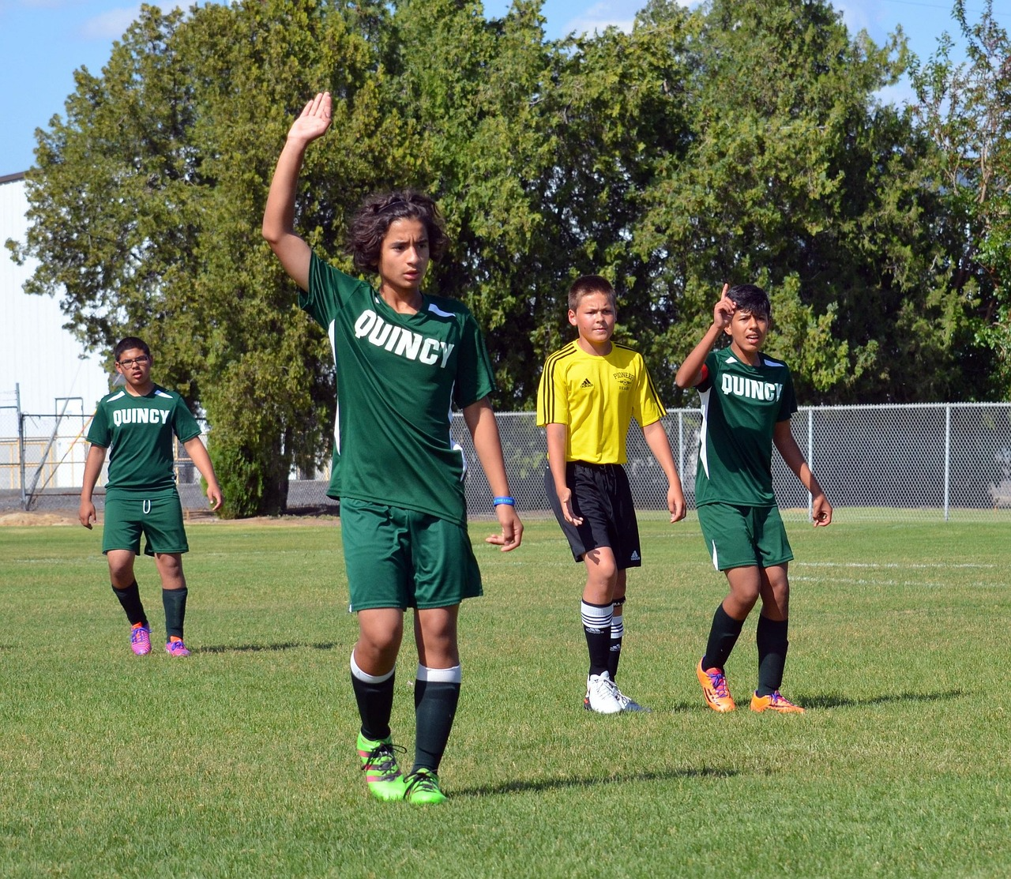
Paragraph Application
Write a short prediction paragraph about a school event.
Use at least 3 different modal adverbs.
Underline each modal adverb.

Slide 12
Exit Quiz
Which is strongest: possibly or certainly?
Add a modal adverb:
The class will win.
Why do writers use modal adverbs?

Slide 13
Exit Quiz – Answers
Certainly.
The class will probably / certainly win.
They show how certain the writer is.

