Slide 1

Formal and Informal Tone Choices – Year 4
(Full Unit Slide Deck)
A complete unit of lessons teaching pupils to recount the same event in different forms, choosing language and tone to suit audience and purpose. Teacher narration appears in lighter blue italics. Modelled examples include embedded teacher thinking.

Slide 2
Unit Outcomes
Compare how the same event is recounted differently for different audiences.
Select formal or informal vocabulary and relevant details to suit a chosen audience.
Use direct speech and reported speech appropriately in different recount forms.
Write two contrasting openings for the same event, using tone to suit audience and purpose.
Write and edit a recount that deliberately matches a chosen audience and purpose.
Organise ideas into clear paragraphs using fronted adverbials for cohesion.
Grammar focus: fronted adverbials, direct speech punctuation, reported speech, and pronoun choice.

Slide 3
Lesson 1: Comparing a Diary and Newspaper Recount
Learning Objective
To compare how the same event is recounted differently for different audiences.

Slide 4
Lesson 1: Comparing a Diary and Newspaper Recount
Success Criteria
I can identify features of a diary and a newspaper recount.
I can explain how language choices affect tone.
I can sort examples of formal and informal language into a comparison chart.

Slide 5
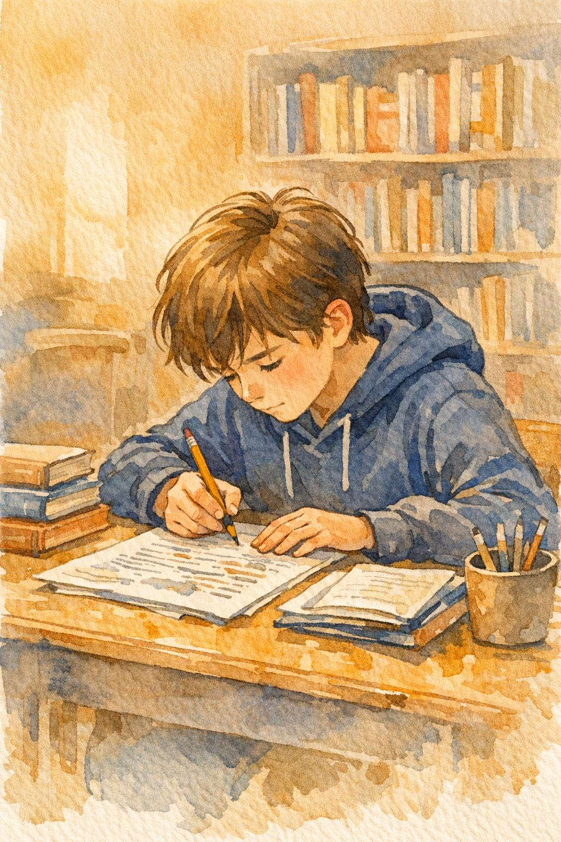
Lesson 1: Comparing Recounts – Our Focus Today
This week we are going to become experts at making writing sound right for its reader.
The same event can be retold in more than one way. If I write in a diary, I sound personal and honest, almost as if I am talking to myself. If I write for a newspaper, I sound more formal and factual because I am informing the public.
Today I want you to notice that writers do not just change a few words; they also change what details they include, the pronouns they choose and the overall tone.

Slide 6
Lesson 1: Comparing Recounts – Vocabulary
formal – language that sounds serious, polite and suitable for a wide audience
informal – language that sounds chatty, relaxed and personal
audience – the person or people who will read or hear the writing
purpose – the reason a text has been written
diary – a personal written record of thoughts and events
newspaper report – a factual account of an event written for the public
tone – the mood or feeling created by the writer’s language choices
recount – a text that retells events in the order they happened
personal – relating to one person’s own thoughts and feelings
factual – based on facts rather than opinions or feelings

Slide 7
Lesson 1: Comparing Recounts
Modelled Example
Two recounts of the Greenfield Pond event:
Diary version:
“I could hardly believe what happened at Greenfield Pond today! When I got to school, everyone was talking about it. The diggers had arrived and the pond was being drained. I felt sick.”
Newspaper version:
“Pupils at Brookton Primary were surprised yesterday when work began to drain Greenfield Pond. The council confirmed that forty new homes will be built on the site.”
In the diary, the first person pronoun I and the exclamation mark make the tone personal and immediate. In the newspaper version, the naming of the school and the past time phrase make it sound more formal and report-like.

Slide 8
Lesson 1: Comparing Recounts – Guided Example
Diary Version
“I could hardly believe what happened at Greenfield Pond today! When I got to school, everyone was talking about it. The diggers had arrived and the pond was being drained. I felt sick. I kept thinking about the frogs and the dragonflies. Nobody even asked us what we thought.”
Newspaper Version
“Pupils at Brookton Primary were surprised yesterday when work began to drain Greenfield Pond. The council confirmed that forty new homes will be built on the site. A spokesperson said the project would bring much-needed housing to the area.”
Comparing Recounts Together
Read each recount together and highlight evidence for tone. Complete a comparison chart with these headings:
Audience • Purpose • Pronouns • Language choices • Overall effect
“Would this detail matter to a friend reading a diary, or to the wider public reading a newspaper?”
Co-construct: Diary – personal pronouns, exclamation marks, feelings, informal vocabulary. Newspaper – third person, past time phrases, factual details, formal vocabulary.

Slide 9
Lesson 1: Comparing Recounts – Independent Task
Diary Version
“After school, I ran straight to the pond. The water was already half gone and the mud smelled horrible. I wanted to cry. Mum said it would be all right, but I do not believe her. That pond was the best place in the whole village.”
Newspaper Version
“Work to drain Greenfield Pond continued on Tuesday afternoon. A spokesperson for the building company said the project was on schedule. Local wildlife groups have been consulted about relocating protected newts from the site.”
Work in Pairs
Read the extracts above and complete your own comparison chart. Use these headings:
Audience • Purpose • Pronouns • Language choices • Overall effect
Underline informal phrases in the diary version.
Circle formal words in the newspaper version.
Challenge: Explain which details were included in one version but left out of the other and why that suits the audience.
Remember: The same event sounds different depending on who the writer is talking to and why.

Slide 10
How Tone Changes for Audience and Purpose
Our display list – add your ideas!
Share one difference you noticed between the two recount forms and explain how it changes the reader’s experience.
Listen to your partner’s ideas – can we add anything new to the list?
Be ready to explain: How does changing the audience change the way we write?
Remember: This list will guide your writing for the rest of the unit. Keep it visible – we will return to it in every lesson.
Next lesson: We will choose vocabulary and details to suit different audiences.

Slide 11
Lesson 2: Choosing Vocabulary and Details for Different Audiences
Learning Objective
To select formal or informal vocabulary and relevant details to suit a chosen audience.

Slide 12
Lesson 2: Choosing Vocabulary and Details
Success Criteria
I can sort words and phrases by tone.
I can explain which details suit a diary and which suit a newspaper report.
I can build a vocabulary bank to support my writing.

Slide 13

Lesson 2: Choosing Vocabulary – Our Focus Today
Good writers make choices before they write.
They think: Who is reading this? What do they need to know? How should it sound?
Today we are going to collect words and phrases that belong to different tones.
Some language sounds chatty, emotional and personal. Other language sounds calm, precise and factual.
We will also decide which details matter most to different readers because not every recount includes everything.

Slide 14
Lesson 2: Choosing Vocabulary – Key Terms
vocabulary bank – a collection of useful words and phrases organised by purpose
audience – the person or people who will read or hear the writing
purpose – the reason a text has been written
formal – language that sounds serious and suitable for a wide audience
informal – language that sounds chatty, relaxed and personal
precise – exact and carefully chosen
emotive – language that creates a strong feeling in the reader
recount – a text that retells events in the order they happened
witness – a person who saw an event happen
headline – the title that summarises a newspaper report

Slide 15
Lesson 2: Choosing Vocabulary
Modelled Example
Let’s sort these phrases under two headings: informal diary and formal newspaper.
Informal: “I was so worried”, “it was horrible”, “I could not stop thinking about it”
Formal: “residents reported”, “shortly after midday”, “the event took place”
“I was so worried” - sounds natural in a diary but too emotional for a newspaper. “Residents reported sounds “ - formal and factual – it would not belong in a personal diary.
The same shift works with detail choices: a diary includes feelings and reactions; a newspaper includes time, place and key facts.

Slide 16
Lesson 2: Choosing Vocabulary – Guided Example
Which details would be most important in each form?
For a diary about Greenfield Pond, you may choose: feelings about the pond, favourite memories of visiting, personal reactions to the news.
For a newspaper report, they may choose: when the decision was made, who made it, how many homes will be built, what happens next.
Let’s model turning a plain note into two versions:
Plain: We heard about the pond.
Diary: When Mum told me about the pond, I felt a lump in my throat.
Newspaper: The council confirmed the decision on Thursday afternoon.
Discuss: Which version sounds personal? Which sounds factual? What changed?

Slide 17
Lesson 2: Choosing Vocabulary – Independent Task
Your task:
Sort the prepared vocabulary cards into two sections: formal and informal.
Then create your own vocabulary bank with possible fronted adverbials, useful verbs and details for each audience.
Choose a moment from the Greenfield Pond event and note which details you would include for a diary and which for a newspaper report.
⭐ Challenge: Write one pair of contrasting sentences using your vocabulary bank – one diary-style and one newspaper-style.
Sort these words and phrases into formal or informal
confirmed • gutted • residents • dead upset • a spokesperson said • I couldn’t believe it • approximately • loads of • construction commenced • it was horrible • relocated • ran straight there • expressed concern • the best place ever • local authority • no one even cared • scheduled • really scary • significant • massive
Remember: Good writers choose their words before they write.

Slide 18
Lesson 2: Choosing Vocabulary – Plenary
Share and Discuss
Read aloud one pair of contrasting sentences from your vocabulary bank.
The class checks whether the tone is clear and suggests small improvements where needed.
Discussion: Which words made the biggest difference between formal and informal?
Could you hear the difference in tone when your partner read their sentences aloud?
Next lesson: We will learn how to use direct speech and reported speech in our recounts.
Reflection
Writers choose different words and details depending on who they are writing for and why.
Key idea: Writers choose different words and details depending on who they are writing for and why.
Next lesson: We will learn how to use direct speech and reported speech in our recounts.

Slide 19
Lesson 3: Using Direct Speech and Reported Speech in Recounts
Learning Objective
To use direct speech and reported speech appropriately in different recount forms.

Slide 20

Lesson 3: Direct and Reported Speech – Our Focus Today
Speech helps a recount feel lively and believable, but writers do not always use it in the same way.
In a diary, direct speech can make a moment feel immediate, as if the reader is hearing it happen.
In a newspaper report, reported speech often sounds more formal and concise.
Today we are learning how to use both types of speech correctly and how to choose the one that best matches our purpose.

Slide 21
Lesson 3: Direct and Reported Speech – Vocabulary
direct speech – the exact words someone said, shown inside inverted commas
reported speech – retelling what someone said without using their exact words
inverted commas – the punctuation marks that go around spoken words
speaker – the person who said the words
punctuation – marks such as full stops, commas and speech marks that help the reader
formal – language that sounds serious and suitable for a wide audience
informal – language that sounds chatty, relaxed and personal
witness statement – what a person who saw an event says about it

Slide 22
Lesson 3: Direct and Reported Speech
Modelled Example
“Look out!” shouted Mia.
This is direct speech. It tells you the exact words spoken by Mia and the reporting clause to clarify who is speaking
The sentence can be changed into reported speech:
Mia shouted for everyone to look out.
Both sentences share the same information, but the direct speech sounds dramatic and immediate, while the reported speech sounds smoother and more formal.
Now with Greenfield Pond:
Direct: “They cannot drain our pond!” cried one resident angrily.
Reported: One resident said that the pond should not be drained.

Slide 23
Lesson 3: Direct and Reported Speech – Guided Practice
Let’s transform these Greenfield Pond sentences into both forms:
Direct: “We are very excited about the new homes,” said the developer.
Reported: The developer said that they were very excited about the new homes.
Direct: “I will miss the frogs,” whispered Sam sadly.
Reported: Sam whispered sadly that he would miss the frogs.
Discuss together:
Which version sounds better in a diary?
Which fits a newspaper report?
How do pronouns change when we move from direct to reported speech?
Where could you add a fronted adverbial before one of these sentences?

Slide 24
Lesson 3: Direct and Reported Speech – Guided Example
With a partner, practise transforming these sentences:
Direct: “This is the worst day ever,” I muttered to myself.
Reported version: ___
Direct: “The building work will begin next month,” announced the councillor.
Reported version: ___
Now try the other way:
Reported: The wildlife warden explained that the newts would need to be moved carefully.
Direct version: ___
Discuss: Which form sounds more personal? Which sounds more factual?
Think about: How did the pronouns change? Did the tense shift?
Remember: Direct speech uses inverted commas and needs careful punctuation.
Reported speech changes pronouns and sometimes the tense.

Slide 25
Lesson 3: Direct and Reported Speech – Independent Task
Your task:
Complete sentence practice: punctuate direct speech correctly, match direct and reported versions, and rewrite short sentences from one form into the other.
Then write two or three sentences about the Greenfield Pond event:
One diary-style sentence using direct speech.
One newspaper-style sentence using reported speech.
Challenge: Embed a fronted adverbial before one of your sentences.
Remember:
Direct speech uses inverted commas and needs careful punctuation.
Reported speech changes pronouns and sometimes the tense.

Slide 26
Lesson 3: Direct and Reported Speech – Plenary
Share and Compare
Hold up or read out a pair of matching speech sentences.
The class identifies which one sounds more formal and explains why.
Discussion:
When would you choose direct speech in your writing?
When would reported speech be a better choice?
Key idea:
Direct speech makes a recount feel immediate and dramatic. Reported speech makes it sound smoother and more formal. Good writers choose deliberately.
Next lesson: We will write two contrasting openings for the same event – one as a diary and one as a newspaper report.

Slide 27
Lesson 4: Shared Writing of Two Contrasting Openings
To write two contrasting openings for the same event, using tone to suit audience and purpose.

Slide 28

Lesson 4: Contrasting Openings – Our Focus Today
Today we are putting our learning together.
We are going to write two openings about exactly the same event, but each one will sound different because the audience is different.
I need to think carefully about how to begin. A diary opening may begin with a feeling or reaction, while a newspaper opening often begins with key facts.
Even though the event is the same, the writer’s choices will make each paragraph feel different.

Slide 29
Lesson 4: Contrasting Openings – Vocabulary
opening – the first sentence or paragraph of a piece of writing
audience – the person or people who will read or hear the writing
purpose – the reason a text has been written
paragraph – a group of sentences about one idea or point
tone – the mood or feeling created by the writer’s language choices
first person – writing from the I perspective
third person – writing about someone using he, she or they
fronted adverbial – a word or phrase at the start of a sentence that tells when, where or how
recount – a text that retells events in the order they happened

Slide 30
Lesson 4: Contrasting Openings
Modelled Diary Opening
Let’s look at this diary recount together:
Yesterday was one of the worst days I can remember. When I walked past Greenfield Pond on the way to school, I saw the fences going up and the diggers parked on the grass. My stomach dropped. I wanted to shout at someone, but I did not know who.
Notice how I used first person – I saw, my stomach, I wanted.
The exclamation of emotion and the personal reaction make this sound like a real diary. The reader feels what I felt.
Key choices: first person voice, emotional response, personal detail, informal tone.

Slide 31
Lesson 4: Contrasting Openings
Modelled Newspaper Opening
Let’s share-write a newspaper opening for the same event:
Residents near Greenfield Pond in Brookton were surprised on Monday morning when construction vehicles arrived at the site. The council confirmed that work would begin this week to drain the pond and prepare the land for forty new family homes.
This time I named the place, stated the time and focused on the event rather than my feelings.
The third person and factual tone make it sound like a formal report for the public.
Key changes: third person, factual details, formal vocabulary, no personal feelings.

Slide 32
Lesson 4: Contrasting Openings – Guided Example
Suggest improvements to both paragraphs.
Add a fronted adverbial to one opening:
Diary:
Early that morning, I walked past the pond and saw the fences... Choose a stronger verb: Replace saw with spotted or noticed. “They cannot do this!” I whispered to my friend.
Newspaper:
On Monday morning, residents near Greenfield Pond noticed... Choose a stronger verb: Replace said with announced or confirmed. A council spokesperson confirmed that the project had been approved.
Decide: should each opening include direct or reported speech?
Check: Does the diary remain personal? Does the newspaper remain factual and clear?

Slide 33
Lesson 4: Contrasting Openings – Independent Task
Your task:
Write your own paired opening paragraphs for the Greenfield Pond event:
Version 1 – Diary Opening
Use first person and personal reactions
Include feelings and sensory detail
Write as if you are talking to yourself at the end of the day
Version 2 – Newspaper Opening
Use third person and factual detail
Include time, place and key facts
Write as if you are informing the public
Challenge: Include a well-punctuated direct speech sentence in the diary and a reported speech sentence in the newspaper version.
Use your vocabulary bank from Lesson 2 to support your choices.

Slide 34
Lesson 4: Contrasting Openings – Plenary
Compare and Discuss
In pairs, compare your two openings and explain which choices created the different tones.
A few examples are shared with the class to identify successful contrasts.
Discussion: Which single word or detail made the biggest difference between your two versions?
Could your partner tell which was the diary and which was the newspaper? How?
Key Idea:
The same event can be written in very different ways. The audience and purpose guide every choice the writer makes.
Next lesson: You will write an independent final recount and edit it carefully for tone.

Slide 35
Lesson 5: Independent Final Write and Editing for Tone
Learning Objective
To write and edit a recount that deliberately matches a chosen audience and purpose.

Slide 36
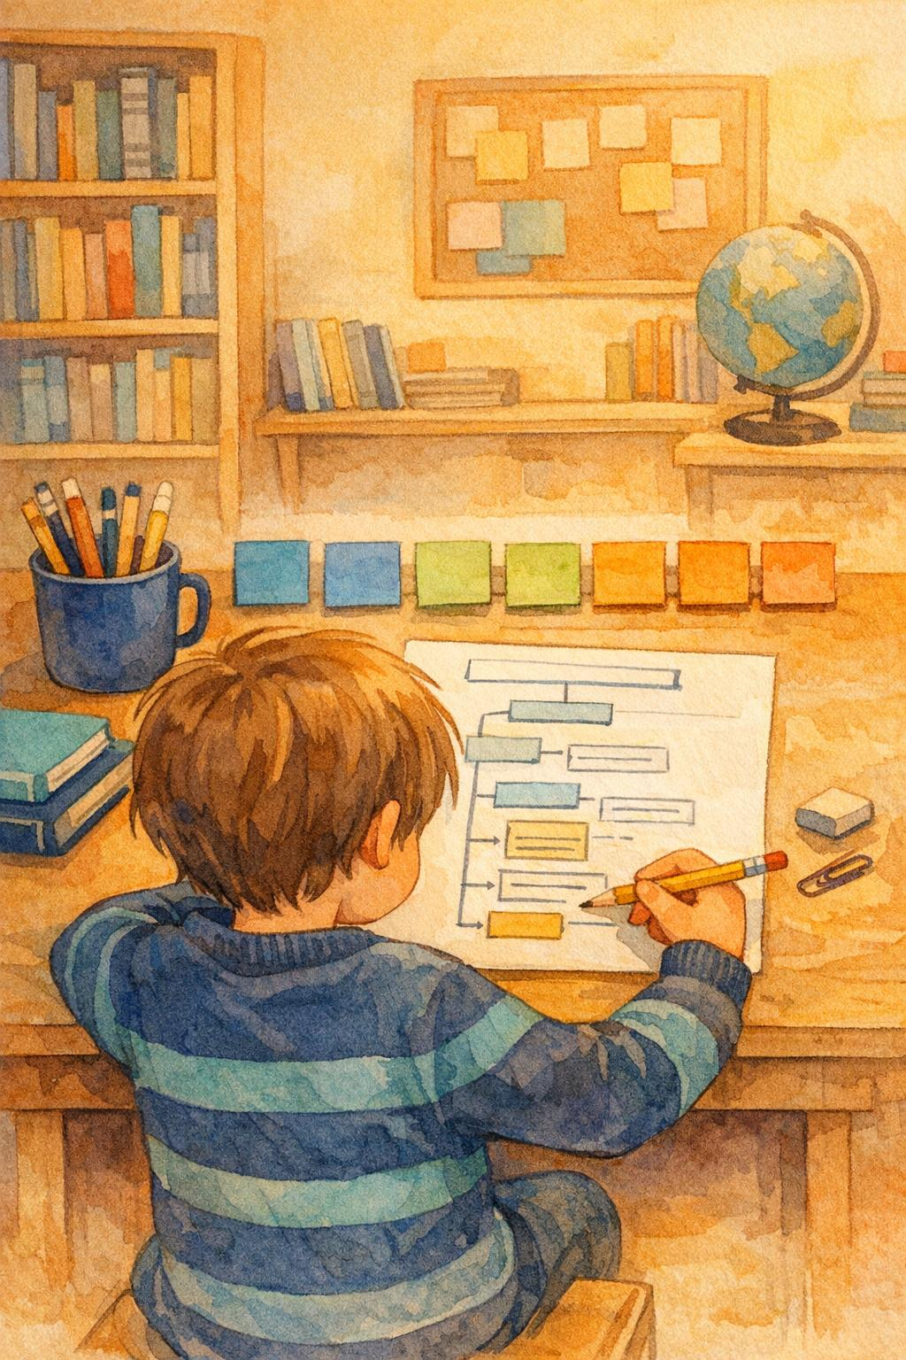
Lesson 5: Final Write and Editing – Our Focus Today
Today you are writing independently, so this is the point where all your choices matter.
Before I begin, I need to decide whether I am writing a diary or a newspaper recount.
That choice will affect my pronouns, my details, my vocabulary and the kind of speech I include.
After drafting, I must reread my work as an editor. I will check whether the tone stays consistent, whether my paragraphs are clear and whether my speech punctuation is accurate.

Slide 37
Lesson 5: Final Write and Editing
Success Criteria
I can sustain an appropriate formal or informal tone.
I can organise my recount into clear paragraphs.
I can use fronted adverbials and speech accurately when editing my work.

Slide 38
Lesson 5: Final Write
Modelled Planning and Editing
Now let’s revisit a planning frame:
What happened first? Which details matter most to this audience? Where could I include speech?
A short example paragraph:
Before: It was really bad and everyone was upset about the pond.
Diary version: I felt worried and shaky as I watched the water disappear.
Newspaper version: The incident caused concern among local residents.
Notice how I changed vague words into precise ones. Really bad became worried and shaky for the diary, and caused concern for the newspaper. Each version matches its audience.

Slide 39
Lesson 5: Editing Checklist
Use this checklist to guide your editing:
Pronouns: Have I used first person for a diary or third person for a newspaper consistently?
Paragraphing: Are my ideas organised into clear paragraphs?
Fronted adverbials: Have I used time or place adverbials to move the reader through the recount?
Speech punctuation: Is my direct speech punctuated accurately with inverted commas?
Details: Do the details I have included suit my chosen audience?
Tone: Does every sentence sound formal or informal to match my purpose?
Check each one systematically. Use coloured pencils to mark improvements.

Slide 40
Lesson 5: Final Write – Guided Example
Orally rehearse your first few sentences before you begin writing.
Say them aloud: do they sound right for your chosen form?
Check pronouns – are they consistent throughout? Check paragraphing – does each paragraph focus on one part of the event? Check fronted adverbials – have you used them to guide the reader through time? Check speech punctuation – are inverted commas in the right places? Check that details suit the audience – personal for diary, factual for newspaper.

Slide 41
Lesson 5: Final Write – Independent Task
Your task: Write a complete recount of the Greenfield Pond event in your chosen form – either a diary entry or a newspaper report.
After drafting, edit using coloured pencils or the editing checklist, focusing on:
Tone – does it stay consistent throughout?
Paragraphing – are ideas clearly organised?
Speech accuracy – is direct or reported speech used and punctuated correctly?
Fronted adverbials – have you used them to guide the reader?
If time allows, swap work with a partner for a brief peer check focused on whether the writing clearly sounds formal or informal.
Challenge: Write both versions – a diary entry and a newspaper report about the same event.

Slide 42
Lesson 5: Self-Assessment and Peer Check
Check Your Draft: Does my opening set the scene clearly for my chosen audience?
Is my recount organised in a logical time order with clear paragraphs?
Have I stayed in first person (diary) or third person (newspaper) throughout?
Have I included details that suit my audience – feelings for a diary, facts for a newspaper?
Have I used fronted adverbials to move the reader through the event?
Is my direct or reported speech punctuated accurately? Does my ending leave the reader understanding what happened and why it mattered?
Highlight one place where your tone is particularly clear and effective.

Slide 43
Lesson 5: Final Reflection
Complete the sentence: I chose this tone because....
Read a short section of your recount aloud.
Your partner listens for clear evidence of deliberate tone choice.
Discussion: Can your partner tell whether the writing is a diary or a newspaper report? What gave it away? Which choices did you make deliberately to match your audience and purpose?
Key idea: Good writers control their tone by choosing pronouns, vocabulary, details and speech forms that suit their reader. The same event can sound completely different depending on who you are writing for..

