Slide 1
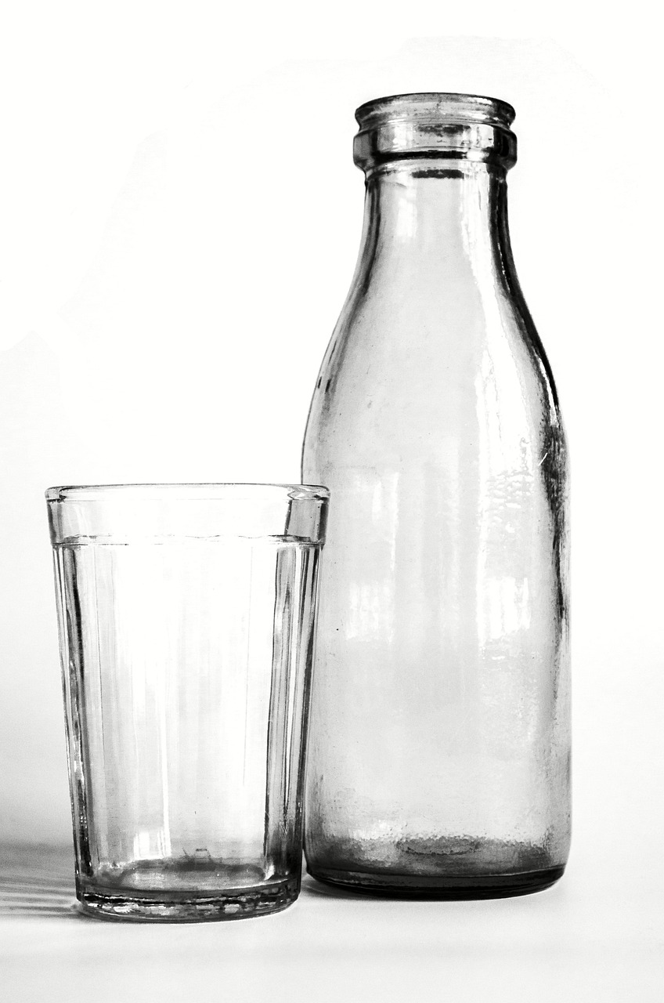
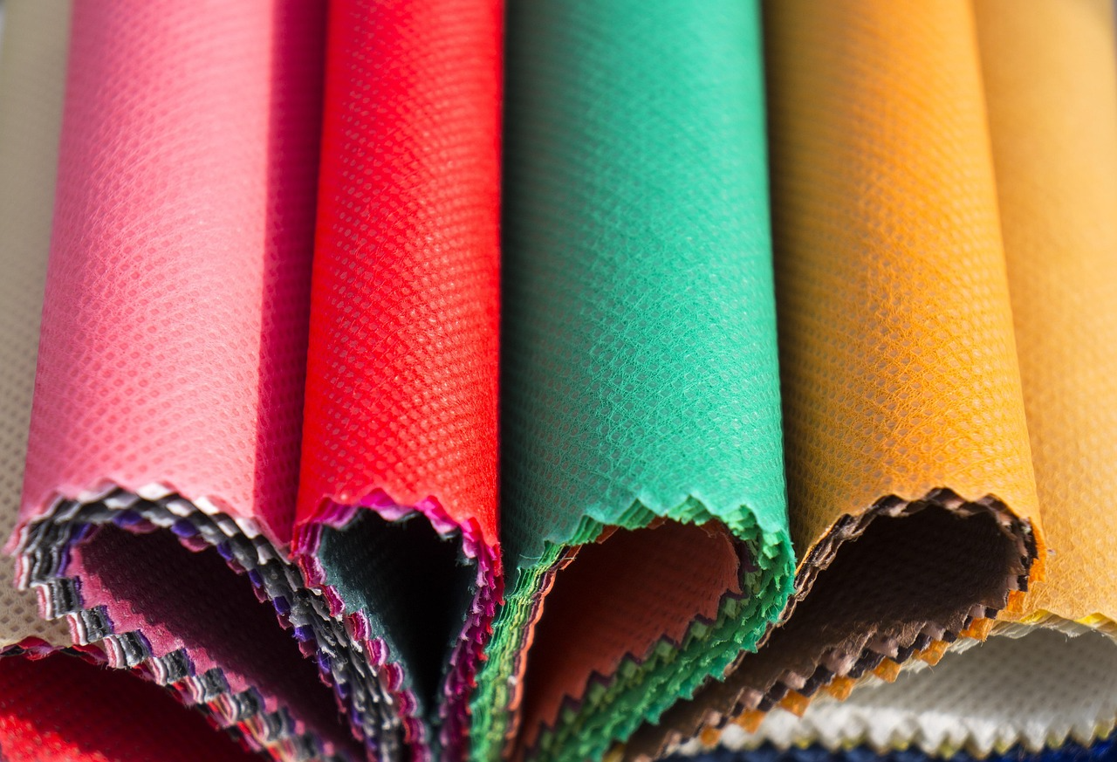

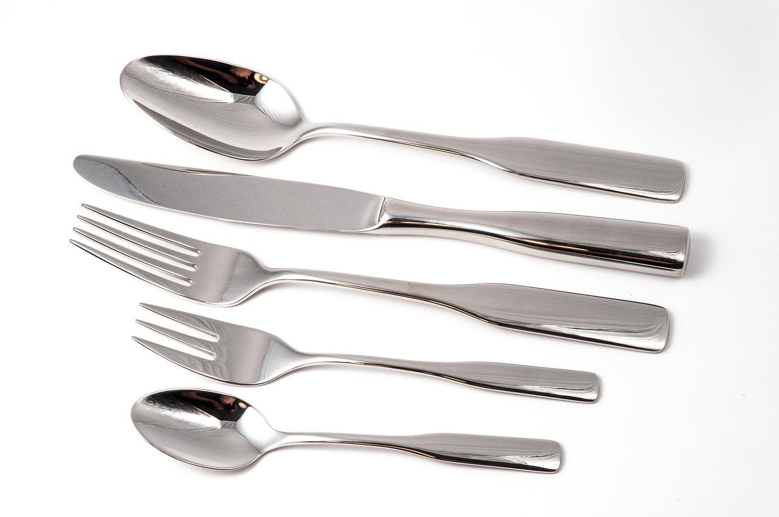
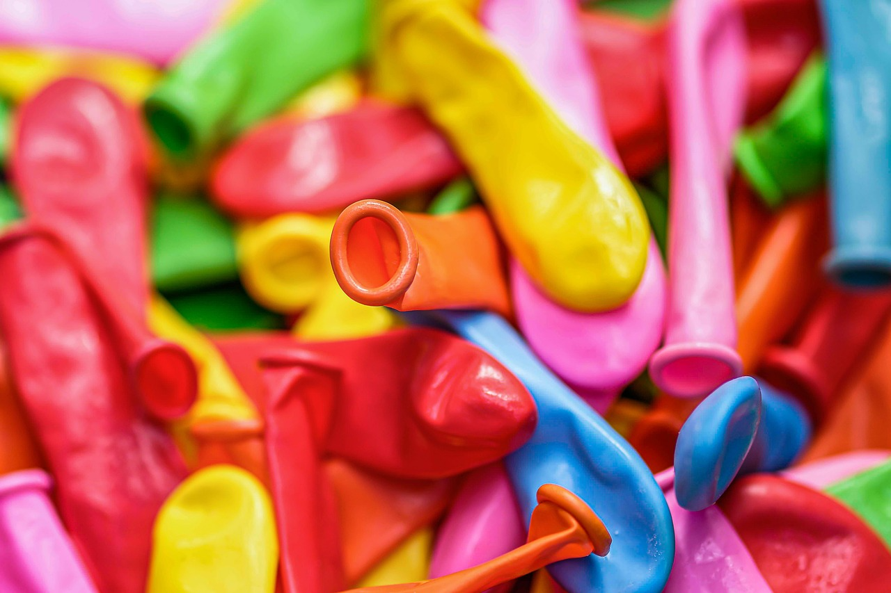
Year 2 Science – Uses of Everyday Materials
In this unit we will need some everyday items made of various materials:
metal, glass, plastic, fabric, paper, rubber
Notes:
Introduce the unit. Remind: object = the thing; material = what it is made from. Use pictures to prompt quick oral responses.

Slide 2
Year 2 Science – Uses of Everyday Materials
In this unit we will…
• Identify and name everyday materials
• Describe and compare properties
• Group materials in different ways
• Choose the best material for a job
• Do a simple test and record results
Notes:
Introduce the unit. Remind: object = the thing; material = what it is made from. Use pictures to prompt quick oral responses.

Slide 3
Knowledge Organiser
Sticky Knowledge
• Objects are made from materials
• Materials have properties
• We can group materials by properties
• Some materials are better for certain jobs
• We can do simple tests and record results
Key Vocabulary
material, object, wood, plastic, metal, glass, rock, water
hard, soft, smooth, rough, bendy, stiff
waterproof, absorbent
compare, group, suitable, purpose
observe, test, result, record
Working Scientifically
• Ask questions
• Observe closely
• Perform simple tests
• Record results
• Use results to answer questions
Misconceptions
• Object and material are not the same
• Groupings can be different and still correct
• Waterproof means water does not soak through
Notes:
Revisit this slide each lesson. Keep key words visible and encourage pupils to use them in full sentences.

Slide 4
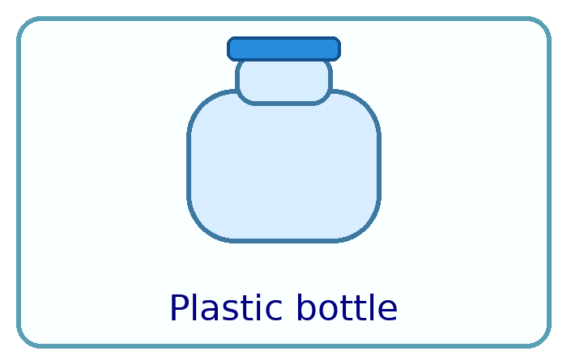
Lesson 1: What are objects made from?
WALT
To identify and name a variety of everyday materials.
Key Vocabulary
material, object, wood, plastic, metal, glass, rock, water
WILF (Success Criteria)
• I can name common materials.
• I can say what an object is made from.
• I can use the words object and material correctly.
Talk Partner Questions
• What is the object?
• What is it made from?
• Can one object be made from more than one material?
Notes:
Explain WALT/WILF. Quick pre-teach: say the word, show the picture/object, pupils repeat.

Slide 5

Lesson 1 Starter
Do Now / Retrieval
Show 3 objects. Say the object name and the material.
Talk partner: “This is a ___. It is made from ___.”
Teacher prompts
• Tell me all that you know about each item and what they are made of
• Make sure to use full sentences
Notes:
Keep the starter short and punchy. Use it as retrieval and confidence-building.

Slide 6
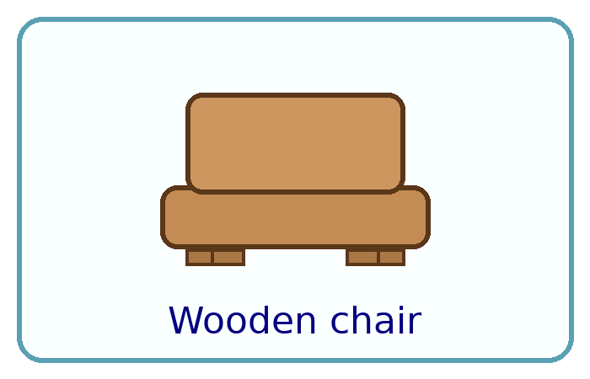
Lesson 1 Teaching Steps
Listen carefully…
• Today we are learning about materials.
• An object is the thing you can hold.
• A material is what the object is made from.
• Listen: “The object is a spoon. The material is metal.”
• You will use these words when you sort objects.
Key words
material, object, wood, plastic, metal, glass, rock, water
Notes:
Teacher tasks (in notes):
Step 1: Model object vs material with 2 items. Step 2: Guided sort 6–8 items; label groups. Step 3: Independent sort + table recording. Checks: cold call, mini-whiteboards, repeat key sentence.
Tip: After each bullet, ask pupils to repeat the sentence back or answer a quick question.

Slide 7
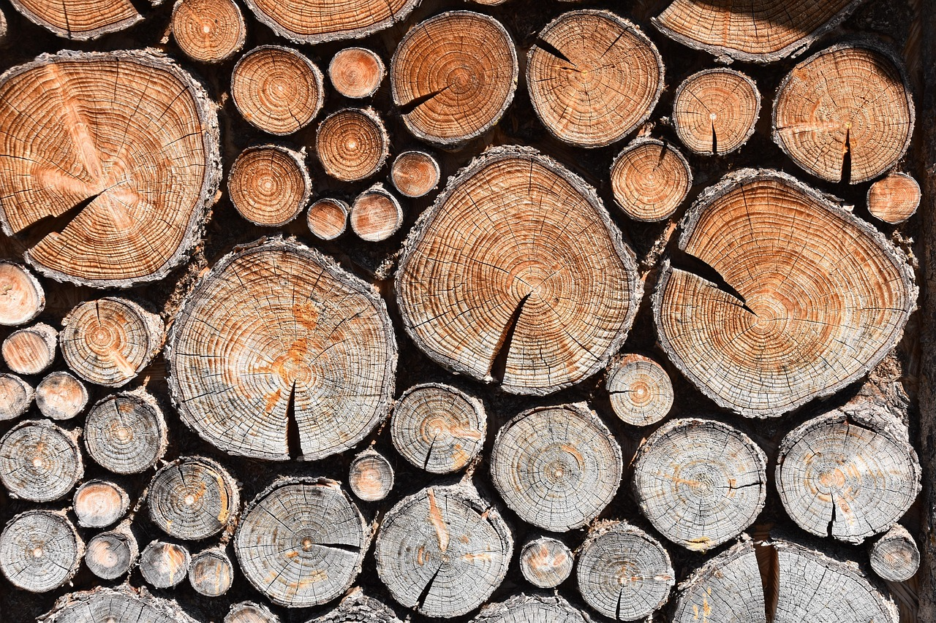
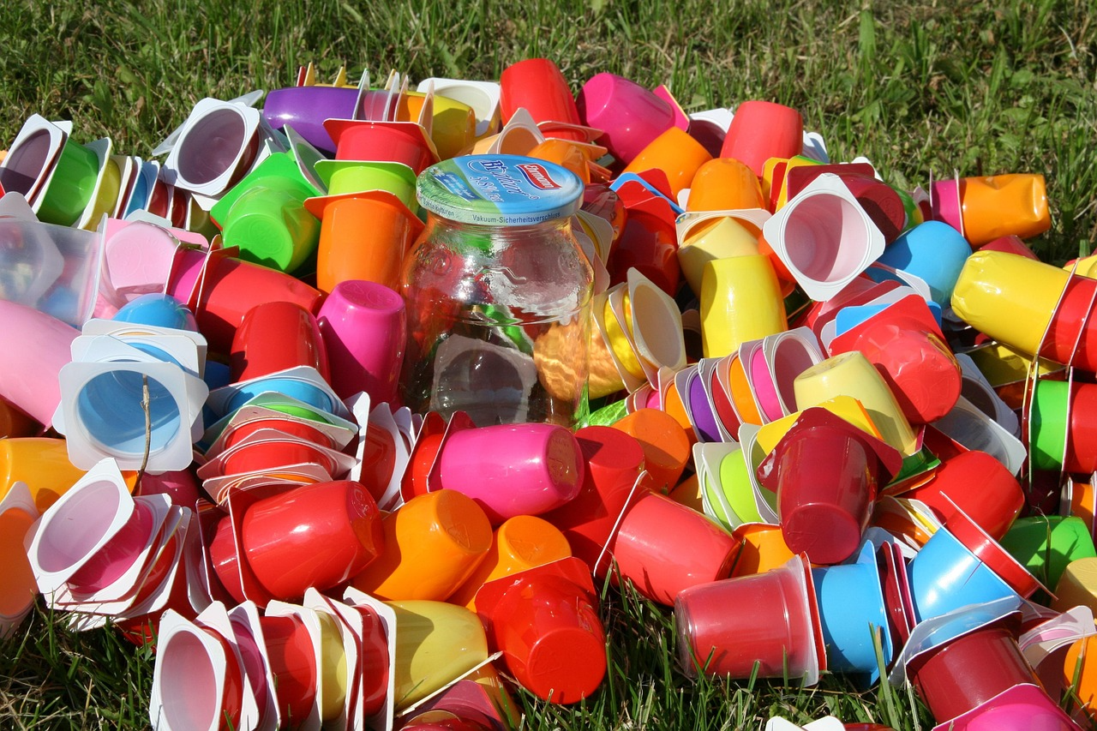
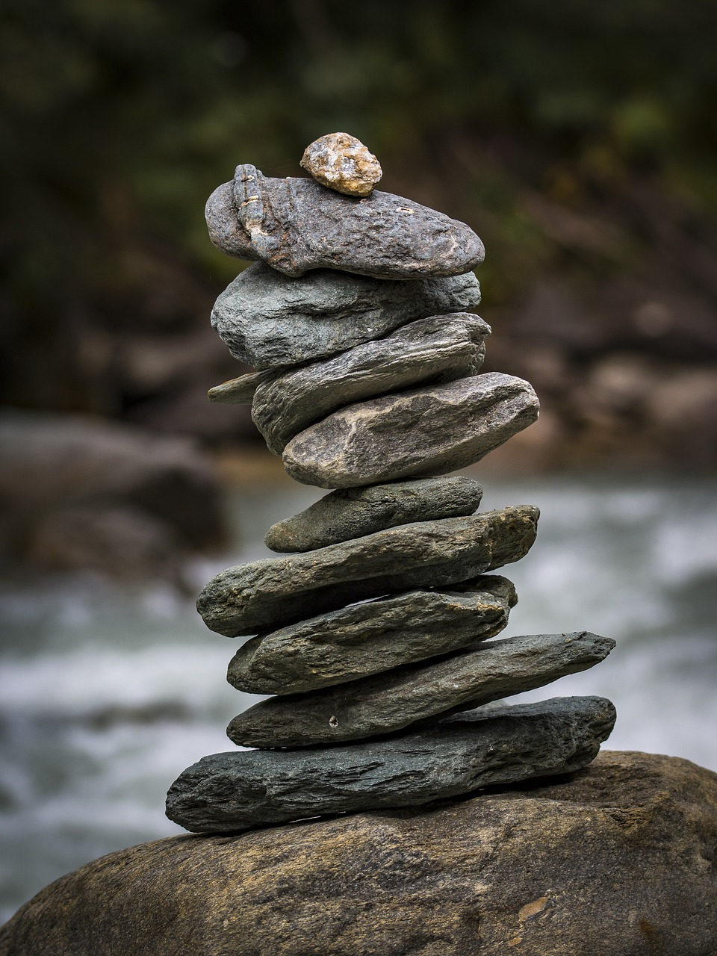
Lesson 1 Starter
Retrieval
Say the object name and the material.
Talk partner: “This is a ___. It is made from ___.”
Wood
Metal
Plastic
Stone
Glass
Fabric
Paper
Rubber
Notes:
Reveal the name of material after the children have had a guess what it might be called

Slide 8
Lesson 1 Main Activity
Resources
• Materials/objects
• Word bank
• Recording sheet
• Trays/hoops (if sorting)
Main task
Sort classroom/home objects by material.
Record: draw 3 objects and label the material.
Greater Depth
Find objects made from 2 materials and explain why using “because… so…”. Create your own grouping rule.
SEND / Adaptive Teaching
Picture/word cards; reduce to 2–3 materials; adult models sentence stems; verbal recording or photos.
Notes:
Large paper A3 with 4 sections – metal, plastic, glass, rubber. Find objects in the room and the ch, to place them in the correct section. Then, record in the record sheet. Alternatively - use picture cards.
Circulate and listen for vocabulary accuracy. Prompt reasoning with “Which property made you choose that?”

Slide 9
Lesson 1 Main Activity
Item
Material | Plastic
I know because | It is bendy but solid. It is transparent.
Notes:
Large paper A3 with 4 sections – metal, plastic, glass, rubber. Find objects in the room and the ch, to place them in the correct section. Then, record in the record sheet. Alternatively – use the worksheet and picture cards.
Listen for vocabulary accuracy. Prompt reasoning with “Which property made you choose that?”

Slide 10
Lesson 1 Plenary
Plenary task
Exit: “Object or material?” Hold up O/M card.
Say one object and one material.
Exit ticket
One sentence: “I learned that…”
Vocabulary checkpoint
Use at least 2 key words in a sentence.
Assessment evidence
Listen for correct vocabulary; check tables and labels.
Notes:
Use plenary to consolidate and quickly assess. Collect a few pupil sentences as evidence.

