Slide 1
Year 3 Non‑Chronological Reports
8‑lesson sequence with explicit narration, teacher modelling, guided practice and independent tasks.
Core model text: All About Penguins.
Writing outcome: an independent non‑chronological report (e.g., All About Owls).

Slide 2
Lesson 1 – Learning Objective
Today we are learning to identify the key features of a non‑chronological report, including how authors use headings, subheadings and paragraphs to organise information clearly.

Slide 3
Lesson 1 – Our Focus Today
Today we are exploring the structure and purpose of a non‑chronological report.
We will analyse how a report presents factual information organised by topic, rather than in time order.
We will identify features such as headings, subheadings, introductory paragraphs and topic sentences that guide the reader.

Slide 4
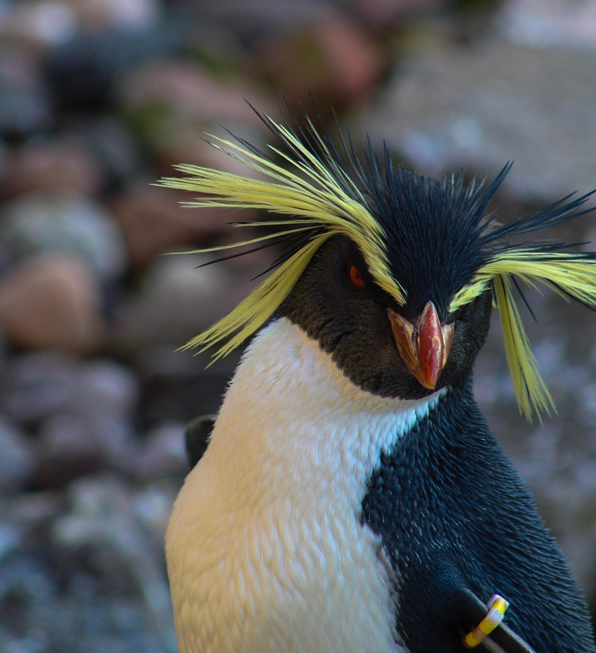
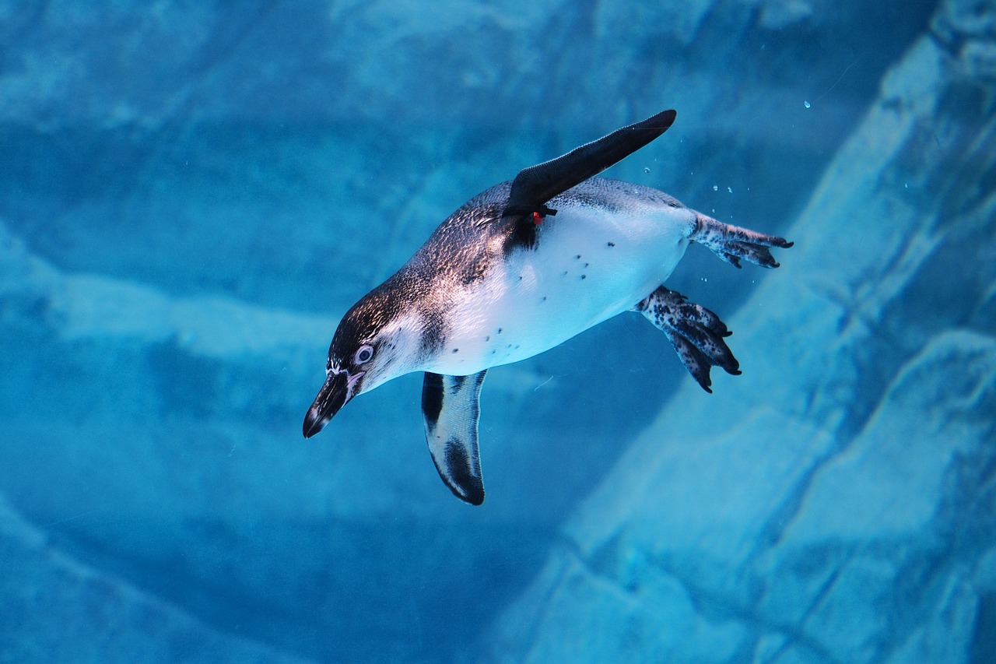
Lesson 1 – Model Text
Topic Sentence
Conjunction / Adverbial
Technical Vocabulary
All About Penguins
Penguins are flightless birds that are found mainly in the Southern Hemisphere.
Although they cannot fly, penguins are remarkably strong swimmers and can reach speeds of up to 22 miles per hour underwater.
These fascinating creatures have adapted to survive in some of the coldest environments on Earth.
Read the text all the way through once. Notice how the author uses formal language and presents facts rather than telling a story.

Slide 5
Lesson 1 – Model Text (Sections)
Topic Sentence
Conjunction / Adverbial
Technical Vocabulary
Appearance
Penguins have short, stiff wings called flippers, which they use to propel themselves through the water. Their bodies are covered in dense, waterproof feathers that keep them warm. In addition, they have webbed feet and a streamlined beak.
Food
Penguins are carnivores that feed primarily on fish, krill and squid. Because they are excellent divers, they can hunt prey deep beneath the ocean surface.
Habitat
Penguins are found across the Southern Hemisphere, including Antarctica, South America and New Zealand. Emperor penguins huddle together in large groups to conserve body heat during the harsh Antarctic winter.
Notice how each paragraph focuses on one topic. Each begins with a topic sentence that introduces the main idea.

Slide 6
Lesson 1 –What we notice
I notice this text is giving me factual information written in a formal tone.
It is not telling a story — there is no chronological sequence or characters.
The information is organised into paragraphs, each grouped by topic with a clear heading and topic sentence.

Slide 7
Lesson 1 – Annotation - Features
Topic Sentence
Conjunction / Adverbial
Technical Vocabulary
All About Penguins
Penguins are flightless birds that are found mainly in the Southern Hemisphere. Although they cannot fly, penguins are remarkably strong swimmers and can reach speeds of up to 22 miles per hour underwater. These fascinating creatures have adapted to survive in some of the coldest environments on Earth.
Appearance
Penguins have short, stiff wings called flippers, which they use to propel themselves through the water. Their bodies are covered in dense, waterproof feathers that keep them warm. In addition, they have webbed feet and a streamlined beak.
Food
Penguins are carnivores that feed primarily on fish, krill and squid. Because they are excellent divers, they can hunt prey deep beneath the ocean surface.
Habitat
Penguins are found across the Southern Hemisphere, including Antarctica, South America and New Zealand. Emperor penguins huddle together in large groups to conserve body heat during the harsh Antarctic winter.
Circle the title. Underline subheadings. Highlight topic sentences. Box each paragraph. Identify conjunctions and adverbials.

Slide 8
Lesson 1 – Guided Practice (We Do)
Annotate a second short report from the booklet together.
• Find the title
• Find the subheadings and topic sentences
• Highlight conjunctions and adverbials
• Box each paragraph
Refer back to the All About Penguins annotation. Notice how paragraphs link together.

Slide 9
Lesson 1 – Independent Task (You Do)
Annotate your own copy of the penguin report independently.
Success check:
• Title circled
• Subheadings and topic sentences underlined
• Conjunctions and adverbials highlighted
• Paragraphs boxed and labelled by topic

Slide 10
Lesson 1 – Challenge
Write a short paragraph explaining what a non‑chronological report is and how it differs from a narrative.
Use at least one subordinating conjunction (e.g., although, because, when).

Slide 11
Lesson 2 – Learning Objective
Today we are learning how headings, subheadings and paragraphs help organise information into a clear structure.

Slide 12
Lesson 2 – Our Focus Today
Headings, subheadings and paragraphs work together to create a clear structure.
Each paragraph should focus on one main idea, introduced by a topic sentence.
We will practise grouping related facts into well‑organised paragraphs under appropriate headings.

Slide 13
Lesson 2 – Teacher Modelling: Sorting Facts
Fact cards:
• Penguins are carnivores that feed primarily on fish.
This fact is about diet, so it belongs under the Diet paragraph.
• Penguins have short, stiff wings called flippers, which they use underwater.
This fact describes a physical feature, so it belongs in the Appearance paragraph.
• Penguins are found across the Southern Hemisphere, including Antarctica.
This fact tells me where they live, so it goes under Habitat. I would start this paragraph with a topic sentence.
Group related facts into paragraphs under the correct heading: Diet / Appearance / Habitat. Write a topic sentence for each.

Slide 14
Lesson 2 – Guided Practice (We Do)
Cut one of the reports from the booklet into sentence strips. Sort them back into their groups.
• Say the heading and a topic sentence aloud
• Explain why each fact belongs in that paragraph
Refer back to the penguin report. Notice how each paragraph begins with a topic sentence that introduces the main idea.

Slide 15
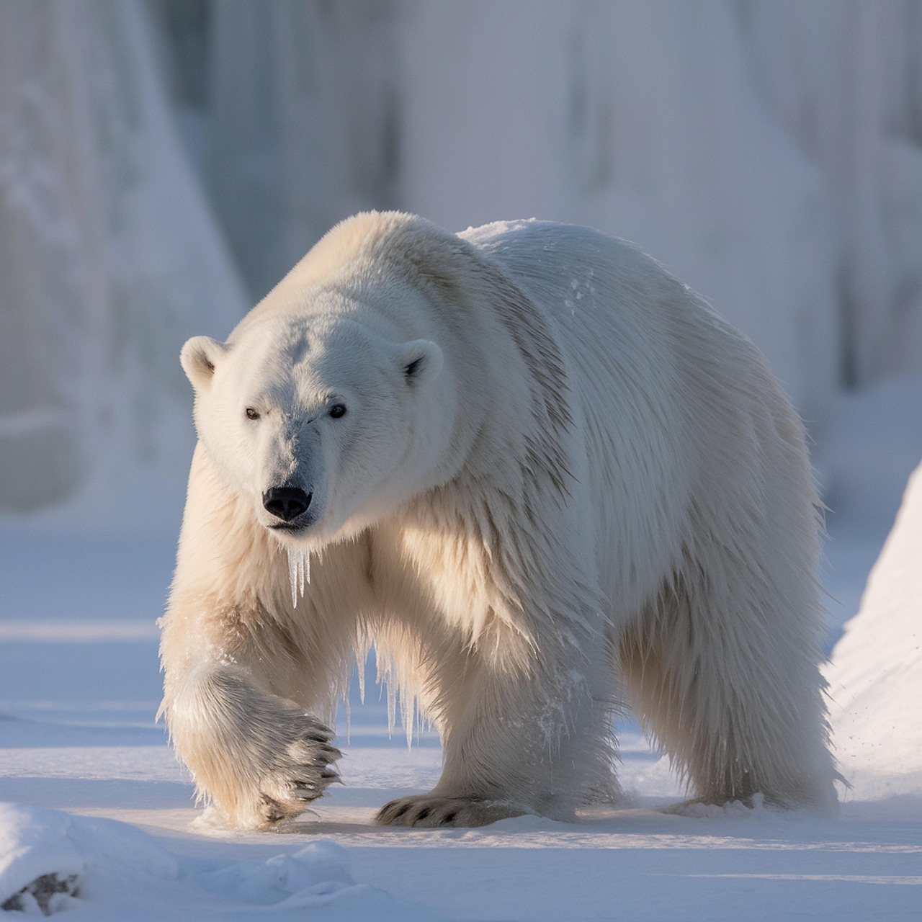
Lesson 2 – Independent Task
This non‑chronological report has lost its subheadings and its paragraphs are muddled! Can you reorganise it?
Topic: The Polar Bear
__________________________
Polar bears are large, powerful mammals that inhabit the frozen Arctic. Because they have evolved to survive extreme cold, they are perfectly suited to one of the harshest environments on Earth.
__________________________
Although their fur appears white, polar bears actually have black skin underneath, which helps them absorb heat from the sun. They also have a thick layer of blubber that provides insulation against freezing temperatures.
__________________________
Polar bears are usually found near frozen oceans and vast expanses of sea ice. This environment is essential because it provides the ideal hunting ground for catching seals.
__________________________
Notes:
Use the copy of the task in the task folder

Slide 16
Lesson 2 – Independent Task (continued)
Continue reorganising the report by reading the remaining paragraphs below.
As carnivores, polar bears feed mainly on ringed seals and bearded seals. They are patient hunters that wait beside breathing holes in the ice before catching prey with their powerful claws.
__________________________
Polar bears are strong swimmers and have been recorded swimming over 60 miles without resting. Despite their strength, they are largely solitary animals that prefer to live and hunt alone.

Slide 17
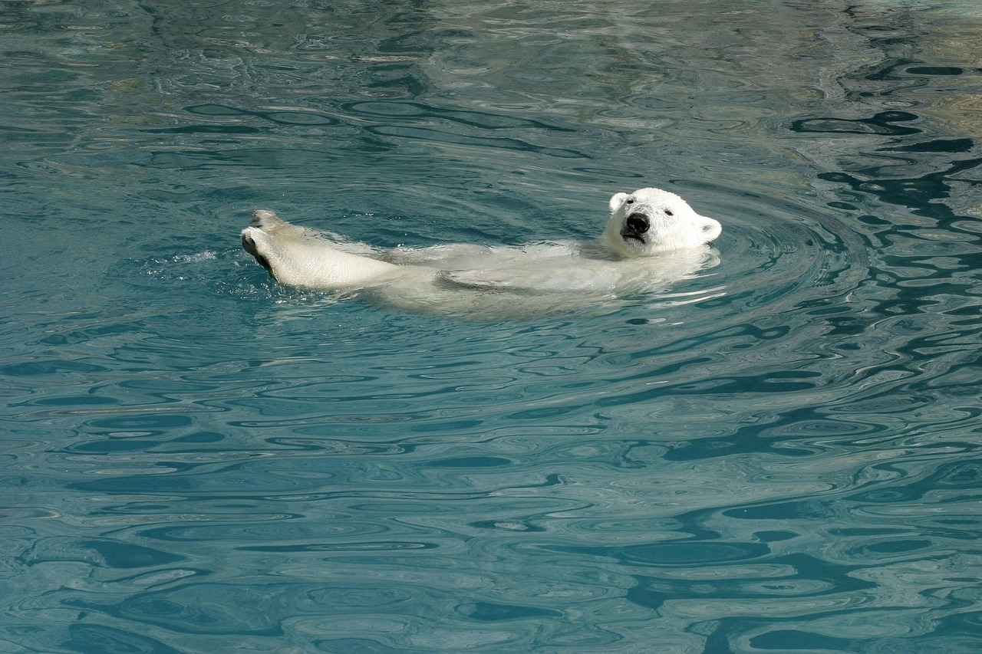
Lesson 2 – Challenge
Research additional facts about polar bears from at least two different sources.
Write these as a new paragraph with a topic sentence, using conjunctions such as although, because and however.

Slide 18
Lesson 3 – Learning Objective
Today we are learning how to write clear compound and complex sentences using a range of conjunctions and adverbial phrases.

Slide 19
Lesson 3 – Our Focus Today
A well‑crafted factual sentence uses precise vocabulary and varied sentences
We will build compound sentences using coordinating conjunctions (and, but, so, or) and complex sentences using subordinating conjunctions (because, although, when, if, while).

Slide 20
Lesson 3 – Teacher Modelling: Build a Sentence
Start with a simple sentence:
Penguins eat fish.
Make it compound (add a coordinating conjunction):
Penguins eat fish, and they also hunt for krill and squid.
Make it complex (add a subordinating conjunction):
Because penguins are skilled divers, they can catch fish at great depths.
Add an adverbial opener:
Deep beneath the ocean surface, penguins chase their prey at remarkable speeds.
Conjunction
Conjunction
Adverbial Opener

Slide 21
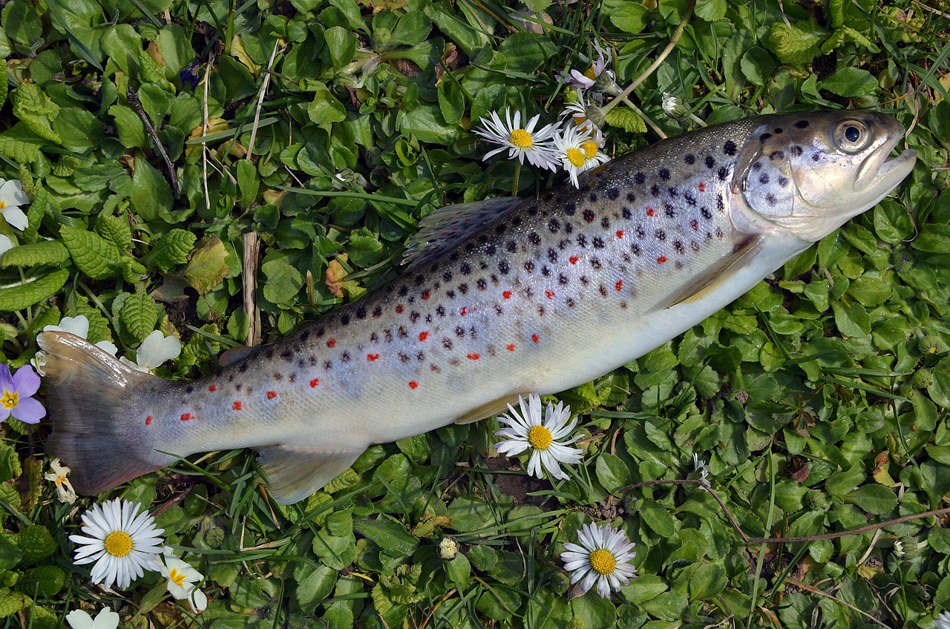
Lesson 3 – Annotate the Sentence
Because penguins are skilled divers, they can catch fish at great depths.
Label: subordinating conjunction (Because) • subordinate clause (penguins are skilled divers) • main clause (they can catch fish at great depths)

Slide 22
Lesson 3 – Guided Practice (We Do)
Penguins are flightless birds.
Penguins are flightless birds, but they are excellent swimmers. (compound)
Although penguins cannot fly, they use their flippers to glide through the water. (complex)
In the icy waters of Antarctica, penguins dive to incredible depths in search of food. (adverbial opener)
Notice how each version adds complexity. Can you identify the conjunction or adverbial in each?

Slide 23
Lesson 3 – Independent Task (You Do)
Choose one interesting animal you would like to write a non‑chronological report about.
Gather facts from at least two sources and write them as full sentences in your book.
Now upgrade each sentence: turn simple sentences into compound or complex sentences using conjunctions (and, but, because, although, when).

Slide 24

Lesson 3 – Challenge
Rewrite three of your facts as complex sentences, each using a different subordinating conjunction (e.g., although, because, when, while, if).
Underline the subordinate clause in each.

