Slide 1
Lesson 4
Counting in 3s from 0
I can count forwards and backwards in 3s from 0 and use grouping to help me
60 minutes

Slide 2
WALT
I can count forwards and backwards in 3s from 0 and use grouping to help me.

Slide 3
Key Vocabulary
count
group
sequence
pattern
forwards
backwards
skip count
threes
predict
multiple
repeat
rhythm

Slide 4
Fluency Starter
Quick recap – counting in 2s, 5s, and 10s
1) Count in 2s: 2, 4, 6, 8, __, __, __
2) Count in 5s: 5, 10, 15, __, __, __
3) Count back in 10s: 100, 90, 80, __, __, __

Slide 5
Fluency Starter – Answers
1) 2, 4, 6, 8, 10, 12, 14
2) 5, 10, 15, 20, 25, 30
3) 100, 90, 80, 70, 60, 50

Slide 6
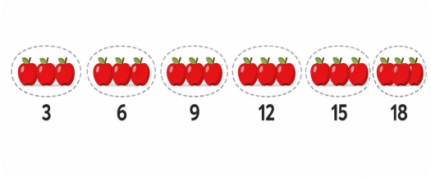
I Do – Model 1: Counting Forwards
“I make groups of 3 and count each group.”
Groups of 3:
3, 6, 9, 12, 15, 18
Full sequence from 0:
0, 3, 6, 9, 12, 15, 18, 21, 24, 27, 30
“Each time I add 3 more.”

Slide 7
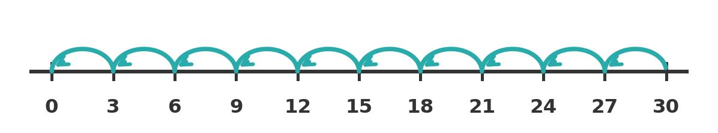
I Do – Model 2: Counting Backwards
“I count backwards by taking away 3 each time.”
Start at 30 and count back:
30, 27, 24, 21, 18, 15, 12, 9, 6, 3, 0
Real-world example:
4 tricycles have 12 wheels
because 3, 6, 9, 12
“I check every jump is exactly 3.”

Slide 8
We Do – Guided Practice
Fingers and objects ready!
Q1: Count together from 0 to 30 in 3s
Stop & think: What comes after 9? After 21?
Q2: Count backwards from 18 in 3s
Stop & think: What is 18 take away 3? Keep going!
Q3: 5 teams of 3 children. How many?
Stop & think: Count in 3s five times: 3, 6, 9, 12, 15

Slide 9
Hinge Question
A pupil counts in 3s and says: 3, 6, 9, 11, 14. What is the mistake?
A) Added 2 instead of 3 B) Skipped a number C) Started from 1 D) Counted backwards
The pupil added 2 after 9 instead of 3. It should be 12, 15.
Answer: A) Added 2 instead of 3

Slide 10
You Do – Independent Practice
Group 1 – Support
Group 2 – Core
Group 3 – Stretch
1) 0, 3, __, 9, __, 15
2) 3, 6, 9, __, __, 18
3) Count to 18 in 3s
4) 15, 12, __, 6, __, 0
5) Draw 4 groups of 3 circles
6) How many in 3 groups of 3?
1) 0, 3, __, 9, __, 15, __
2) 6, 9, 12, __, 18, __, 24
3) 27, 24, __, 18, __, 12, __
4) Next 5 after 30 in 3s?
5) 7 triangles = how many sides?
6) 6 teams of 3 = how many?
7) Sort: 6, 8, 9, 11, 12, 15
8) Count back from 24 to 0
1) 0, 3, __, 9, __, 15, __, 21
2) 27, 24, __, 18, __, 12, __, 6
3) Write next 5 after 30 in 3s
4) 7 triangles = how many sides?
5) 6 teams, 3 children each?
6) Zara says 3, 6, 9, 12. Next?
7) Sort: 6, 8, 9, 11, 12, 15,
16, 18, 21
8) Count back from 24 to 0
9) Which numbers under 30 in
both 2s and 3s patterns?
10) "Counting in 3s is easier
when I..."

Slide 11
You Do – Answers
Group 1 – Answers
Group 2 – Answers
Group 3 – Answers
1) 6, 12
2) 12, 15
3) 3, 6, 9, 12, 15, 18
4) 9, 3
5) 12 circles
6) 9
1) 6, 12, 18
2) 15, 21
3) 21, 15, 9
4) 33, 36, 39, 42, 45
5) 21 sides
6) 18 children
7) In 3s: 6, 9, 12, 15
8) 24, 21, 18, 15, 12,
9, 6, 3, 0
1) 6, 12, 18
2) 21, 15, 9, 3
3) 33, 36, 39, 42, 45
4) 21 sides
5) 18 children
6) 15
7) In 3s: 6, 9, 12, 15, 18, 21
Not: 8, 11, 16
8) 24, 21, 18, 15, 12,
9, 6, 3, 0
9) 6, 12, 18, 24
10) Varies

Slide 12
Plenary – Reasoning
Think like a mathematician:
How can grouping objects into threes help you count more accurately?
Grouping lets you see how many without counting one by one. Touch each group and say the next multiple of 3.
Check your work:
Recount each sequence and make sure every jump is 3, not 2 or 4.
Reflection:
Finish this sentence: "Counting in 3s is easier when I..."

