Slide 1
Lesson 2
Counting in 5s
from 0
Count forwards and backwards in 5s from 0
and use this to solve counting problems
Year 2

Slide 2
Learning Objective
I can count forwards and backwards in 5s from 0 and use this to solve counting problems.

Slide 3
What You Need
Pencil
Counters
Paper

Slide 4

What we are learning today
Read aloud to your child
Today we are counting in 5s. Counting in 5s means adding 5 each time.
We can use our hands to help because each hand has 5 fingers.
When we count in 5s, the numbers end in 0 or 5. We will use this pattern to help us count more quickly.

Slide 5

Teach and Practise
Hold up one hand and say 5.
Hold up two hands and say 10. Continue: 15, 20, 25, 30.
Write the sequence: 0, 5, 10, 15, 20, 25, 30.
Now count backwards from 30 in 5s:
30, 25, 20, 15, 10, 5, 0.
Notice the ones digits alternate between 5 and 0.

Slide 6
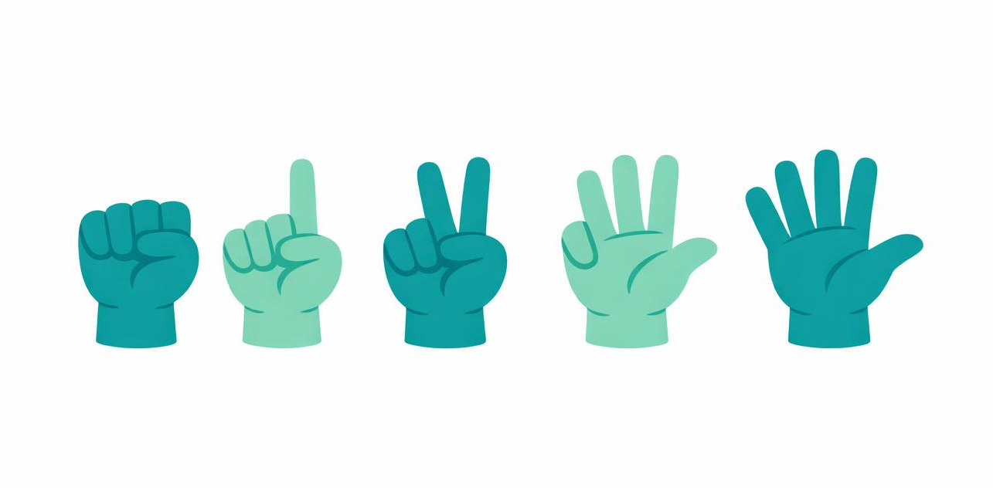
Worked Examples
1) Counting forwards from 0:
0, 5, 10, 15, 20
2) Counting backwards from 25:
25, 20, 15, 10, 5, 0
3) Five hands have 25 fingers:
5, 10, 15, 20, 25
4) Seven 5p coins make 35p:
5, 10, 15, 20, 25, 30, 35
Each time we add 5 more!

Slide 7

Your Tasks (1–2)
Task 1: Fill in the missing numbers
a) 0, 5, __, 15, __, 25, __
b) 10, 15, 20, __, 30, __, 40
c) 35, 30, __, 20, __, 10, __
Task 2: Tick the numbers in the 5s pattern
5, 12, 15, 20, 23, 25, 31, 35, 40
Which numbers end in 0 or 5?

Slide 8

Your Tasks (3–4)
Task 3: Write the next five numbers after 40
when counting in 5s.
Task 4: Solve these problems
a) A glove shop packs gloves in sets of 5. How many gloves are in 4 sets?
b) There are 5 petals on each flower. How many petals on 8 flowers?
c) Riya counts 5, 10, 15, 20. What are the next three numbers?

Slide 9
Task 5 and Think Deeper
Count backwards in 5s from 45 to 0 and write the full sequence.
Think like a mathematician: Why do numbers in the 5s pattern always end in 0 or 5?
How can this help you check your work?
45, 40, 35, 30, 25, 20, 15, 10, 5, 0

Slide 10
Independent Practice
Group 1 – Support
Group 2 – Core
Group 3 – Stretch
1. Fill in: 5, 10, __, 20, 25
2. Fill in: 0, 5, __, 15, 20
3. What comes next? 10, 15, 20, __
4. What comes next? 20, 25, 30, __
5. True or false? 12 is in the 5s pattern.
6. True or false? 25 is in the 5s pattern.
7. Count in 5s from 0 to 30.
8. Circle the 5s numbers: 5, 8, 10, 13, 15
9. How many fingers on 3 hands?
10. Count back: 30, 25, __, 15, 10
1. Fill in: 5, 10, 15, __, __, 30
2. Fill in: 25, 30, __, __, 45
3. What comes next? 35, 40, 45, __
4. Count back: 50, 45, __, __, 30
5. True or false? 40 is in the 5s pattern.
6. True or false? 33 is in the 5s pattern.
7. Circle the odd one out: 10, 15, 18, 20, 25
8. 7 bags of 5 apples. How many?
9. Fill in: 0, __, 10, __, 20, __, 30
10. What is 9 groups of 5?
1. Fill in: 45, 50, __, __, 65
2. Count back: 60, __, __, 45, __
3. Stickers come in 5s. How many in 12 packs?
4. True or false? 55 is in the 5s pattern.
5. True or false? 52 is in the 5s pattern.
6. Fill in: __, __, 70, 75, 80
7. Amy says: 95, 90, 85, 70, 65. Find the mistake.
8. What is 15 groups of 5?
9. Circle NOT in the 5s pattern: 35, 42, 50, 53, 60
10. Explain how you know 100 is in the 5s pattern.

Slide 11
Answers
Group 1 – Support
Group 2 – Core
Group 3 – Stretch
1. 15
2. 10
3. 25
4. 35
5. False – 12 ends in 2
6. True – 25 ends in 5
7. 0, 5, 10, 15, 20, 25, 30
8. 5, 10, 15 (not 8 or 13)
9. 15 fingers
10. 20
1. 20, 25
2. 35, 40
3. 50
4. 40, 35
5. True – 40 ends in 0
6. False – 33 ends in 3
7. 18 (not a multiple of 5)
8. 35 apples
9. 5, 15, 25
10. 45
1. 55, 60
2. 55, 50, 40
3. 60 stickers
4. True – 55 ends in 5
5. False – 52 ends in 2
6. 60, 65
7. Missing 80 (should be 95, 90, 85, 80, 75, 70, 65)
8. 75
9. 42 and 53
10. 100 ends in 0, so it is in the 5s pattern.

Slide 12
Reflection
Finish this sentence:
“I can recognise counting in 5s because...”
Think about what patterns you noticed today.
Well done for learning to count in 5s!

