Slide 1
Lesson 1
Counting in 2s from 0
Year 2 Maths
I can count forwards and backwards in 2s
from 0 and spot the pattern in the numbers.
Year 2

Slide 2
WALT
I can count forwards and backwards in 2s from 0 and spot the pattern in the numbers.

Slide 3
What You Need
Pencil
Number line to 30
Paper
Buttons or coins
20 small objects

Slide 4
Vocabulary
Counting in 2s
Even numbers
Pairs
Pattern
Sequence
Forwards
Backwards

Slide 5
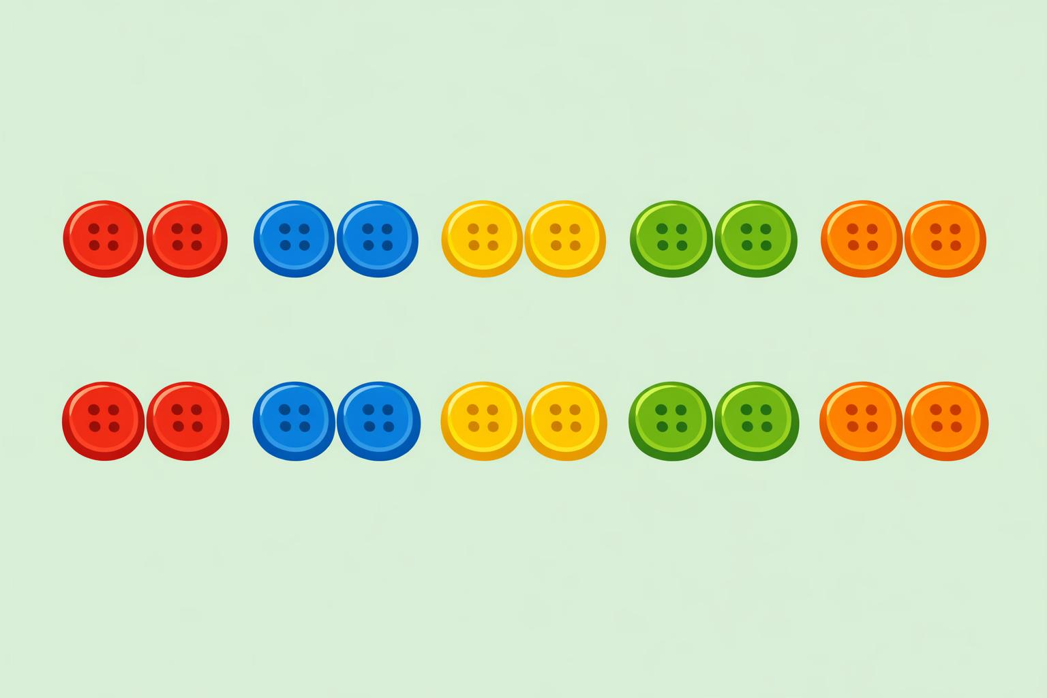
Introduction
Read this aloud or ask an adult to read it to you
Today we are counting in 2s. Counting in 2s means adding 2 each time.
We can think of pairs of objects to help us.
When we count in 2s from 0, the numbers are 0, 2, 4, 6, 8 and so on.

Slide 6
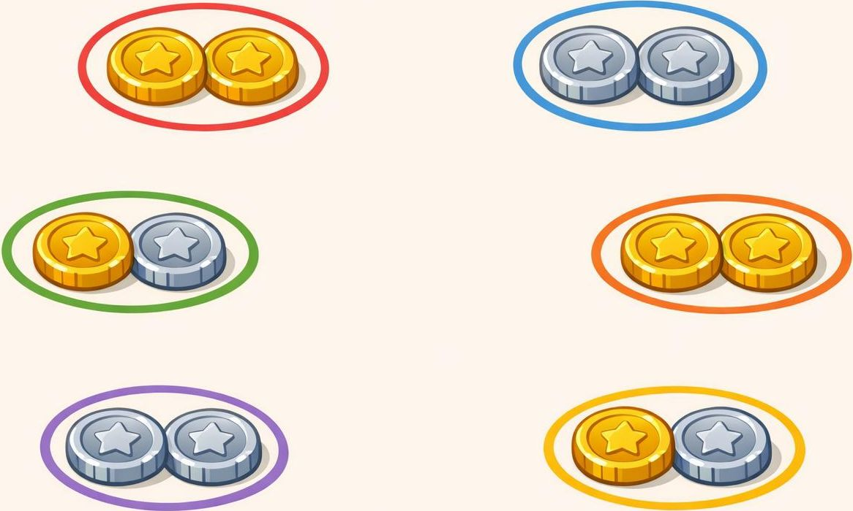
Teach and Practise
Put your objects into pairs. Count each pair: 2, 4, 6, 8, 10.
Write these numbers: 0, 2, 4, 6, 8, 10, 12, 14, 16, 18, 20.
Now count backwards:
20, 18, 16, 14, 12, 10, 8, 6, 4, 2, 0.

Slide 7
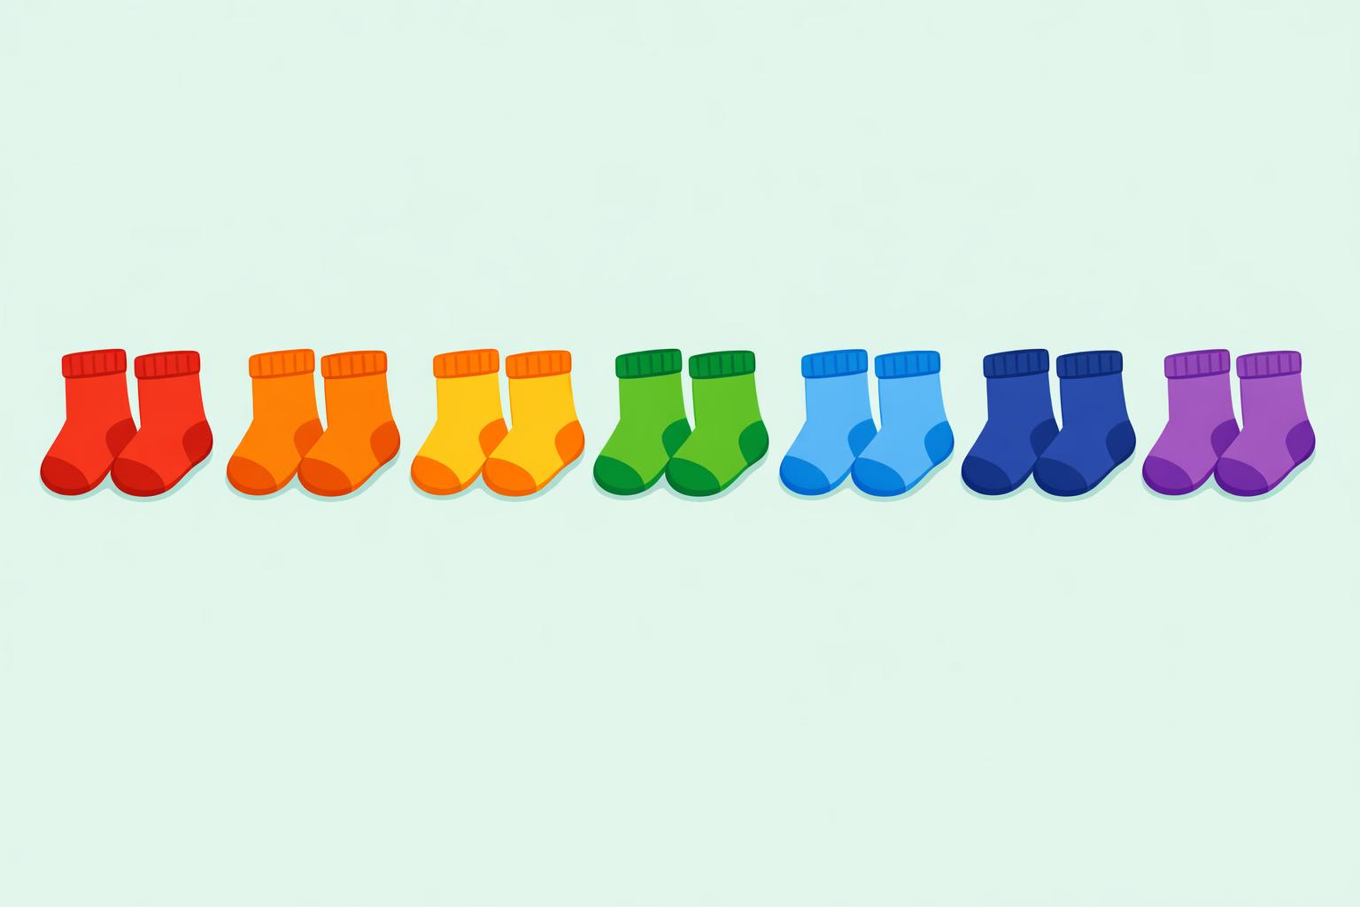
Worked Examples
Example 1: Counting forwards
0, 2, 4, 6, 8, 10
Example 2: Continue the pattern
12, 14, 16, 18, 20
Example 3: Counting backwards
14, 12, 10, 8, 6
Example 4: Pairs of socks
7 pairs of socks: 2, 4, 6, 8, 10, 12, 14
Notice: all these numbers are even!

Slide 8
Your Tasks – Part 1
Task 1: Fill in the missing numbers
a) 0, 2, __, 6, __, 10, __, 14
b) 4, 6, 8, __, 12, __, 16
c) 20, 18, __, 14, __, 10, __, 6
Task 2: Circle the 2s pattern
Which of these belong? 3, 4, 7, 8, 10, 11, 14, 15, 18
Task 3: Extend the sequence
Write the next six numbers after 20 when counting in 2s.

Slide 9
Your Tasks – Part 2
Solve these problems
Task 4a: There are 2 eyes on each teddy. How many eyes do 6 teddies have?
Hint: Count in 2s six times: 2, 4, 6, 8, 10, 12
Task 4b: There are 2 wheels on each scooter. How many wheels do 8 scooters have?
Hint: Count in 2s eight times: 2, 4, 6, 8, 10, 12, 14, 16
Task 4c: A child counts 2, 4, 6, 8. What will they say next?
Hint: Add 2 to the last number.

Slide 10
Task 5: Count Backwards
Count backwards in 2s from 16. Write the full sequence to 0.
Start at 16, subtract 2 each time, and write each number.
Remember: backwards means taking away 2 each time.
Answer: 16, 14, 12, 10, 8, 6, 4, 2, 0

Slide 11
Think Like a Mathematician
Ones Digit Pattern
Even Numbers
Check Your Work
What do you notice about
the ones digit when you
count in 2s?
Write down the ones digits:
0, 2, 4, 6, 8, 0, 2, 4, 6, 8
The ones digits repeat!
They follow the pattern:
0, 2, 4, 6, 8
Why are these numbers
called even numbers?
Even numbers can be
split into two equal
groups with nothing
left over.
6 = 3 + 3
10 = 5 + 5
14 = 7 + 7
Read each sequence aloud.
Make sure you add or
subtract 2 every time.
Use your number line
to check!
Tick each answer you
are sure about.

Slide 12
Challenge and Reflection
Challenge
Think About It
Reflection
Tom says:
“If I count in 2s, I will
say every number.”
Is he correct?
Explain your answer
using examples.
Tom is not correct.
When you count in 2s
you skip one number
each time.
For example:
0, 2, 4, 6, 8...
You never say 1, 3, 5, 7.
Finish this sentence:
“When I count in 2s,
I notice...”
Think about:
- the pattern in the
ones digits
- why they are all
even numbers

Slide 13
Well Done!
Today you learned to:
Count forwards in 2s from 0 to 20 and beyond.
Count backwards in 2s from 20 to 0.
Spot the pattern in the ones digits: 0, 2, 4, 6, 8.
Recognise that counting in 2s gives even numbers.
Key fact:
Even numbers can always be split into two equal groups.
Great work, mathematician!

