Slide 1
Instruction Writing – Year 1
Expanded unit with step-by-step modelling and guided practice.
Model texts are shown on each slide and are edited/annotated across multiple steps.
Teacher annotations are italic, lighter blue and smaller to separate them from the model text.

Slide 2
Year 1
Overview
In this unit we will build instruction writing skills step by step.
Use the model texts to practise spotting and improving features.

Slide 3
Year 1 Lesson 1 What Are Instructions?
Our Focus Today
Learning Objective: To identify features of an instruction text.
Today we are learning what instructions are and why they are important.
Instructions tell us how to do something, so they must be clear and easy to follow.

Slide 4
Year 1 Lesson 1 What Are Instructions?
Our Focus Today
I am going to show you a recipe and we will look closely at the different parts.
I want you to notice the title, the list of things we need, and the steps.

Slide 5
Year 1 Lesson 1 What Are Instructions?
Our Focus Today
I also want you to listen for the bossy verbs — the words that tell us what to do.
By the end of the lesson, you will be able to spot these features in any instruction text.

Slide 6
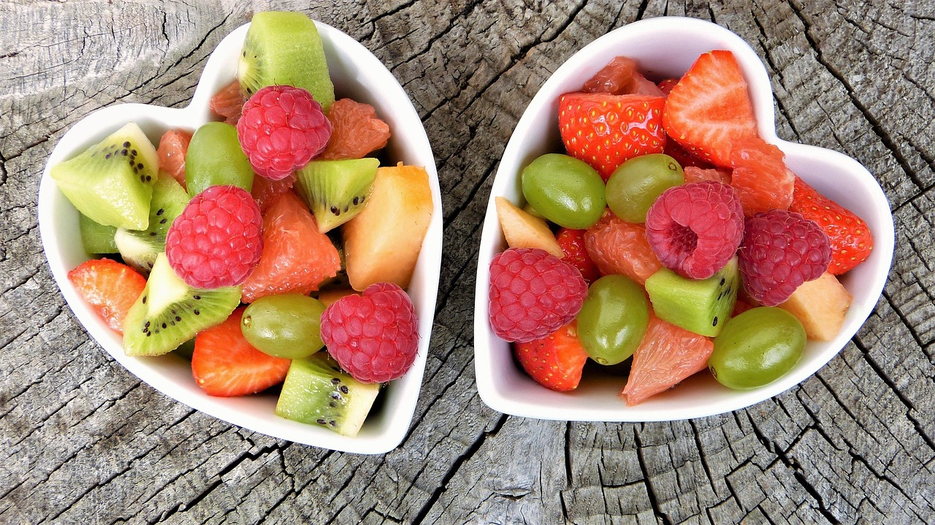
Year 1 Lesson 1 What Are Instructions?
Model Text
How to Make a Fruit Salad
You will need:
• 2 apples
• 1 banana
• a bowl
1. Wash the fruit.
2. Cut the fruit.
3. Put the fruit in the bowl.
4. Mix the fruit.
Read the model text once all the way through.

Slide 7
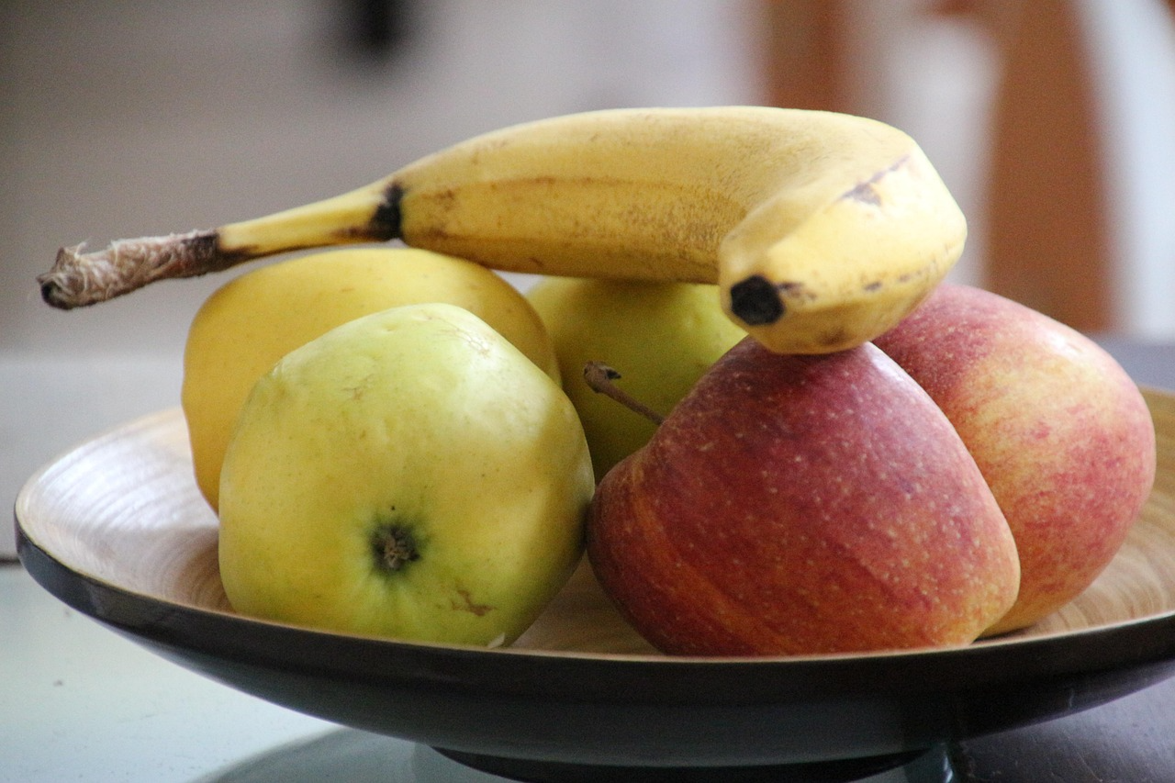
Year 1 Lesson 1 What Are Instructions?
Teacher Modelling – Steps 1 & 2
How to Make a Fruit Salad
You will need:
• 2 apples
• 1 banana
• a bowl
1. Wash the fruit.
2. Cut the fruit.
3. Put the fruit in the bowl.
4. Mix the fruit.
Circle the title.
Underline 'You will need' and label it list.

Slide 8
Year 1 Lesson 1 What Are Instructions?
Teacher Modelling – Steps 3 & 4
How to Make a Fruit Salad
You will need:
• 2 apples
• 1 banana
• a bowl
1. Wash the fruit.
2. Cut the fruit.
3. Put the fruit in the bowl.
4. Mix the fruit.
Put a box around the steps and draw arrows to show the order.
Highlight bossy verbs: Wash, Cut, Put, Mix.

Slide 9
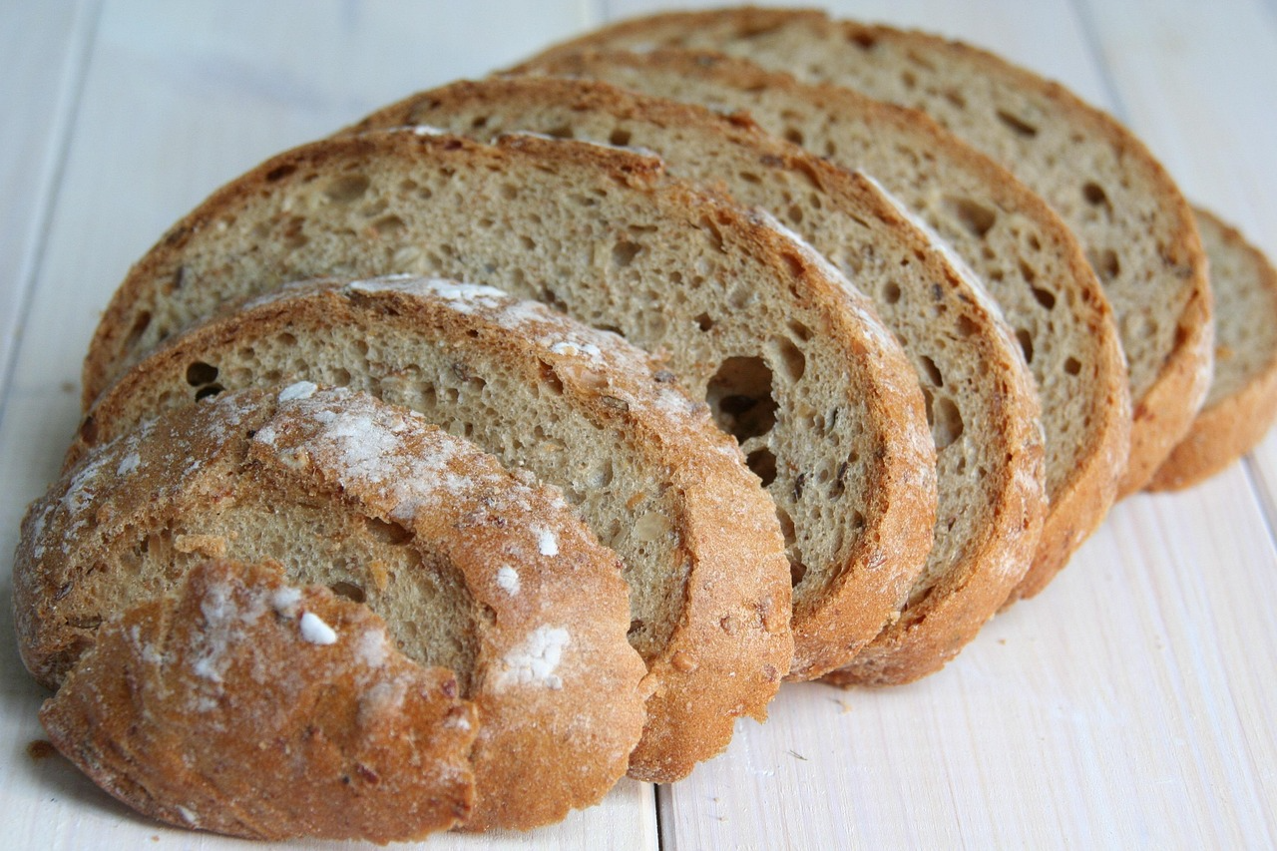
Year 1 Lesson 2 What Are Instructions?
Guided Practice (We Do)
How to Make a Jam Sandwich
You will need:
• 2 slices of bread
• jam
• a knife
1. Spread the jam.
2. Put the slices together.
Together: point to the title, the list, and the steps. Then find the bossy verbs.

Slide 10
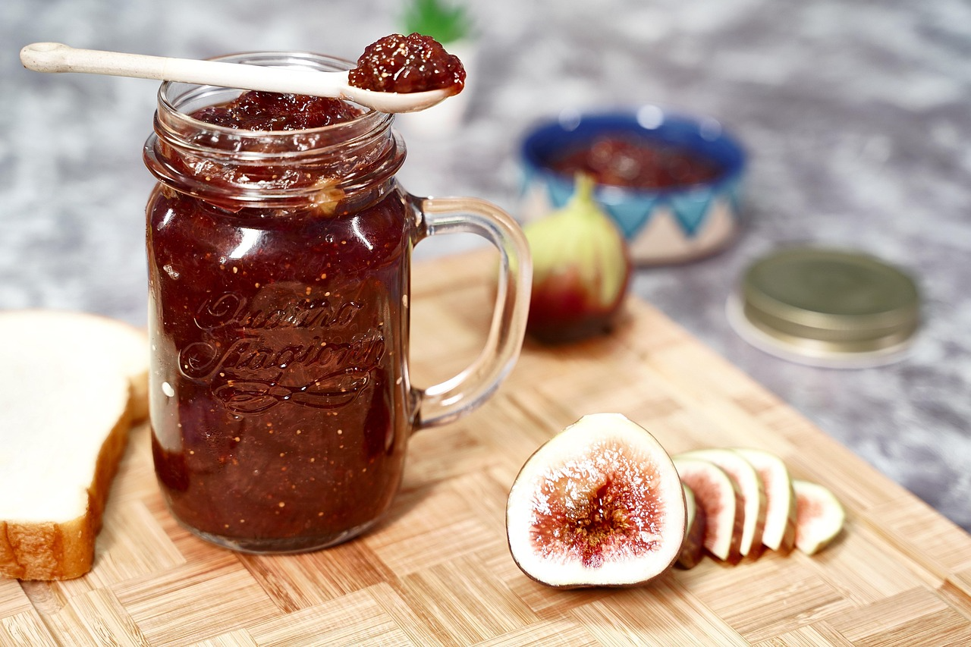
Year 1 Lesson 2 What Are Instructions?
Guided Practice (We Do) – Continue
How to Make a Jam Sandwich
You will need:
• 2 slices of bread
• jam
• a knife
1. Spread the jam.
2. Put the slices together.
Answer: What feature can you spot? Explain how you know.

Slide 11
Year 1 Lesson 1 What Are Instructions?
Independent Task, Fun Activity & Challenge
Use the booklet to print one of the texts , cut it in cards
Sort mixed-up cards into: title, list, steps.
Fun Activity: Instruction Treasure Hunt: find titles, lists and steps hidden around the room.
Challenge: Explain why steps must be in order.

Slide 12
Year 1 Lesson 2 Sequencing Steps
Our Focus Today
Learning Objective: To sequence steps for a cooking task.
Today we are learning how to put steps in the correct order.
When we follow instructions, the order matters.
I am going to show you how to make a simple sandwich and I want you to watch carefully.

Slide 13
Year 1 Lesson 2 Sequencing Steps
Our Focus Today
Listen to the time words I use: first, next, then, finally.
These words help us understand the sequence.

Slide 14
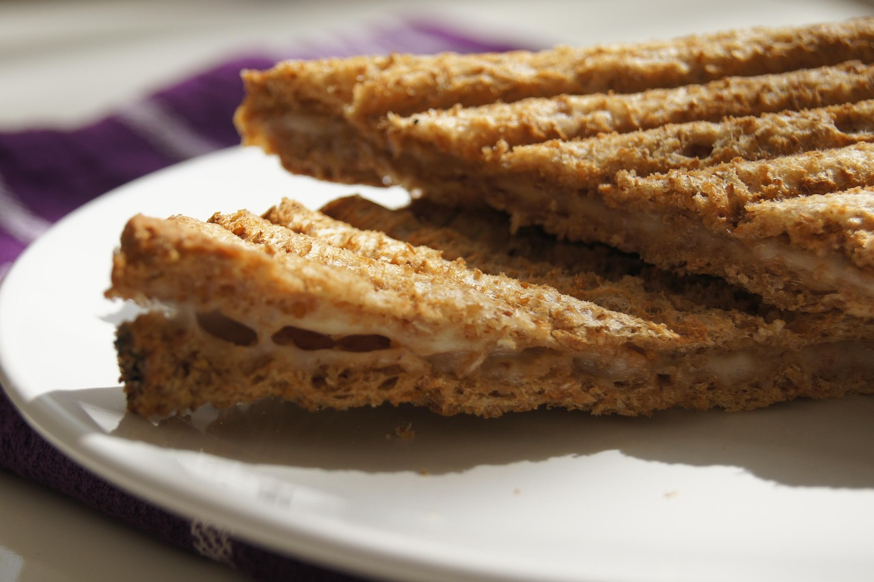
Year 1 Lesson 2 Sequencing Steps
Model Text
How to Make a Sandwich
You will need:
• bread
• butter
• filling
Steps (mixed up):
• Put the sandwich together.
• Get the bread.
• Add the filling.
• Spread the butter.
Read the model text once all the way through.

Slide 15
Year 1 Lesson 2 Sequencing Steps
Teacher Modelling – Step 1
How to Make a Sandwich
Steps (mixed up):
• Put the sandwich together.
• Get the bread.
• Add the filling.
• Spread the butter.
Circle time words when we add them: first, next, then, finally.

Slide 16
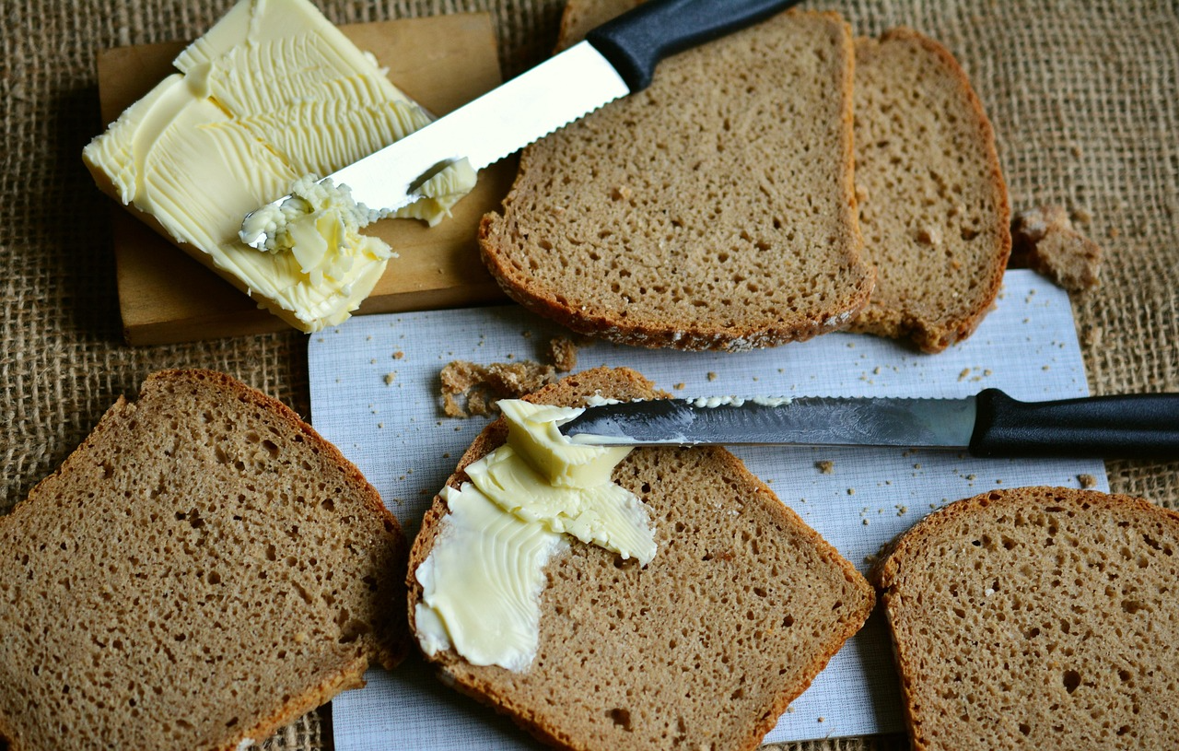
Year 1 Lesson 2 Sequencing Steps
Teacher Modelling – Steps 2 & 3
How to Make a Sandwich
1. First, get the bread.
2. Next, spread the butter.
3. Then, add the filling.
4. Finally, put the sandwich together.
Draw arrows and label each step with a number.
Explain why swapping steps would not work.

Slide 17
Year 1 Lesson 2 Sequencing Steps
Guided Practice (We Do)
How to Make Toast
Steps (mixed up):
• Butter the toast.
• Put bread in the toaster.
• Take toast out.
Together: put the steps in order and add time words.

Slide 18
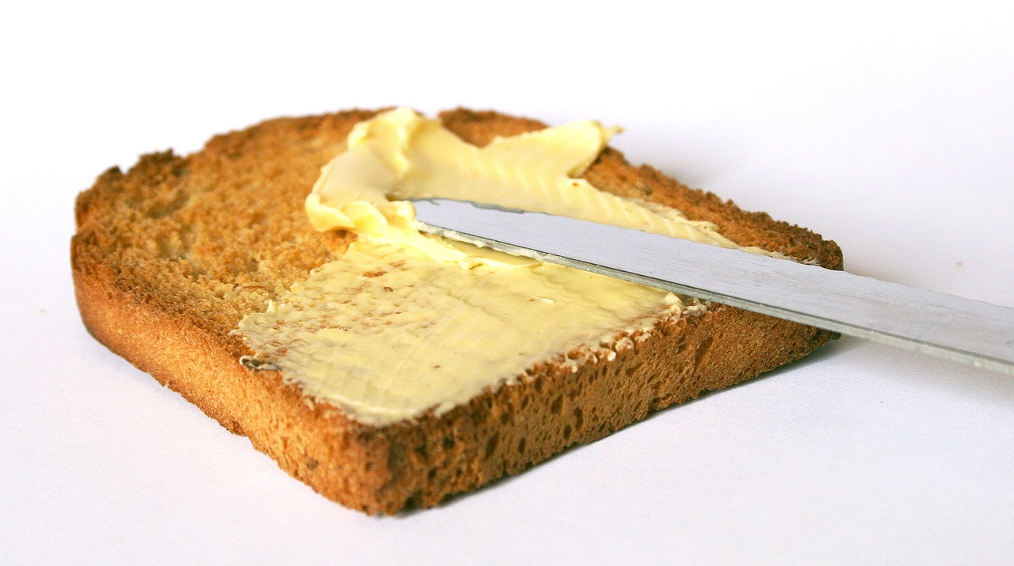
Year 1 Lesson 2 Sequencing Steps
Guided Practice (We Do) – Continue
How to Make Toast
Steps (mixed up):
• Butter the toast.
• Put bread in the toaster.
• Take toast out.
Answer: What feature can you spot? Explain how you know.

Slide 19
Year 1 Lesson 2 Sequencing Steps
Independent Task, Fun Activity & Challenge
Sequence your own picture cards and write the steps using time words.
First , Then , Next , Finally
Fun Activity: Human Sequencing: hold step cards and arrange yourselves in order.
Challenge: Add a drawing to each step.

Slide 20
Year 1 Lesson 3 Bossy Verbs
Our Focus Today
Learning Objective: To use bossy verbs in instructions.
Today we are learning about bossy verbs.
Bossy verbs tell someone exactly what to do. They start the instruction and make it clear.
I am going to show you some examples in a recipe and we will highlight them together.

Slide 21
Year 1 Lesson 3 Bossy Verbs
Model Text
How to Make a Smooth Fruit Mix
1. Wash the fruit.
2. Peel the banana.
3. Chop the apple.
4. Mix it in a bowl.
Read the model text once all the way through.

Slide 22

Year 1 Lesson 3 Bossy Verbs
Teacher Modelling – Step 1
How to Make a Smooth Fruit Mix
1. Wash the fruit.
2. Peel the banana.
3. Chop the apple.
4. Mix it in a bowl.
Highlight the bossy verbs (the command words).

Slide 23

Year 1 Lesson 3 Bossy Verbs
Teacher Modelling – Steps 2 & 3
How to Make a Smooth Fruit Mix
1. Wash the fruit.
2. Peel the banana.
3. Chop the apple.
4. Mix it in a bowl.
Circle the verb at the start of each sentence.
Explain: bossy verbs come at the start to tell you what to do straight away.

Slide 24

Year 1 Lesson 3 Bossy Verbs
Guided Practice (We Do)
Bossy Verb Hunt
Stir the yogurt.
Pour the drink.
Eat the snack.
Together: underline the bossy verb in each sentence.

Slide 25
Year 1 Lesson 3 Bossy Verbs
Guided Practice (We Do) – Continue
Bossy Verb Hunt
Stir the yogurt.
Pour the drink.
Eat the snack.
Answer: What feature can you spot? Explain how you know.

Slide 26
Year 1 Lesson 3 Bossy Verbs
Independent Task, Fun Activity & Challenge
Write 3–5 command sentences starting with a bossy verb.
Fun Activity: Bossy Verb Simon Says: Chop! Stir! Mix!
Challenge: Replace a weak verb with a stronger one.

