Slide 1
Lesson 5
Count, Read and Write Numbers to 10
Apply counting, reading and writing
numbers to 10 in mixed contexts
40 minutes

Slide 2
Lesson Plan
40-minute lesson
⏰ Fluency Starter and Vocabulary 5 min
📋 My Turn 10 min
✏️ Do Together 10 min
★ Independent Practice 10 min
Differentiated tasks: Support, Expected, and Greater Depth
🔍 Plenary 5 min

Slide 3
Learning Objective
LO: To apply counting, reading and writing numbers to 10 in fluency and reasoning activities.
Success Criteria:
I can count, read and write numbers to 10.
I can match numerals to sets and representations.
I can explain my answers using mathematical vocabulary.

Slide 4
Key Vocabulary
count
read
write
represent
numeral
total
more
fewer
equal

Slide 5
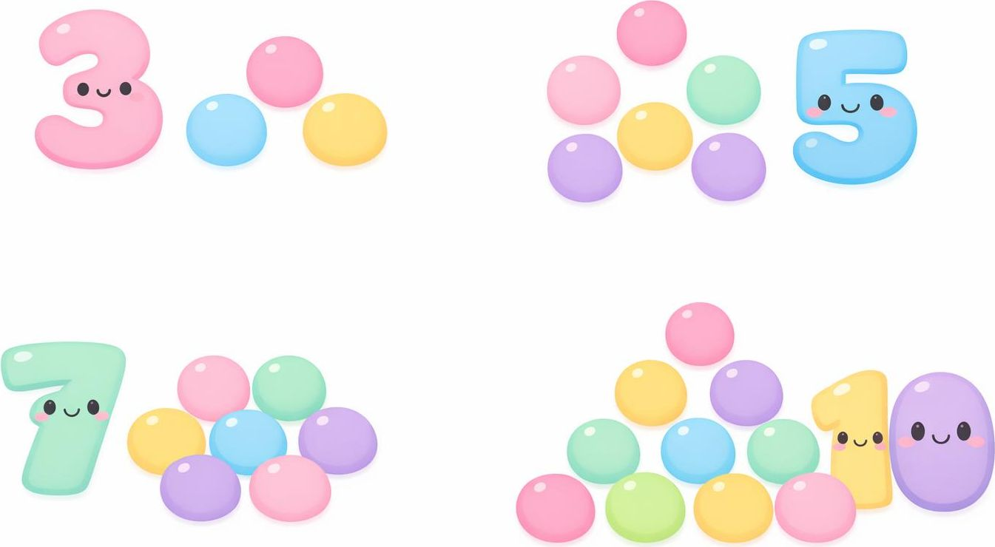
Pictorial Fluency
How many dots can you see? Count them!
Point to the number that matches each set.
Can you read this number? Now show it with your fingers.
Which number matches this group of stars?

Slide 6
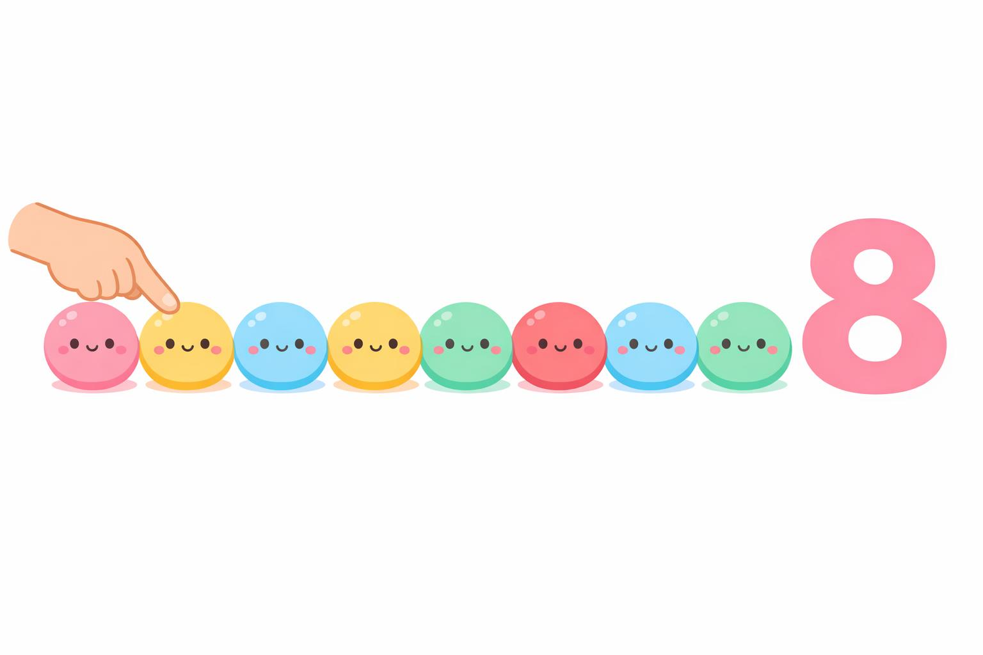
I Do – Teacher Models Mixed
I can count 8 counters. One, two, three, four, five, six, seven, eight.
Now I read the numeral. It says 8.
I write the number 8.
I can draw 8 dots too. That is another way to show 8.
I can move between the amount, the spoken number name and the written numeral. They all show the same number.

Slide 7
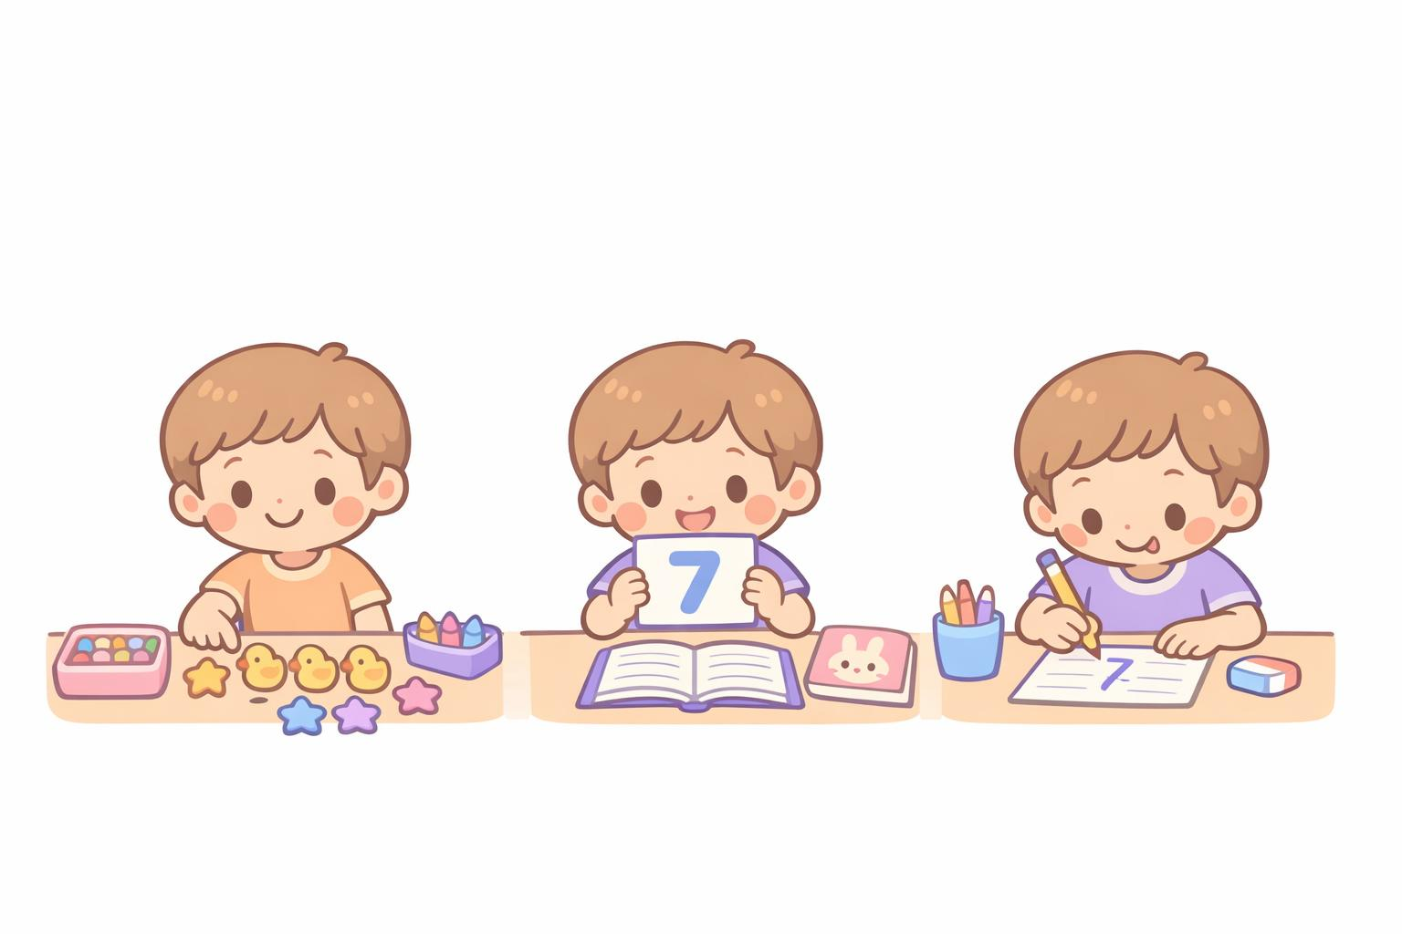

Now your turn
I can count the set.
I can read the numeral.
I can write the numeral.
I can show the number in another way.
5

Slide 8

We Do – Guided Practice
Use the carousel tasks with mixed representations.
Count the set of toys.
What numeral matches?
Read the numeral. Can you build it with cubes?
Write the missing numbers.
8, 7, _ , 5, 4, _, 2, 1
Tell your partner: How do you know your answer is correct?
Stem sentence:
“I know this is __ because __.”
1
2

Slide 9
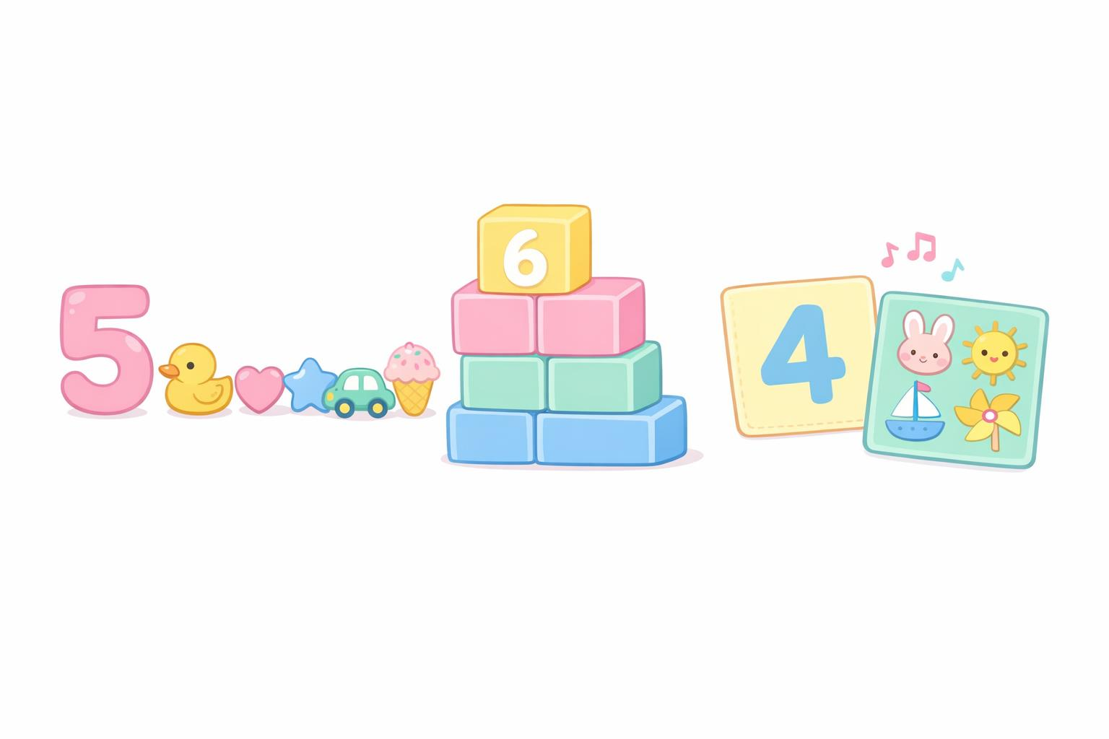
You Do – Group 1 (Support)
Group 1 – Support
1) Count 5 cubes/counters and write 5.
2) Read number 6 and build it with cubes or Lego.
3) Match number 4 to a picture ( you can build it with Lego blocks or counters) .
4) Trace and say numerals 7 and 8.
5) Count a set of 10 and circle the correct numeral.

Slide 10
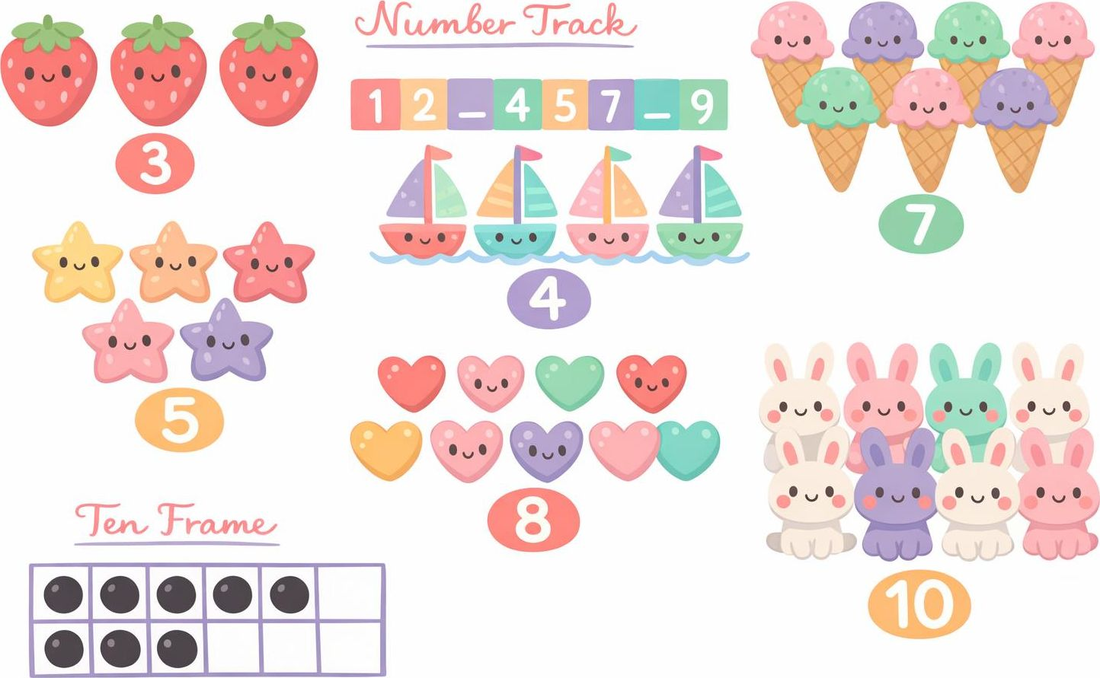
You Do – Group 2
Group 2 – Expected
Count and label these mixed sets to 10.
2) Choose the correct numeral for each picture and explain why.
3) Read numerals 0-10 in random order.
4) Write the missing numerals in a number track 10 _ 8 _ 6 _ 4_ 2_ 0
5) Represent 9 in a ten frame and as a drawing.
3
1
8
9
7
4
2
10
5
0
6

Slide 11
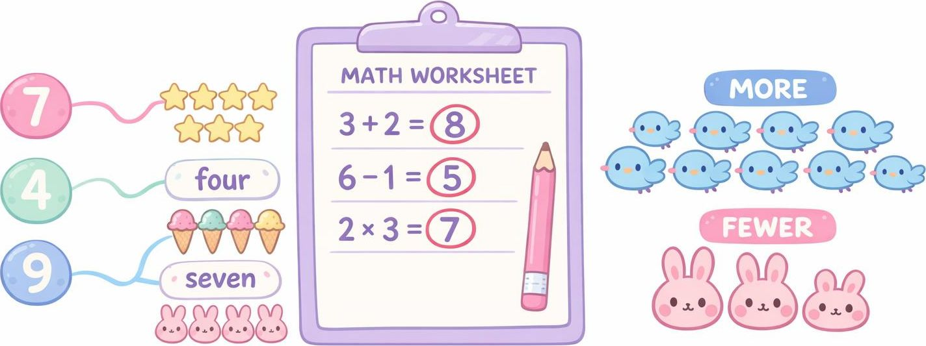

You Do – Group 3
Group 3 – Greater Depth
1) Find the mistakes
2) Correct three mistakes in the completed worksheet
3) Compare two sets on these pictures and explain which has fewer ( count the dots )
4) Write your own number clues for a partner to solve.
5) Complete: “I know this set still shows 12 because __.”

Slide 12

Plenary – Reasoning
One set of counters is spread out, and another set is close together.
Which set has more?
How do you know?
Explain your reasoning.
Well done ! The seta have the same number of counters

