Slide 1
Lesson 4
Represent Numbers to 10
Represent numbers to 10 using
objects, pictures and ten frames
40 minutes

Slide 2
Lesson Plan
40-minute lesson
⏰ Fluency Starter and Vocabulary 5 min
📋 My Turn (Teacher Models) 10 min
✏️ Do Together (Guided Practice) 10 min
★ Independent Practice 10 min
Differentiated tasks: Support, Core, and Challenge
🔍 Plenary 5 min

Slide 3
Learning Objective
LO: To represent numbers to 10 using objects, pictures, ten frames and fingers.
Success Criteria:
I can show a number in different ways.
I can use objects, pictures or ten frames to represent a number.
I can explain how I know two representations show the same amount.

Slide 4
Key Vocabulary
represent
show
amount
ten frame
part
whole
equal
same

Slide 5

Pictorial Fluency
How many stickers? Say the number quickly!
Show this number on your fingers.
Can you show it on a ten frame?
Draw a picture to match this number.
How many ways can you represent this number?
5

Slide 6
I Do – Teacher Models Representations
Counters
● ● ● ● ● ● ●
Here is the number 7. I can show it with counters.
I can show 7 on a ten frame.
I can hold up 7 fingers.
This is still 7 even though it looks different.
The number stays the same when the representation changes.
Ten Frame
● ● ● ● ●
● ● ○ ○ ○
Fingers
5 + 2 = 7

Slide 7

Now your turn
I can show the same number in different ways.
I check that each representation
has the same amount.
5

Slide 8
We Do – Guided Practice
We will build number 6 on a ten frame .
Then with triangles
Can you spot the match?
These two representations both show the same number.
How do we know? Let’s check together.
Stem sentence:
“I can show the same number in different ways. I check that each representation has the same amount.”

Slide 9
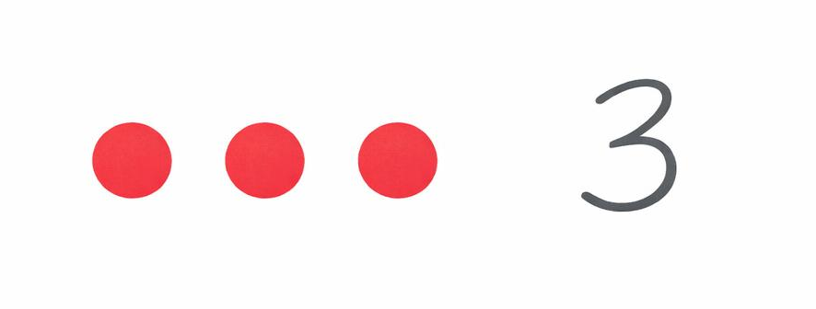
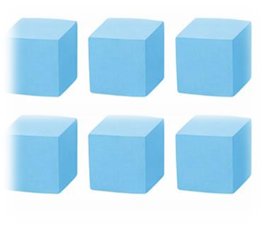
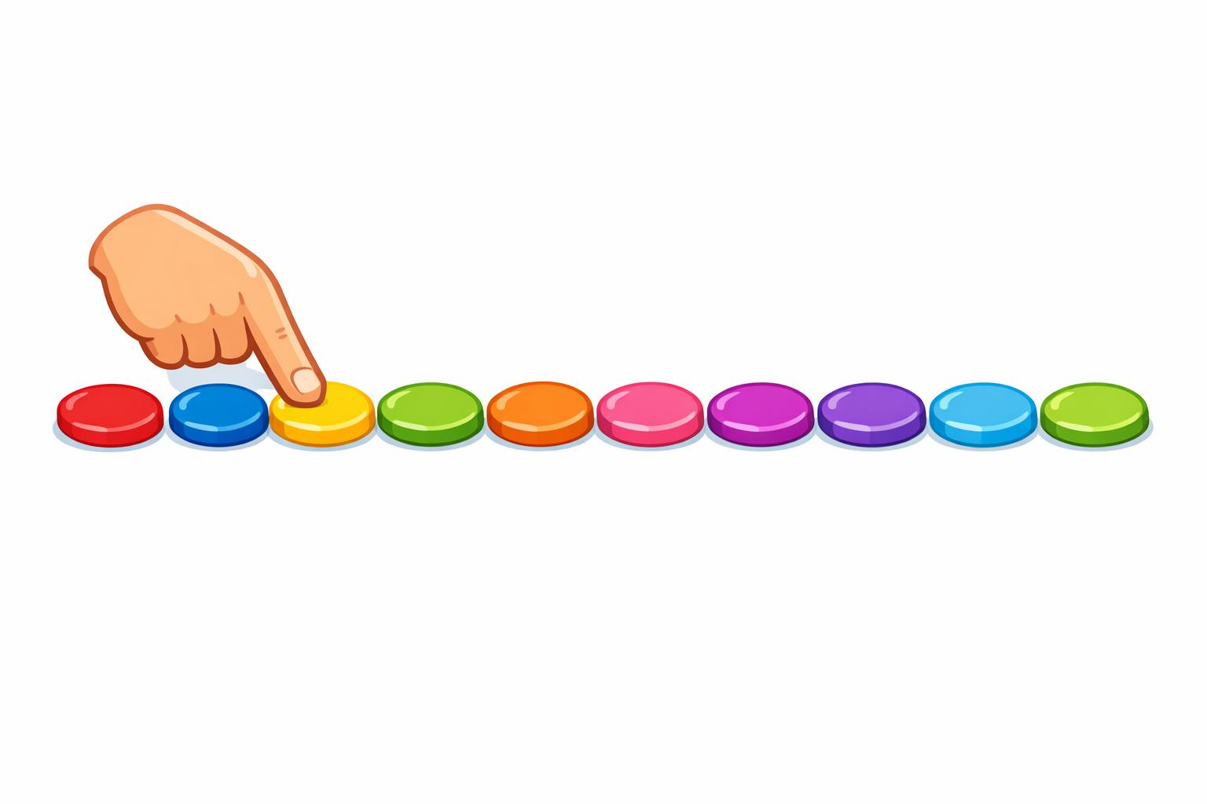
You Do – Group 1 (Support)
Group 1 – Support
1) Make 4 on a ten frame.
2) Show 5 on your fingers.
3) Draw 3 dots to match numeral 3.
4) Build 6 with cubes.
5) Match numeral 7 to the correct picture.
7

Slide 10
You Do – Group 2 (Expected)
8
Group 2 – Expected
1) Represent 8 in two different ways.
2) Complete a ten frame for 9.
3) Draw a picture to show 6.
4) Match the sets of counters and numbers
5) Explain why two pictures both represent 8.
5
8
6

Slide 11
You Do – Group 3 (Greater Depth)
Group 3 – Greater Depth
1) Find three different ways to represent 10.
2) Explain why a full ten frame always shows 10.
3) Spot the odd one out from four representations.
5) Complete: “These look different, but they are both _ because …”
4) Draw two representations of 8
10
4

Slide 12
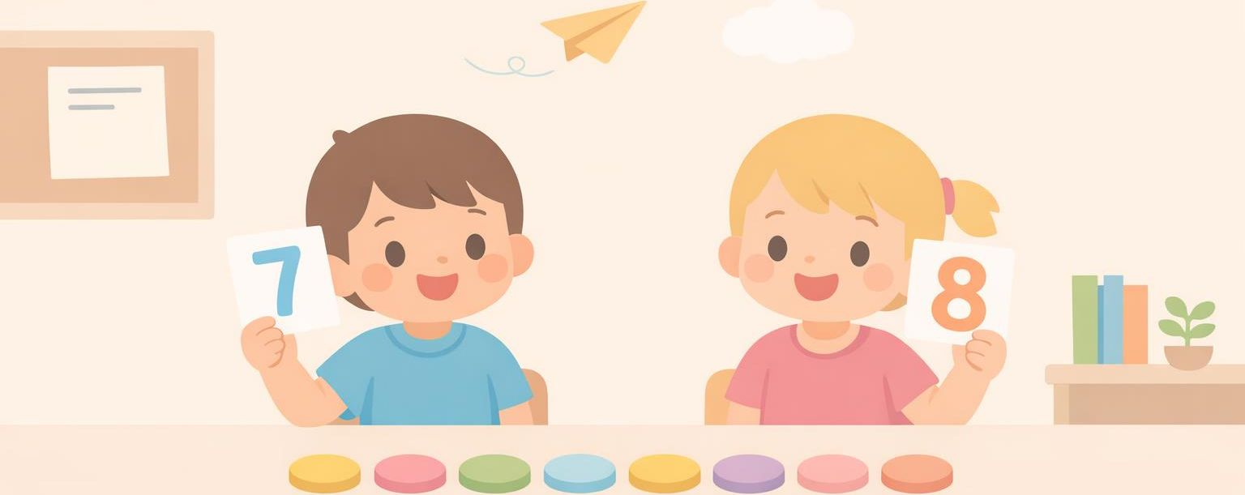
Plenary – Reasoning
Which is easier to count quickly for 9: a line of 9 counters or 9 on a ten frame?
Think of a story to go with the picture

