Slide 1
Lesson 3
Write Numerals from 0 to 10
Write numerals to 10 correctly
and match them to quantities
40 minutes

Slide 2
Lesson Plan
40-minute lesson
⏰ Fluency Starter and Vocabulary 5 min
📋 My Turn (Teacher Models) 10 min
✏️ Do Together (Guided Practice) 10 min
★ Independent Practice 10 min
Differentiated tasks: Support, Core, and Challenge
🔍 Plenary 5 min

Slide 3
Learning Objective
LO: To write numerals to 10 correctly and match them to quantities.
Success Criteria:
I can form numerals 0 to 10 correctly.
I can match a written numeral to a set.
I can check that my numeral is the right way round.

Slide 4
Key Vocabulary
write
numeral
digit
form
match
amount
zero

Slide 5



Pictorial Fluency
How many dots can you see? Say the number quickly!
Count the stars. How many?
Write the number
Count the apples. What numeral matches this set?
Show me the numeral for this group. Write it in the air!

Slide 6

I Do – Teacher Models Numeral Writing
When I write 5, I start at the top
Curve
Then make the line
I say the number name as I write the numeral so I remember what it represents.

Slide 7
Now your turn
I say the number name
I form the numeral carefully
and I check that it matches the amount.
6
7
8
9
10

Slide 8
We Do – Guided Practice
Air-write numerals together.
Trace on whiteboards, then write numerals to match shown sets.
Can you spot the mistake?
This number is written upside down!
How should we fix it? Let’s correct it together.
Stem sentence:
“I say the number name, I form the numeral carefully, and I check it matches the amount.”
7

Slide 9
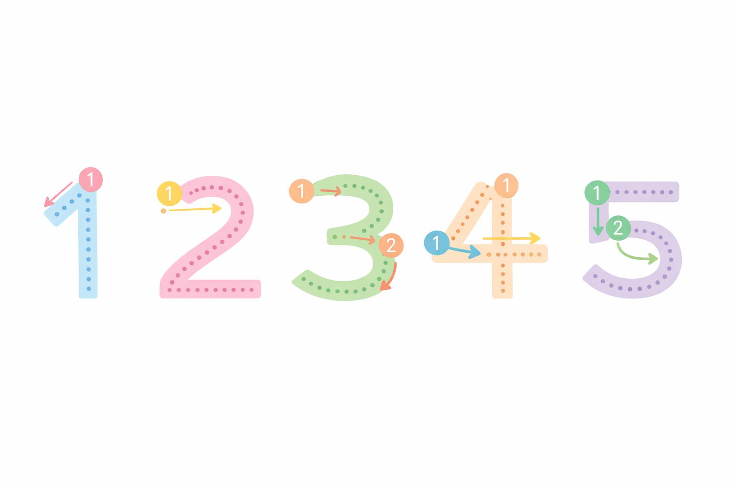
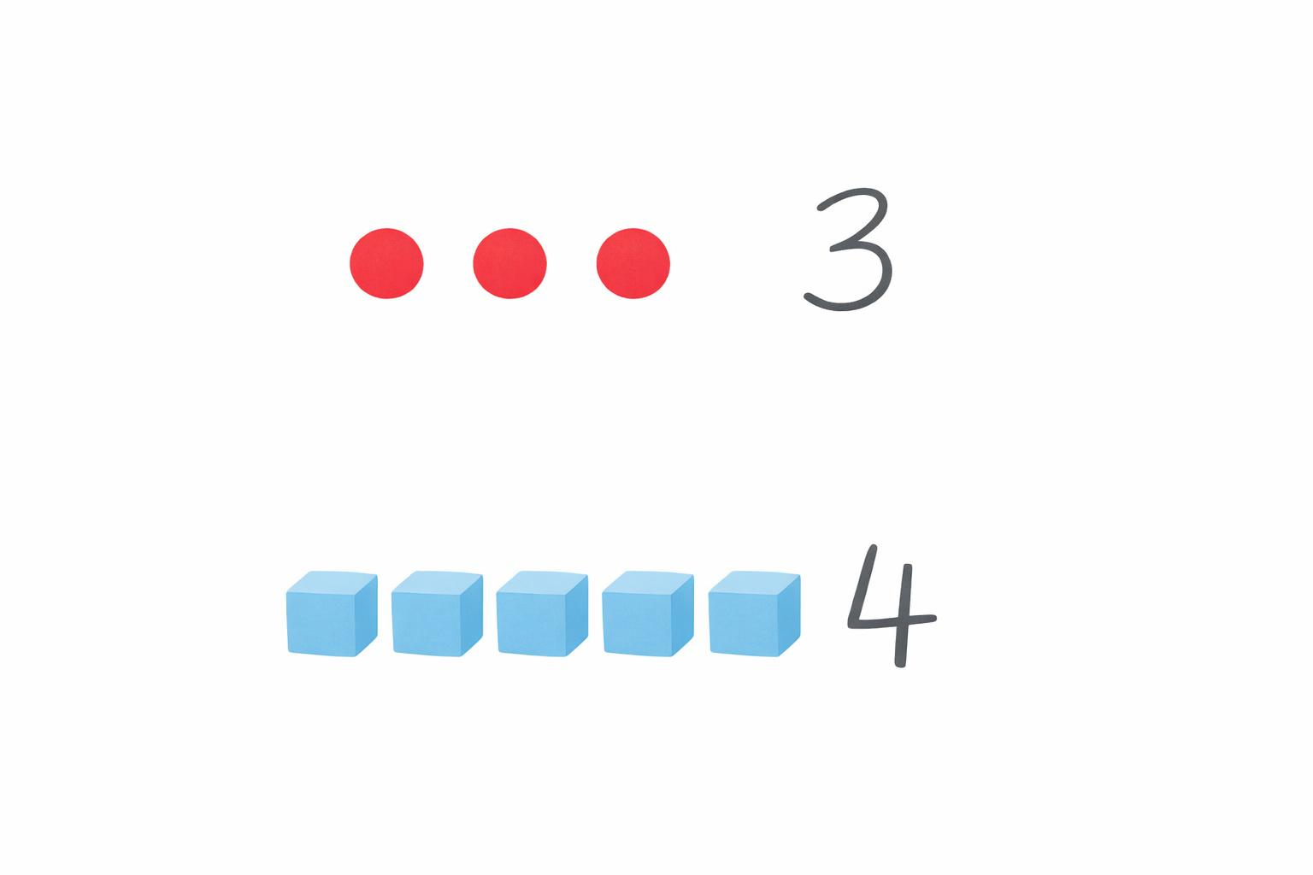
You Do – Group 1 (Support)
Group 1 – Support
1) Trace numbers 1–5.
2) Write numeral 3 to match three dots.
3) Write numeral 4 to match four cubes.
4) Copy numerals 6 and 7 from a model.
5) Match written numerals 0–5 to sets of cubes

Slide 10
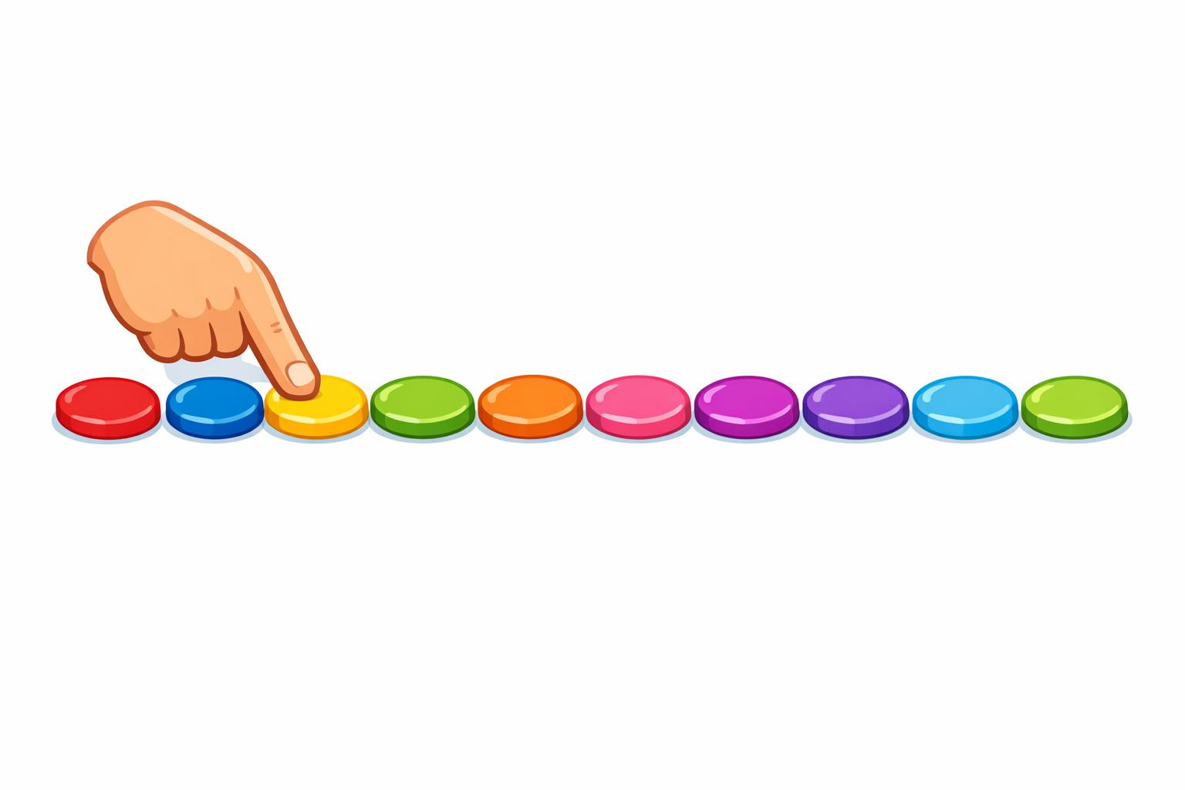
You Do – Group 2
0
1
2
3
4
5
Group 2 – Core
6
7
8
9
10
1) Write numbers 0–10 in order.
2) Look at a set of counters and write the numeral.
3) Look at the ten frame and write the numeral.
4) Fill in the missing numeral in 2, 3, __, 5.
5) Write the numeral that matches the objects in the picture

Slide 11
You Do – Group 3 (Greater Depth)
Group 3 – Greater Depth
1) Write numerals to match these shapes
2) Explain how to write 8 clearly so it is not confused with 3.
3) Write a numeral for a hidden set after hearing the count (eleven) .
4) Create and label your own sets from 0 to 10.

Slide 12
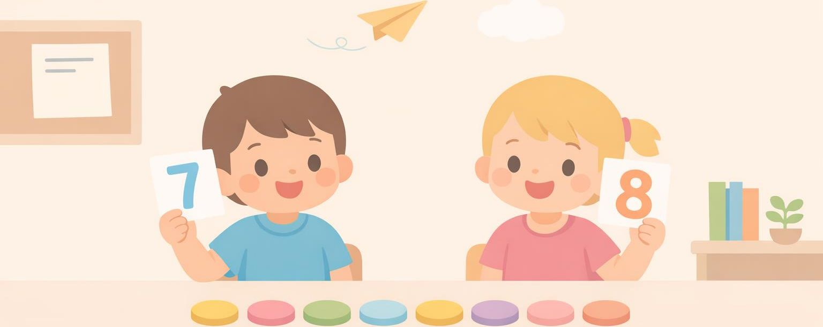
Plenary – Reasoning
Two children wrote different numerals for the same set of 7 counters.
What could have gone wrong, and how could they check?

