Slide 1
Lesson 2
Read Numerals from 0 to 10
To recognise and read numerals to 10 confidently
40 minutes

Slide 2
Lesson Plan
40-minute lesson
⏰ Fluency Starter and Vocabulary 5 min
📋 My Turn 10 min
✏️ Do Together 10 min
★ Independent Practice 10 min
Differentiated tasks: Support, Core, and Challenge
🔍 Plenary 5 min

Slide 3
Learning Objective
LO: To recognise and read numerals to 10 confidently.
Success Criteria:
I can recognise numerals from 0 to 10.
I can say the number name for each numeral.
I can match a numeral to the correct amount.

Slide 4
Key Vocabulary
numeral
number
zero
read
identify
match
same
different

Slide 5
Pictorial Fluency
Look at the numbers.
Can you read each one?
Point to number 3.
Now point to number 5.
How many fingers do you hold up for number 5?
Show me the number that comes after 8.
0
1
2
3
4
5
6
7
8
9
10

Slide 6
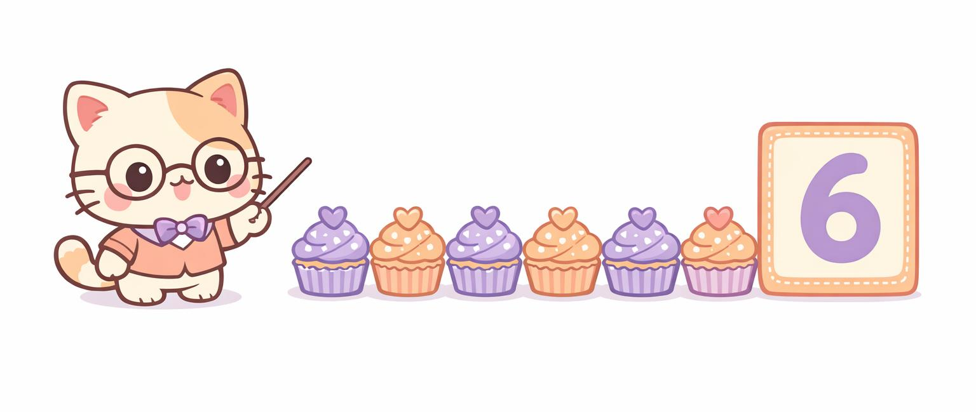
I Do – Teacher Models Reading Numerals
A number is the symbol we write for a number.
This symbol is 6. I say six.
I can match the number 6 to a set with six objects.

Slide 7
We Do – Guided Practice
I will flash a numeral card. Read it aloud!
Now match the numeral to a ten frame ( point to it)
Partner talk:
Stem sentence:
“This is __. I know because …”
5
4
8
7

Slide 8
You Do – Group 1 (Support)
Group 1 – Support
3
6
10
2
1) Using your cubes, count this many cubes
2) Read number cards 4, 5, 6 with adult support.
3) Circle number seven:
5 3 2 7 9
4) Match number 8 to the correct ten frame.
5) Order number cards 0–5.
9
8

Slide 9
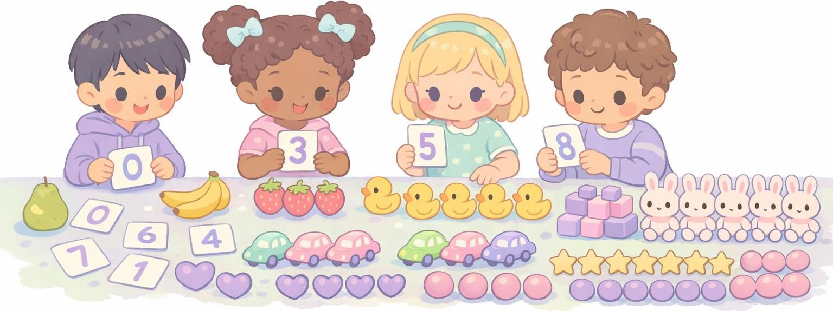
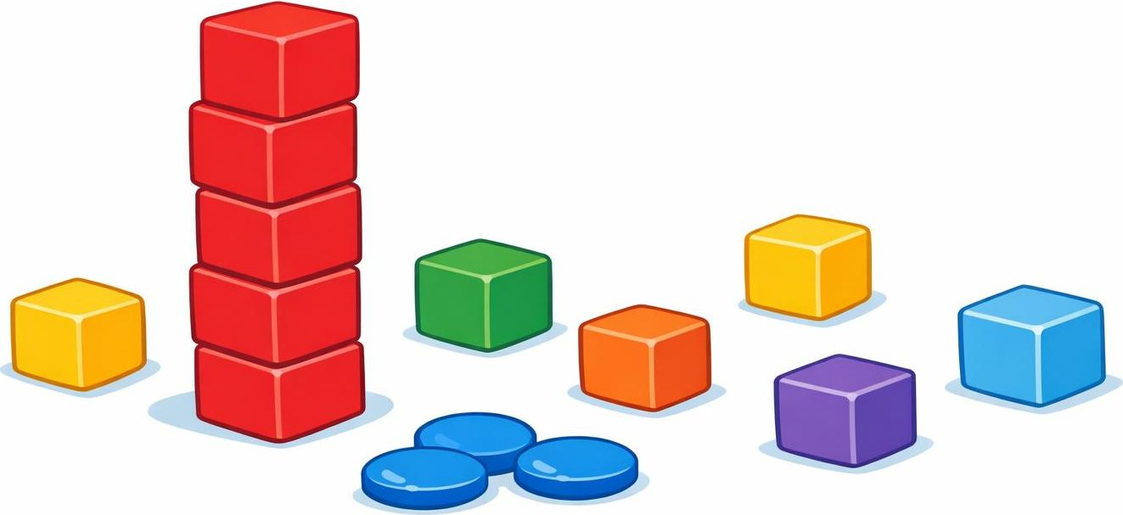
You Do – Group 2- Core
Group 2
1) Read and match numbers 0–10 to the correct amount with cubes
2) Find the missing number in 3, 4, __, 6.
3) Sort number cards 0- 10 into correct order.
4) Choose the number that shows one less than 9.
8
9
6
10
3
0
2
5
1
7
4

Slide 10
You Do – Group 3 (Greater Depth)
Group 3 – Greater Depth
6
9
1) Explain how you know which number is which
2) Are these matches correct? Explain
3) Find all numerals greater than 5 and order them from the greatest to the smallest
4) Make a riddle: “I am a numeral greater than 6 but less than 8.”
5) Order 0–10 and explain what comes before and after 5.
3
4

Slide 11
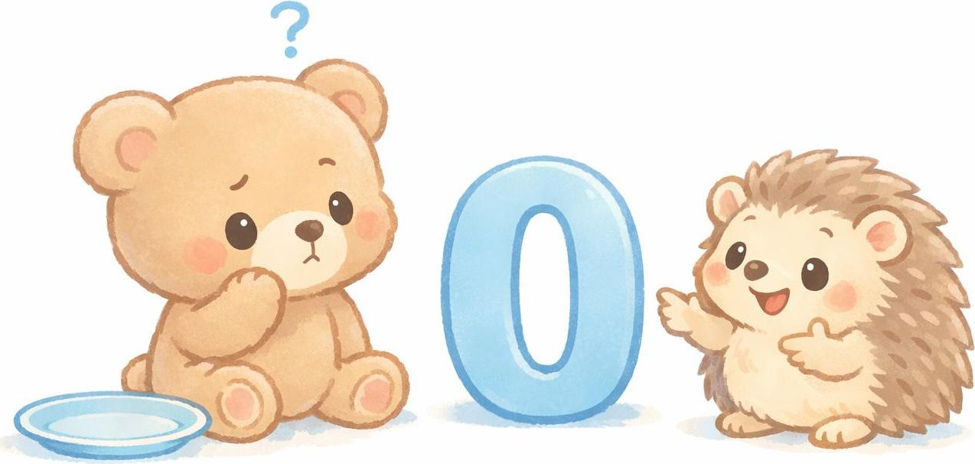
Plenary – Reasoning
A pupil says the numeral 0 means there is nothing to count, so it is not a number.
Do you agree?
Why or why not?

