Slide 1
Lesson 1
Count Objects to 10
Count sets of objects accurately to 10
by touching or moving each object once
40 minutes

Slide 2
Lesson Plan
40-minute lesson
⏰ Fluency Starter and Vocabulary 5 min
📋 My Turn 10 min
✏️ Do Together 10 min
★ Independent Practice 10 min
Differentiated tasks: Support, Core, and Challenge
🔍 Plenary 5 min

Slide 3
Learning Objective
LO: To count sets of objects accurately to 10 by touching or moving each object once.
Success Criteria:
I can count objects carefully by touching each object once.
I can say the total using the last number counted.
I can spot when a set has been counted incorrectly.

Slide 4
Key Vocabulary
count
number
numeral
how many
total
altogether
more
less
same

Slide 5

Pictorial Fluency
Look at the picture. How many objects can you see?
Count the dots. Touch each one as you count.
How many cubes are in the line?
Can you count the scattered stars? Remember: touch each one once!

Slide 6
I Do – Teacher Models Counting
I am counting carefully so I do not miss any objects and I do not count any object twice. Count with me.
I say one number name for each object.
When I stop, the last number I say tells me how many there are altogether.
Ten!

Slide 7
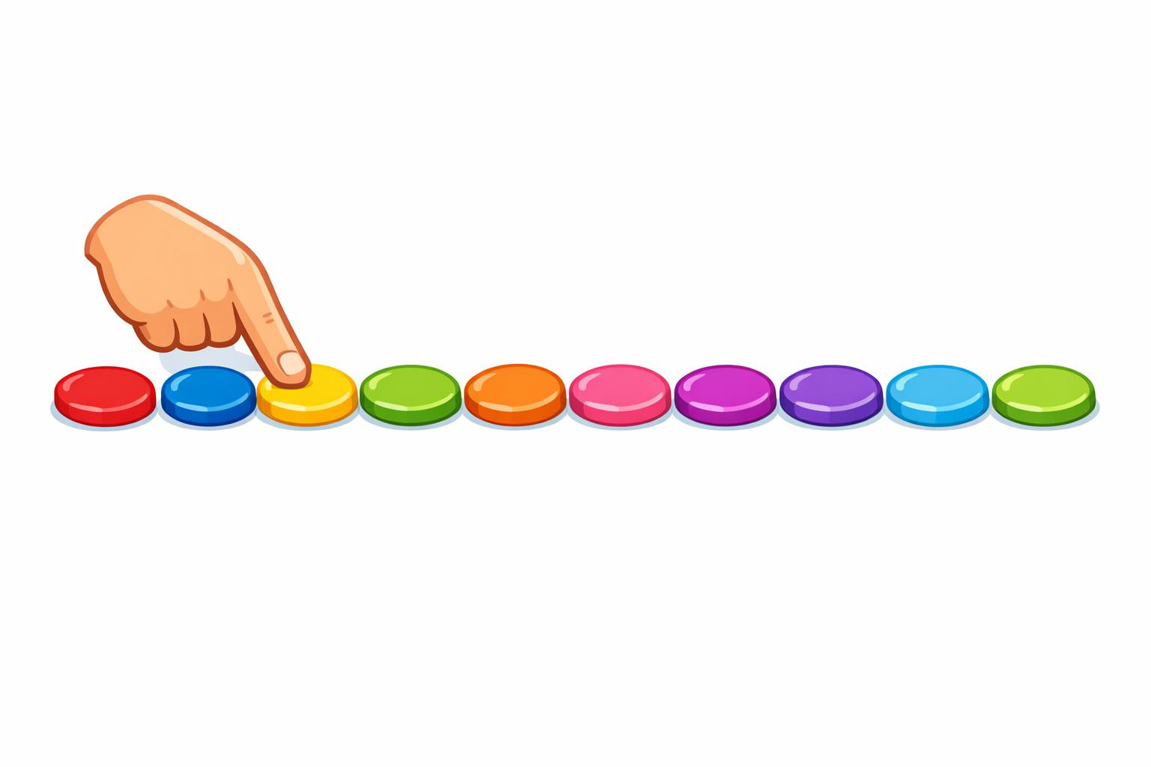
Now your turn
Count one object at a time.
Say one number name for each object.
The last number you say tells you the total.
“There are __ objects altogether because the last number I said was __.”

Slide 8
We Do – Guided Practice
Count these sets together using cubes, counters and pictures.
Can you spot the mistake?
I counted this set and got 7.
But look – I counted this counter twice!
How many are there really?
Stem sentence:
“There are __ objects altogether because the last number I said was __.”

Slide 9
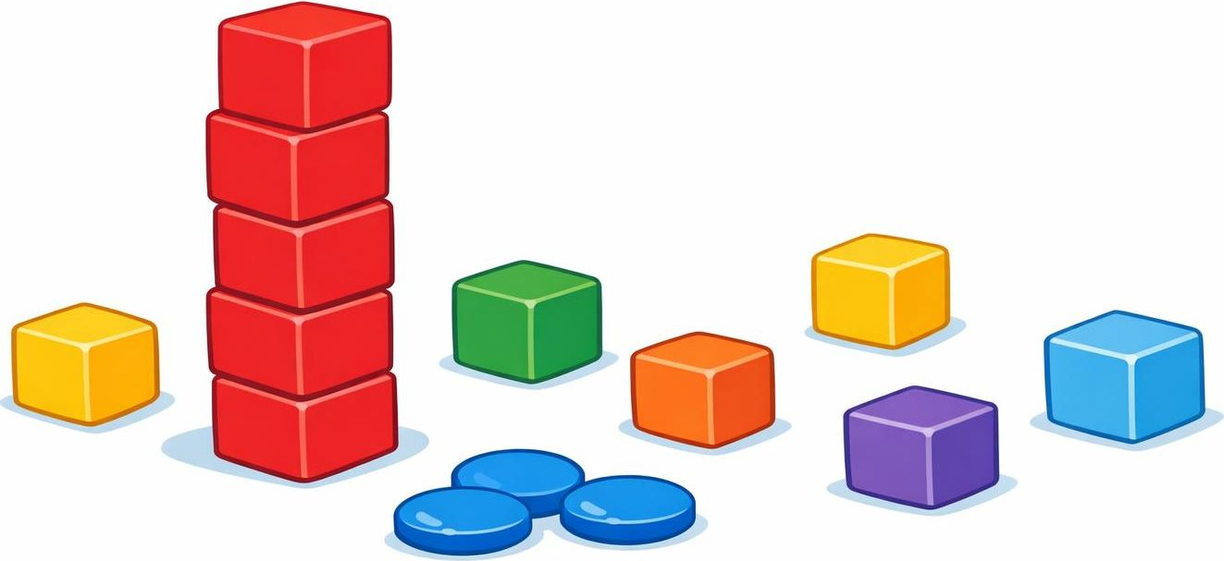
You Do – Group 1 (Support)
Group 1 – Support
1) Count these cubes and say the total.
2) Count the counters and circle the correct numeral.
3) Count the dice arranged in a line.
4) Count the dots on the dice
5) Match each set to its number
3 4 11 20

Slide 10
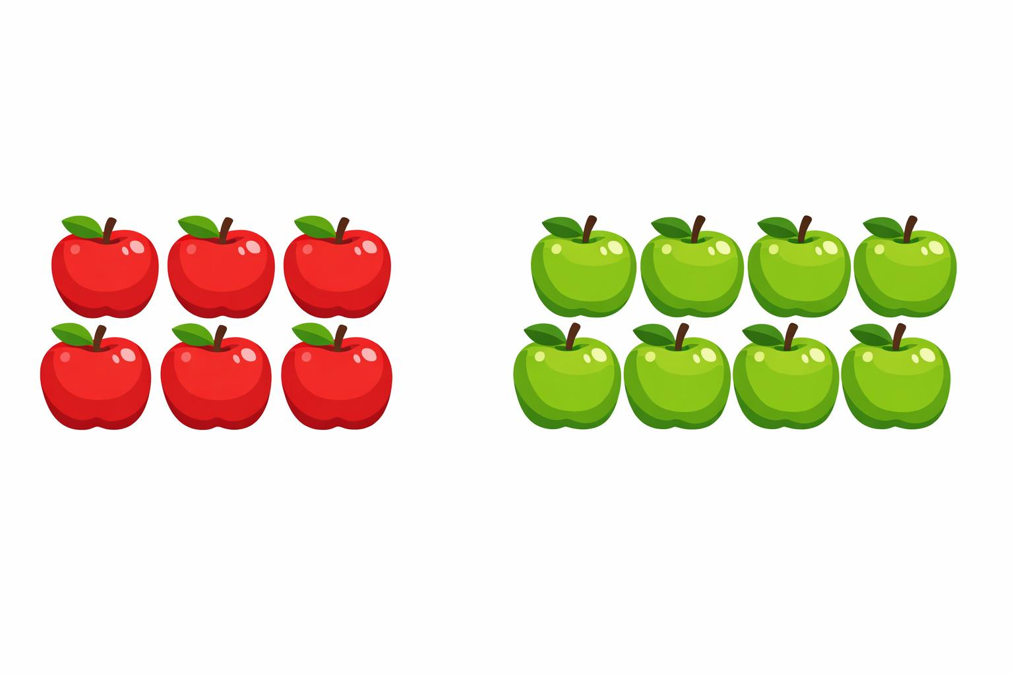
You Do – Group 2 (Expected)
Group 2 – Core
1) Count the red apples. How many?
2) How many green apples?
3) How many apples altogether?
4) Which are more ? The red apples or the green apples?
5) Draw your own set to show 10.

Slide 11


You Do – Group 3 (Greater Depth)
Group 3 – Greater Depth
1) Is it true that the two sets of toys are the same ?
2) Explain
3) I have mixed up all my toys. How many are there now?
4) My friend said there are 9. Is that true?
5) Complete: “I know this set shows 12 because ...”

Slide 12
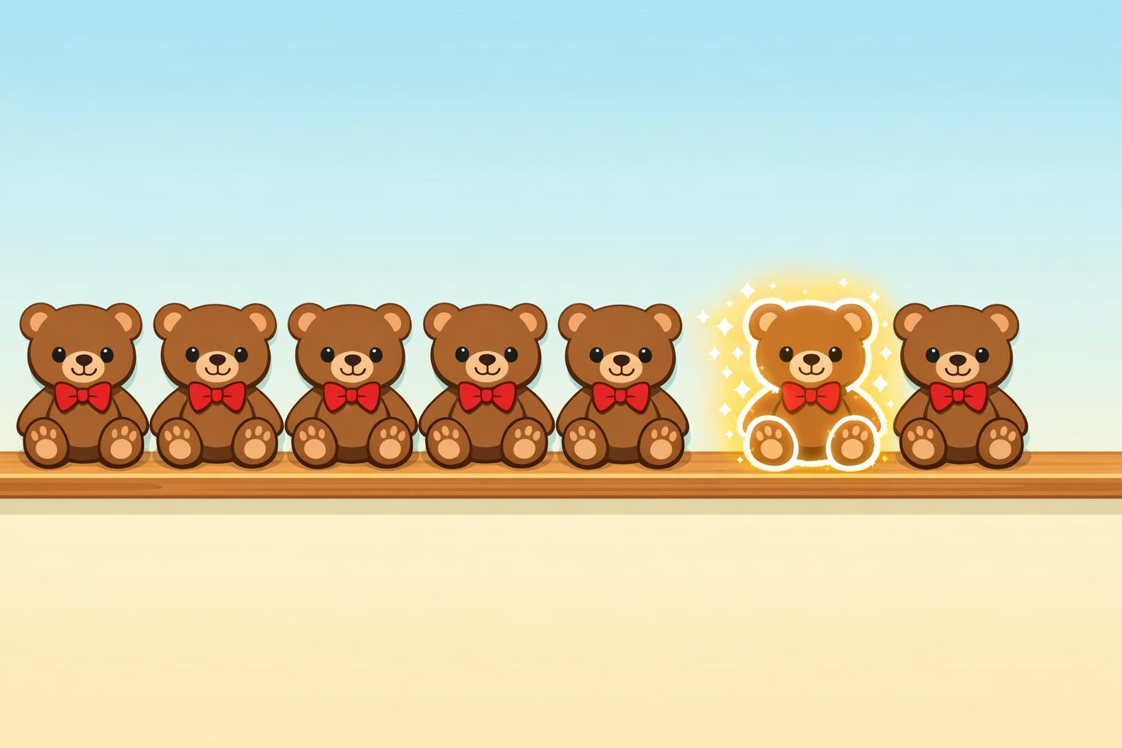
Plenary – Reasoning
Sam counted 8 bears but touched one bear two times.
Do you think there are 8 bears?
Explain your reasoning.

